Slide 1
COMMON THREAD

Slide 2
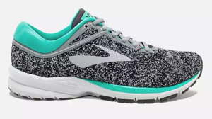
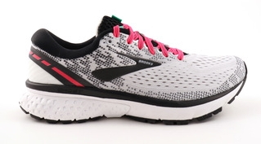
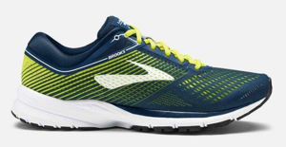
Question 1:
WHAT COMPANY MAKES THESE RUNNING SHOES?

Slide 3
Question 2:
WHAT IS THE THREE LETTER ABBREVIATION FOR THE MONTH THAT CONTAINS NATIONAL HANGOVER DAY?

Slide 4
Question 3:
WHAT IS THE FIRST NAME OF THE FIRST PRESIDENT OF THE REPUBLIC OF TEXAS?

Slide 5
Question 4:
WHAT ARE THE U.S. NAVY'S PRIMARY SPECIAL OPERATIONS FORCES USUALLY CALLED?

Slide 6
Question 5:
WHAT WAS THE ACRONYM FOR THE ARMS CONTROL TALKS BETWEEN THE USA AND USSR IN THE EARLY 70'S?

Slide 7
Question 6:
WHAT IS THE LAST NAME OF THE ACTOR WHO PLAYED THE TITLE ROLE ON "DEXTER"?

Slide 8
Question 7:
WHAT DELAND BBQ RESTAURANT IS LOCATED AT THE CORNER OF INTERNATIONAL SPEEDWAY AND WOODLAND BLVD.?

Slide 9
Question 8:
WHAT PROPERTY GROUP OWNS THE MOST MALLS IN AMERICA?

Slide 10
Question 9:
WHAT POLICE RANK IS RIGHT ABOVE LIEUTENANT?

Slide 11
Question 10:
WHAT DO ALL THESE ANSWERS HAVE IN COMMON?

Slide 12
ANSWERS WILL BE PROVIDED SHORTLY

Slide 13
Question 1:
WHAT COMPANY MAKES THESE RUNNING SHOES?
BROOKS

Slide 14
Question 2:
WHAT IS THE THREE LETTER ABBREVIATION FOR THE MONTH THAT CONTAINS NATIONAL HANGOVER DAY?
JAN

Slide 15
Question 3:
WHAT IS THE FIRST NAME OF THE FIRST PRESIDENT OF THE REPUBLIC OF TEXAS?
SAM (HOUTON)

Slide 16
Question 4:
WHAT ARE THE U.S. NAVY'S PRIMARY SPECIAL OPERATIONS FORCES USUALLY CALLED?
SEALS

Slide 17
Question 5:
WHAT WAS THE ACRONYM FOR THE ARMS CONTROL TALKS BETWEEN THE USA AND USSR IN THE EARLY 70'S?
SALT

Slide 18
Question 6:
WHAT IS THE LAST NAME OF THE ACTOR WHO PLAYED THE TITLE ROLE ON "DEXTER"?
(MICHAEL C.) HALL

Slide 19
Question 7:
WHAT DELAND BBQ RESTAURANT IS LOCATED AT THE CORNER OF INTERNATIONAL SPEEDWAY AND WOODLAND BLVD.?
SONNY'S

Slide 20
Question 8:
WHAT PROPERTY GROUP OWNS THE MOST MALLS IN AMERICA?
SIMON

Slide 21
Question 9:
WHAT POLICE RANK IS RIGHT ABOVE LIEUTENANT?
CAPTAIN

Slide 22
Question 10:
WHAT DO ALL THESE ANSWERS HAVE IN COMMON?
FIRST HALF OF MUSICAL DUOS

