Slide 1
COMMON THREAD

Slide 2
Question 1:
FOR THE SUN'S LIGHT TO GET TO URANUS, IT TAKES 4 WHAT? MINUTES, HOURS, OR DAYS?

Slide 3
Question 2:
WHICH IS BIGGEST? THE PRODUCT, QUOTIENT, SUM, OR DIFFERENCE OF THE TWO NUMBERS 1.5 AND 2.5?

Slide 4
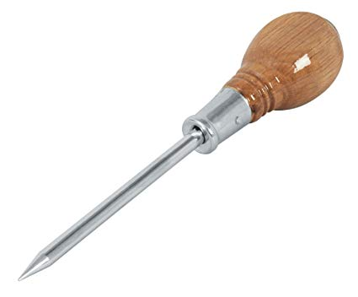
Question 3:
WHAT TOOL IS THIS?

Slide 5
Question 4:
FINISH THIS ALEXANDER POPE RHYME: "SATAN NOW IS WISER THAN OF ____, AND TEMPTS BY MAKING RICH, NOT MAKING POOR"?

Slide 6
Question 5:
WHAT IS THE 3-LETTER NAME OF YOPLAIT'S "FRENCH STYLE YOGURT" BRAND?

Slide 7
Question 6:
WHAT 4-LETTER WORD COMES FROM THE GREEK MEANING "SONG OF PRAISE"?

Slide 8
Question 7:
WHAT IS THE TERM FOR A FEMALE SHEEP?

Slide 9
Question 8:
WHAT IS THE METRIC UNIT OF POWER, EQUAL TO ONE JOULE PER SECOND?

Slide 10
Question 9:
IN "THE LORD OF THE RINGS" BOOKS, WHAT IMAGE IS MOST ASSOCIATED WITH SAURON?

Slide 11
Question 10:
WHAT DO ALL THESE ANSWERS HAVE IN COMMON?

Slide 12
ANSWERS WILL BE PROVIDED SHORTLY

Slide 13
Question 1:
FOR THE SUN'S LIGHT TO GET TO URANUS, IT TAKES 4 WHAT? MINUTES, HOURS, OR DAYS?
HOURS

Slide 14
Question 2:
WHICH IS BIGGEST? THE PRODUCT, QUOTIENT, SUM, OR DIFFERENCE OF THE TWO NUMBERS 1.5 AND 2.5?
SUM

Slide 15
Question 3:
WHAT TOOL IS THIS?
AWL

Slide 16
Question 4:
FINISH THIS ALEXANDER POPE RHYME: "SATAN NOW IS WISER THAN OF ____, AND TEMPTS BY MAKING RICH, NOT MAKING POOR"?
YORE

Slide 17
Question 5:
WHAT IS THE 3-LETTER NAME OF YOPLAIT'S "FRENCH STYLE YOGURT" BRAND?
OUI

Slide 18
Question 6:
WHAT 4-LETTER WORD COMES FROM THE GREEK MEANING "SONG OF PRAISE"?
HYMN

Slide 19
Question 7:
WHAT IS THE TERM FOR A FEMALE SHEEP?
EWE

Slide 20
Question 8:
WHAT IS THE METRIC UNIT OF POWER, EQUAL TO ONE JOULE PER SECOND?
WATT

Slide 21
Question 9:
IN "THE LORD OF THE RINGS" BOOKS, WHAT IMAGE IS MOST ASSOCIATED WITH SAURON?
EYE

Slide 22
Question 10:
WHAT DO ALL THESE ANSWERS HAVE IN COMMON?
HOMONYMS OF PRONOUNS

