Slide 1
COMMON THREAD

Slide 2
Question 1:
WHAT IS THE STAGE NAME OF THE LEAD GUITARIST FOR U2?

Slide 3
Question 2:
WHAT 2005 FILM WAS A CONTINUATION OF THE TV SERIES "FIREFLY"?

Slide 4
Question 3:
THE OFFICIAL MAGAZINE OF THE NAACP, FOUNDED IN 1910 BY W. E. B. DU BOIS, IS CALLED THE WHAT?

Slide 5
Question 4:
THE BACKUP BAND FOR KATRINA, WHO SANG "WALKING ON SUNSHINE", IS CALLED THE WHAT?

Slide 6
Question 5:
WHAT WAS THE NAME OF JONI MITCHELL'S 2ND ALBUM, CONTAINING THE SONGS "CHELSEA MORNING" AND "BOTH SIDES NOW"?

Slide 7
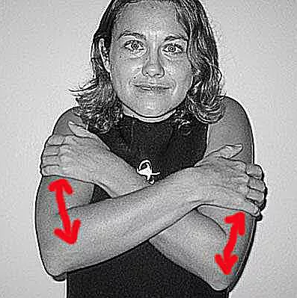
Question 6:
WHAT DOES THIS SCUBA DIVING SIGNAL MEAN?

Slide 8
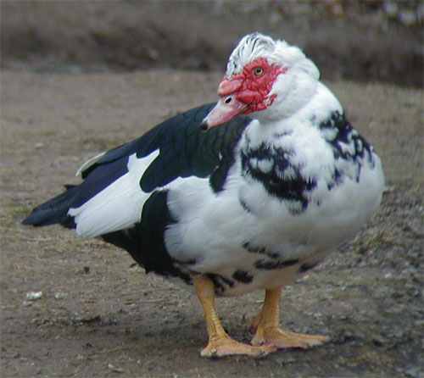
Question 7:
WHAT KIND OF DUCK IS THIS?

Slide 9
Question 8:
WHAT WORD IN THE FIRST SENTENCE OF THE U.S. CONSTITUTION CONTAINS THE LETTER "Q"?

Slide 10
Question 9:
WHAT IS THE FABLED DRINK OF THE GREEK GODS, WHOSE NAME MEANS "OVERCOMING DEATH"?

Slide 11
Question 10:
WHAT DO ALL THESE ANSWERS HAVE IN COMMON?

Slide 12
ANSWERS WILL BE PROVIDED SHORTLY

Slide 13
Question 1:
WHAT IS THE STAGE NAME OF THE LEAD GUITARIST FOR U2?
THE EDGE

Slide 14
Question 2:
WHAT 2005 FILM WAS A CONTINUATION OF THE TV SERIES "FIREFLY"?
SERENITY

Slide 15
Question 3:
THE OFFICIAL MAGAZINE OF THE NAACP, FOUNDED IN 1910 BY W. E. B. DU BOIS, IS CALLED THE WHAT?
CRISIS

Slide 16
Question 4:
THE BACKUP BAND FOR KATRINA, WHO SANG "WALKING ON SUNSHINE", IS CALLED THE WHAT?
WAVES

Slide 17
Question 5:
WHAT WAS THE NAME OF JONI MITCHELL'S 2ND ALBUM, CONTAINING THE SONGS "CHELSEA MORNING" AND "BOTH SIDES NOW"?
CLOUDS

Slide 18
Question 6:
WHAT DOES THIS SCUBA DIVING SIGNAL MEAN?
COLD

Slide 19
Question 7:
WHAT KIND OF DUCK IS THIS?
MUSCOVY

Slide 20
Question 8:
WHAT WORD IN THE FIRST SENTENCE OF THE U.S. CONSTITUTION CONTAINS THE LETTER "Q"?
TRANQUILITY

Slide 21
Question 9:
WHAT IS THE FABLED DRINK OF THE GREEK GODS, WHOSE NAME MEANS "OVERCOMING DEATH"?
NECTAR

Slide 22
Question 10:
WHAT DO ALL THESE ANSWERS HAVE IN COMMON?
NAMES OF SEAS ON THE MOON

