Slide 1
1500-1550

Slide 2
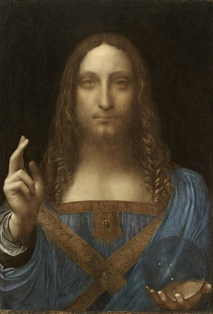
Question 1:
THE MOST EXPENSIVE PAINTING EVER SOLD AT AUCTION WAS PAINTED AROUND 1500 BY WHAT ARTIST?

Slide 3
Question 2:
IN 1513, WHAT SPANISH EXPLORER BECAME THE FIRST EUROPEAN TO REACH THE PACIFIC OCEAN FROM THE EAST?

Slide 4
Question 3:
IN 1513, WHAT ITALIAN PHILOSOPHER WROTE "THE PRINCE"?

Slide 5
Question 4:
WHOSE "NINETY-FIVE THESES", QUESTIONING THE PRACTICE OF SELLING INDULGENCES, BEGAN THE PROTESTANT REFORMATION IN 1517?

Slide 6
Question 5:
WHAT "MAGNIFICENT" SULTAN OF TURKEY CONQUERED HUNGARY AND MOST OF THE MIDDLE EAST AND NORTH AFRICA?

Slide 7
Question 6:
WHAT SPANIARD CONQUERED PERU IN 1533, AND KILLED THE INCAN EMPEROR EVEN AFTER HE PAID A HUGE RANSOM?

Slide 8
Question 7:
WHAT KING OF ENGLAND MARRIED 1 JANE, 2 ANNES AND 3 CATHERINES?

Slide 9
Question 8:
WHAT POLISH MATHEMATICIAN FORMULATED A MODEL OF THE SOLAR SYSTEM PLACING THE SUN AT ITS CENTER?

Slide 10
Question 9:
WHO WAS THE RUTHLESS FIRST TSAR OF RUSSIA?

Slide 11
Question 10:
WHAT SPANIARD CONQUERED MEXICO AND DEFEATED THE AZTEC EMPIRE?

Slide 12
ANSWERS WILL BE PROVIDED SHORTLY

Slide 13
Question 1:
THE MOST EXPENSIVE PAINTING EVER SOLD AT AUCTION WAS PAINTED AROUND 1500 BY WHAT ARTIST?
LEONARDO DA VINCI

Slide 14
Question 2:
IN 1513, WHAT SPANISH EXPLORER BECAME THE FIRST EUROPEAN TO REACH THE PACIFIC OCEAN FROM THE EAST?
VASCO NÚÑEZ DE BALBOA

Slide 15
Question 3:
IN 1513, WHAT ITALIAN PHILOSOPHER WROTE "THE PRINCE"?
NICCOLÒ MACHIAVELLI

Slide 16
Question 4:
WHOSE "NINETY-FIVE THESES", QUESTIONING THE PRACTICE OF SELLING INDULGENCES, BEGAN THE PROTESTANT REFORMATION IN 1517?
MARTIN LUTHER

Slide 17
Question 5:
WHAT "MAGNIFICENT" SULTAN OF TURKEY CONQUERED HUNGARY AND MOST OF THE MIDDLE EAST AND NORTH AFRICA?
SULEIMAN I

Slide 18
Question 6:
WHAT SPANIARD CONQUERED PERU IN 1533, AND KILLED THE INCAN EMPEROR EVEN AFTER HE PAID A HUGE RANSOM?
FRANCISCO PIZARRO

Slide 19
Question 7:
WHAT KING OF ENGLAND MARRIED 1 JANE, 2 ANNES AND 3 CATHERINES?
HENRY VIII

Slide 20
Question 8:
WHAT POLISH MATHEMATICIAN FORMULATED A MODEL OF THE SOLAR SYSTEM PLACING THE SUN AT ITS CENTER?
NICOLAUS COPERNICUS

Slide 21
Question 9:
WHO WAS THE RUTHLESS FIRST TSAR OF RUSSIA?
IVAN THE TERRIBLE

Slide 22
Question 10:
WHAT SPANIARD CONQUERED MEXICO AND DEFEATED THE AZTEC EMPIRE?
HERNÁN CORTÉS

