Slide 1
1550-1600

Slide 2
Question 1:
WHO WAS KNOWN AS "THE VIRGIN QUEEN"?

Slide 3
Question 2:
POPE GREGORY XIII IS BEST KNOWN FOR IMPLEMENTING WHAT, IN 1582?

Slide 4
Question 3:
THE EIGHTY YEARS' WAR IS ALSO KNOWN AS THE WAR OF INDEPENDENCE OF WHAT EUROPEAN NATION?

Slide 5
Question 4:
WHAT DANISH ASTRONOMER, WHO HAD AN ARTIFICIAL BRASS NOSE AFTER LOSING HIS IN A DUEL, WAS THE FIRST TO DOCUMENT A SUPERNOVA?

Slide 6
Question 5:
WHAT ENGLISH EXPLORER WAS THE FIRST TO CAPTAIN A MISSION TO CIRCUMNAVIGATE THE WORLD?

Slide 7
Question 6:
WHAT ITALIAN ASTRONOMER BUILT THE 1ST THERMOMETER, CALLED A THERMOSCOPE?

Slide 8
Question 7:
WHO WAS THE FOREMOST DRAMATIST IN LONDON BEFORE WILLIAM SHAKESPEARE?

Slide 9
Question 8:
DURING THE ST. BARTHOLOMEW'S DAY MASSACRE OF 1572, WHAT GROUP OF FRENCH PROTESTANTS WERE THE VICTIM OF MOB VIOLENCE?

Slide 10
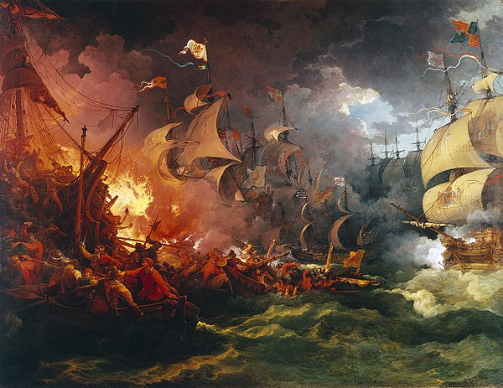
Question 9:
THIS PAINTING IS "DEFEAT OF THE ____ ____, 1588-08-08"?

Slide 11
Question 10:
1565, WHAT CITY IN FLORIDA BECAME THE FIRST PERMANENT SETTLEMENT OF EUROPEANS IN THE U.S.?

Slide 12
ANSWERS WILL BE PROVIDED SHORTLY

Slide 13
Question 1:
WHO WAS KNOWN AS "THE VIRGIN QUEEN"?
QUEEN ELIZABETH I OF ENGLAND

Slide 14
Question 2:
POPE GREGORY XIII IS BEST KNOWN FOR IMPLEMENTING WHAT, IN 1582?
GREGORIAN CALENDAR

Slide 15
Question 3:
THE EIGHTY YEARS' WAR IS ALSO KNOWN AS THE WAR OF INDEPENDENCE OF WHAT EUROPEAN NATION?
THE NETHERLANDS

Slide 16
Question 4:
WHAT DANISH ASTRONOMER, WHO HAD AN ARTIFICIAL BRASS NOSE AFTER LOSING HIS IN A DUEL, WAS THE FIRST TO DOCUMENT A SUPERNOVA?
TYCHO BRAHE

Slide 17
Question 5:
WHAT ENGLISH EXPLORER WAS THE FIRST TO CAPTAIN A MISSION TO CIRCUMNAVIGATE THE WORLD?
FRANCIS DRAKE

Slide 18
Question 6:
WHAT ITALIAN ASTRONOMER BUILT THE 1ST THERMOMETER, CALLED A THERMOSCOPE?
GALILEO GALILEI

Slide 19
Question 7:
WHO WAS THE FOREMOST DRAMATIST IN LONDON BEFORE WILLIAM SHAKESPEARE?
CHRISTOPHER MARLOWE

Slide 20
Question 8:
DURING THE ST. BARTHOLOMEW'S DAY MASSACRE OF 1572, WHAT GROUP OF FRENCH PROTESTANTS WERE THE VICTIM OF MOB VIOLENCE?
HUGUENOTS

Slide 21
Question 9:
THIS PAINTING IS "DEFEAT OF THE ____ ____, 1588-08-08"?
SPANISH ARMADA

Slide 22
Question 10:
1565, WHAT CITY IN FLORIDA BECAME THE FIRST PERMANENT SETTLEMENT OF EUROPEANS IN THE U.S.?
ST. AUGUSTINE

