Slide 1
SIX

Slide 2
Question 1:
6 IS CALLED A PERFECT NUMBER SINCE IT IS THE SUM OF ITS SMALLER FACTORS (6=1+2+3). WHAT IS THE NEXT PERFECT NUMBER?

Slide 3
Question 2:
WHAT SONG BY "SIXPENCE NONE THE RICHER" MADE IT TO #2 ON THE CHARTS AND EARNED THEM A GRAMMY NOMINATION?

Slide 4
Question 3:
WHAT PRESENT WAS GIVEN ON THE 6TH DAY OF CHRISTMAS IN THE SONG "THE 12 DAYS OF CHRISTMAS"?

Slide 5
Question 4:
WHAT U.S. PRESIDENT HAD 6 LETTERS IN HIS FIRST, MIDDLE AND LAST NAME?

Slide 6
Question 5:
THERE ARE 6 SYMBOLIC FOODS ON THE SEDER PLATE DURING WHAT JEWISH HOLIDAY?

Slide 7
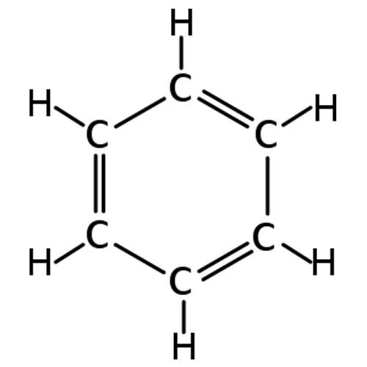
Question 6:
WHAT MOLECULE CONTAINING 6 CARBON AND 6 HYDROGEN ATOMS IS THIS?

Slide 8
Question 7:
WHAT ARE THE 2 MOST POPULAR SPORTS WHICH ALLOW 6 PLAYERS PER TEAM?

Slide 9
Question 8:
WHAT LETTERS ARE ON THE "6" BUTTON OF MOST PHONES?

Slide 10
Question 9:
SIX FLAGS AMUSEMENT PARKS WERE NAMED FOR THE NUMBER OF FLAGS THAT WHAT STATE HAS BEEN UNDER?

Slide 11
Question 10:
WHO DIRECTED THE FILM "THE SIXTH SENSE"?

Slide 12
ANSWERS WILL BE PROVIDED SHORTLY

Slide 13
Question 1:
6 IS CALLED A PERFECT NUMBER SINCE IT IS THE SUM OF ITS SMALLER FACTORS (6=1+2+3). WHAT IS THE NEXT PERFECT NUMBER?
28 (= 1+2+4+7+14)

Slide 14
Question 2:
WHAT SONG BY "SIXPENCE NONE THE RICHER" MADE IT TO #2 ON THE CHARTS AND EARNED THEM A GRAMMY NOMINATION?
KISS ME

Slide 15
Question 3:
WHAT PRESENT WAS GIVEN ON THE 6TH DAY OF CHRISTMAS IN THE SONG "THE 12 DAYS OF CHRISTMAS"?
6 GEESE A–LAYING

Slide 16
Question 4:
WHAT U.S. PRESIDENT HAD 6 LETTERS IN HIS FIRST, MIDDLE AND LAST NAME?
RONALD WILSON REAGAN

Slide 17
Question 5:
THERE ARE 6 SYMBOLIC FOODS ON THE SEDER PLATE DURING WHAT JEWISH HOLIDAY?
PASSOVER

Slide 18
Question 6:
WHAT MOLECULE CONTAINING 6 CARBON AND 6 HYDROGEN ATOMS IS THIS?
BENZENE

Slide 19
Question 7:
WHAT ARE THE 2 MOST POPULAR SPORTS WHICH ALLOW 6 PLAYERS PER TEAM?
HOCKEY & VOLLEYBALL

Slide 20
Question 8:
WHAT LETTERS ARE ON THE "6" BUTTON OF MOST PHONES?
MNO

Slide 21
Question 9:
SIX FLAGS AMUSEMENT PARKS WERE NAMED FOR THE NUMBER OF FLAGS THAT WHAT STATE HAS BEEN UNDER?
TEXAS

Slide 22
Question 10:
WHO DIRECTED THE FILM "THE SIXTH SENSE"?
M. NIGHT SHYAMALAN

