Slide 1
COMMON THREAD

Slide 2
Question 1:
WHAT GREEK LETTER IS 𝝼?

Slide 3
Question 2:
WHAT 1987 FILM STARRING WARREN BEATTY AND DUSTIN HOFFMAN IS CONSIDERED THE WORST FILM EITHER HAS MADE?

Slide 4
Question 3:
IN MUSICAL SOLFÈGE, WHAT NOTE COMES BETWEEN MI AND SO?

Slide 5
Question 4:
WHAT IS THE ONLY MAMMAL CAPABLE OF SUSTAINED FLIGHT?

Slide 6
Question 5:
IN TEXAS HOLD 'EM, WHAT SLANG TERM IS GIVEN TO THE STRONGEST POSSIBLE HAND IN A GIVEN SITUATION?

Slide 7
Question 6:
WHAT IS THE CHEMICAL SYMBOL FOR ELEMENT #88, FOR WHICH MARIE CURIE WON A 1911 NOBEL PRIZE FOR DISCOVERING AND ISOLATING?

Slide 8
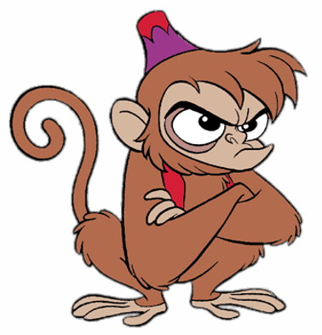
Question 7:
WHAT IS THE NAME OF THIS MONKEY FROM "ALADDIN"?

Slide 9
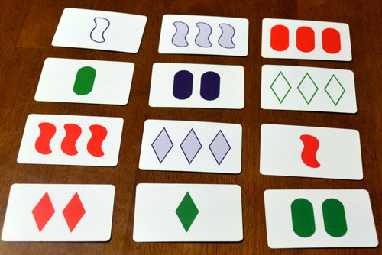
Question 8:
WHAT GAME IS THIS?

Slide 10

Question 9:
WHAT GROUP HAS THIS FLAG?

Slide 11
Question 10:
WHAT DO ALL THESE ANSWERS HAVE IN COMMON?

Slide 12
ANSWERS WILL BE PROVIDED SHORTLY

Slide 13
Question 1:
WHAT GREEK LETTER IS 𝝼?
NU

Slide 14
Question 2:
WHAT 1987 FILM STARRING WARREN BEATTY AND DUSTIN HOFFMAN IS CONSIDERED THE WORST FILM EITHER HAS MADE?
ISHTAR

Slide 15
Question 3:
IN MUSICAL SOLFÈGE, WHAT NOTE COMES BETWEEN MI AND SO?
FA

Slide 16
Question 4:
WHAT IS THE ONLY MAMMAL CAPABLE OF SUSTAINED FLIGHT?
BAT

Slide 17
Question 5:
IN TEXAS HOLD 'EM, WHAT SLANG TERM IS GIVEN TO THE STRONGEST POSSIBLE HAND IN A GIVEN SITUATION?
NUT

Slide 18
Question 6:
WHAT IS THE CHEMICAL SYMBOL FOR ELEMENT #88, FOR WHICH MARIE CURIE WON A 1911 NOBEL PRIZE FOR DISCOVERING AND ISOLATING?
RA(DIUM)

Slide 19
Question 7:
WHAT IS THE NAME OF THIS MONKEY FROM "ALADDIN"?
ABU

Slide 20
Question 8:
WHAT GAME IS THIS?
SET

Slide 21
Question 9:
WHAT GROUP HAS THIS FLAG?
ISIS

Slide 22
Question 10:
WHAT DO ALL THESE ANSWERS HAVE IN COMMON?
NAMES OF EGYPTIAN DIETIES

