Slide 1
COMMON THREAD

Slide 2
Question 1:
WHAT IS THE LAST NAME OF THE COMEDIAN NARRATOR OF THE SITCOM "EVERYBODY HATES CHRIS"?

Slide 3
Question 2:
THE PERIOD BETWEEN 3300 BC AND 1200 BC IS OFTEN REFERRED TO AS THE WHAT AGE?

Slide 4
Question 3:
IN "THE LORD OF THE RINGS" TRILOGY, WHAT RACE WAS GIMLI?

Slide 5
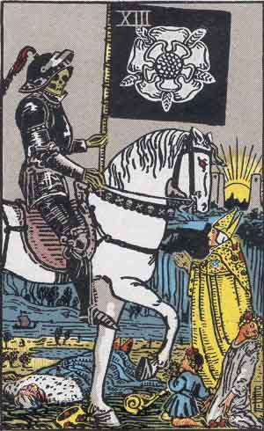
Question 4:
WHAT IS THE NAME OF THIS TAROT CARD?

Slide 6
Question 5:
WHAT DIRECTION IS ALSO THE FIRST NAME OF THE ELDEST DAUGHTER OF KANYE WEST AND KIM KARDASHIAN?

Slide 7
Question 6:
WHAT 5-LETTER WORD MEANS ALMOST THE SAME THING WHEN A "B" IS ADDED TO THE END OF IT?

Slide 8
Question 7:
OF THE 3 MOST COMMON SUBATOMIC PARTICLES, WHICH ONE HAS NO CHARGE?

Slide 9
Question 8:
WHAT IS THE 2-LETTER ABBREVIATION FOR THE CANADIAN PROVINCE JUST NORTH OF MICHIGAN?

Slide 10
Question 9:
WHAT IS THE FIRST NAME OF THE ACTOR WHO PLAYED MUTANT CHARLES XAVIER IN 6 "X-MEN" FILMS?

Slide 11
Question 10:
WHAT DO ALL THESE ANSWERS HAVE IN COMMON?

Slide 12
ANSWERS WILL BE PROVIDED SHORTLY

Slide 13
Question 1:
WHAT IS THE LAST NAME OF THE COMEDIAN NARRATOR OF THE SITCOM "EVERYBODY HATES CHRIS"?
ROCK

Slide 14
Question 2:
THE PERIOD BETWEEN 3300 BC AND 1200 BC IS OFTEN REFERRED TO AS THE WHAT AGE?
BRONZE

Slide 15
Question 3:
IN "THE LORD OF THE RINGS" TRILOGY, WHAT RACE WAS GIMLI?
DWARF

Slide 16
Question 4:
WHAT IS THE NAME OF THIS TAROT CARD?
DEATH

Slide 17
Question 5:
WHAT DIRECTION IS ALSO THE FIRST NAME OF THE ELDEST DAUGHTER OF KANYE WEST AND KIM KARDASHIAN?
NORTH

Slide 18
Question 6:
WHAT 5-LETTER WORD MEANS ALMOST THE SAME THING WHEN A "B" IS ADDED TO THE END OF IT?
SUPER(B)

Slide 19
Question 7:
OF THE 3 MOST COMMON SUBATOMIC PARTICLES, WHICH ONE HAS NO CHARGE?
NEUTRON

Slide 20
Question 8:
WHAT IS THE 2-LETTER ABBREVIATION FOR THE CANADIAN PROVINCE JUST NORTH OF MICHIGAN?
ON(TARIO)

Slide 21
Question 9:
WHAT IS THE FIRST NAME OF THE ACTOR WHO PLAYED MUTANT CHARLES XAVIER IN 6 "X-MEN" FILMS?
PATRICK (STEWART)

Slide 22
Question 10:
WHAT DO ALL THESE ANSWERS HAVE IN COMMON?
CAN BE FOLLOWED BY "STAR"

