Slide 1
COMMON THREAD

Slide 2

Question 1:
WHICH OF THE 2 LEAGUES IN MLB HAS THIS LOGO?

Slide 3
Question 2:
WHAT IS THE 3-LETTER CODE FOR THE LARGEST AIRPORT IN WASHINGTON STATE?

Slide 4
Question 3:
WHAT DO YOU NEED FOR FISHING AND SKIING, AND WANT TO HAVE WHEN RACING CARS?

Slide 5
Question 4:
WHAT IS THE LAST NAME OF KIM KARDASHIAN'S HUSBAND?

Slide 6
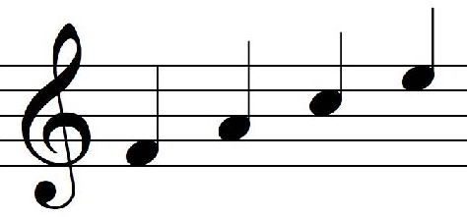
Question 5:
WHAT NOTES ARE THESE?

Slide 7
Question 6:
WHAT IS THE LAST NAME OF THE OLDEST BEATLE?

Slide 8
Question 7:
WHAT 1800'S NATION WAS KNOWN AS "THE HERMIT KINGDOM"?

Slide 9
Question 8:
THE SIOUX NATION IS COMPRISED OF THE LAKOTA AND WHAT OTHER GROUP?

Slide 10
Question 9:
THE NFL PANTHERS AND NHL HURRICANES PLAY FOR WHOM?

Slide 11
Question 10:
WHAT DO ALL THESE ANSWERS HAVE IN COMMON?

Slide 12
ANSWERS WILL BE PROVIDED SHORTLY

Slide 13
Question 1:
WHICH OF THE 2 LEAGUES IN MLB HAS THIS LOGO?
AMERICAN

Slide 14
Question 2:
WHAT IS THE 3-LETTER CODE FOR THE LARGEST AIRPORT IN WASHINGTON STATE?
SEA(TTLE)

Slide 15
Question 3:
WHAT DO YOU NEED FOR FISHING AND SKIING, AND WANT TO HAVE WHEN RACING CARS?
POLE

Slide 16
Question 4:
WHAT IS THE LAST NAME OF KIM KARDASHIAN'S HUSBAND?
(KANYE) WEST

Slide 17
Question 5:
WHAT NOTES ARE THESE?
FACE

Slide 18
Question 6:
WHAT IS THE LAST NAME OF THE OLDEST BEATLE?
(RINGO) STARR

Slide 19
Question 7:
WHAT 1800'S NATION WAS KNOWN AS "THE HERMIT KINGDOM"?
KOREA

Slide 20
Question 8:
THE SIOUX NATION IS COMPRISED OF THE LAKOTA AND WHAT OTHER GROUP?
DAKOTA

Slide 21
Question 9:
THE NFL PANTHERS AND NHL HURRICANES PLAY FOR WHOM?
CAROLINA

Slide 22
Question 10:
WHAT DO ALL THESE ANSWERS HAVE IN COMMON?
CAN FOLLOW "NORTH"

