Slide 1
COMMON THREAD

Slide 2
Question 1:
WHAT HONORIFIC LITERALLY MEANS "ELDER" IN ARABIC?

Slide 3
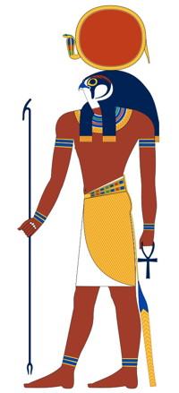
Question 2:
WHAT EGYPTIAN SUN GOD IS THIS?

Slide 4
Question 3:
WHAT ARE THE FIRST 2 SYLLABLES OF THE 3-SYLLABLE AFRICAN-AMERICAN SPIRITUAL SONG TITLE THAT LITERALLY MEANS "COME BY HERE"?

Slide 5
Question 4:
WHAT IS THE FASTEST LAND ANIMAL, CLOCKED AT 60 MPH?

Slide 6
Question 5:
WHAT IS THE LAST NAME OF THE FIRST ACTRESS TO WIN AN OSCAR FOR PLAYING A MALE CHARACTER?

Slide 7
Question 6:
WHAT IS THE MOST POPULATED STATE CAPITAL IN THE U.S.?

Slide 8
Question 7:
WHAT GERMAN BAND SANG "ROCK YOU LIKE A HURRICANE"?

Slide 9
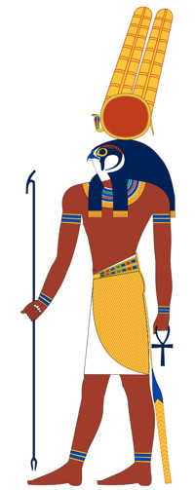
Question 8:
WHAT EGYPTIAN GOD OF WAR IS THIS (YES, THIS IS DIFFERENT THAN #2!)?

Slide 10
Question 9:
MESOPOTAMIA HAS 2 GREAT RIVERS, THE EUPHRATES AND THE WHAT?

Slide 11
Question 10:
WHAT DO ALL THESE ANSWERS HAVE IN COMMON?

Slide 12
ANSWERS WILL BE PROVIDED SHORTLY

Slide 13
Question 1:
WHAT HONORIFIC LITERALLY MEANS "ELDER" IN ARABIC?
SHEIK

Slide 14
Question 2:
WHAT EGYPTIAN SUN GOD IS THIS?
RA

Slide 15
Question 3:
WHAT ARE THE FIRST 2 SYLLABLES OF THE 3-SYLLABLE AFRICAN-AMERICAN SPIRITUAL SONG TITLE THAT LITERALLY MEANS "COME BY HERE"?
KUMBA(YA)

Slide 16
Question 4:
WHAT IS THE FASTEST LAND ANIMAL, CLOCKED AT 60 MPH?
CHEETAH

Slide 17
Question 5:
WHAT IS THE LAST NAME OF THE FIRST ACTRESS TO WIN AN OSCAR FOR PLAYING A MALE CHARACTER?
(LINDA) HUNT

Slide 18
Question 6:
WHAT IS THE MOST POPULATED STATE CAPITAL IN THE U.S.?
PHOENIX

Slide 19
Question 7:
WHAT GERMAN BAND SANG "ROCK YOU LIKE A HURRICANE"?
SCORPIONS

Slide 20
Question 8:
WHAT EGYPTIAN GOD OF WAR IS THIS (YES, THIS IS DIFFERENT THAN #2!)?
MONTU

Slide 21
Question 9:
MESOPOTAMIA HAS 2 GREAT RIVERS, THE EUPHRATES AND THE WHAT?
TIGRIS

Slide 22
Question 10:
WHAT DO ALL THESE ANSWERS HAVE IN COMMON?
RIDES AT BUSCH GARDENS

