Slide 1
IDENTIFY THE MOVIE POSTER COMMON THREAD

Slide 2
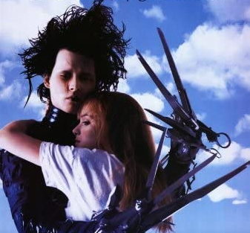
Question 1:

Slide 3
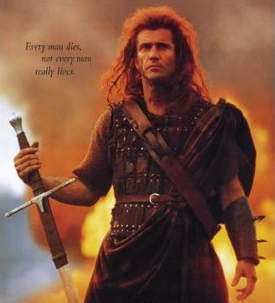
Question 2:

Slide 4

Question 3:

Slide 5
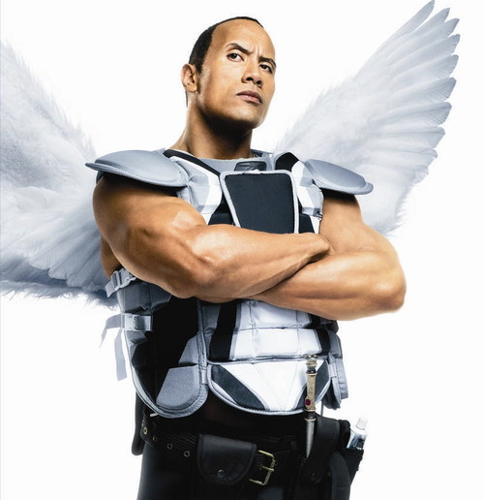
Question 4:

Slide 6
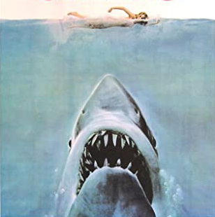
Question 5:

Slide 7
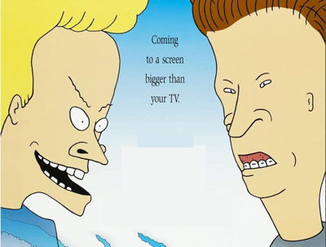
Question 6:

Slide 8
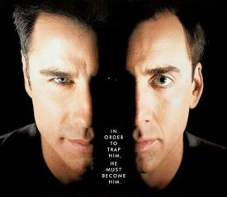
Question 7:

Slide 9
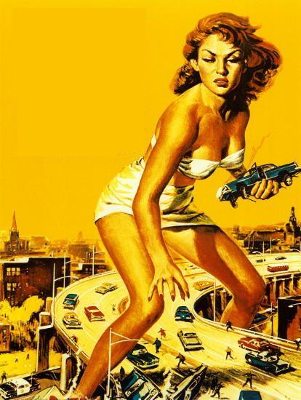
Question 8:

Slide 10
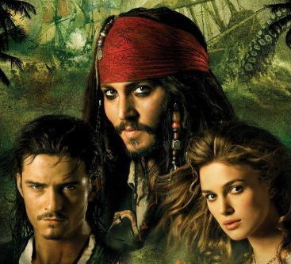
Question 9:

Slide 11
Question 10:
WHAT DO ALL THESE FILMS HAVE IN COMMON?

Slide 12
ANSWERS WILL BE PROVIDED SHORTLY

Slide 13
Question 1:
EDWARD SCISSORHANDS

Slide 14
Question 2:
BRAVEHEART

Slide 15
Question 3:
STAR WARS: THE EMPIRE STRIKES BACK

Slide 16
Question 4:
THE TOOTH FAIRY

Slide 17
Question 5:
JAWS

Slide 18
Question 6:
BEAVIS AND BUTT–HEAD DO AMERICA

Slide 19
Question 7:
FACE/OFF

Slide 20
Question 8:
ATTACK OF THE 50 FOOT WOMAN

Slide 21
Question 9:
PIRATES OF THE CARIBBEAN: DEAD MAN'S CHEST

Slide 22
Question 10:
WHAT DO ALL THESE FILMS HAVE IN COMMON?
TITLES CONTAIN BODY PARTS

