Slide 1
COMMON THREAD

Slide 2
Question 1:
WHAT BODY PARTS ARE MADE OF THE CLAVICLES, SCAPULAE, AND HUMERI?

Slide 3
Question 2:
WHAT 2010 "TRAVEL ROMANCE WITH THRILLER ELEMENTS" FILM STARRED ANGELINA JOLIE AND JOHNNY DEPP?

Slide 4
Question 3:
WHAT TWO ANIMALS ARE MOST COMMONLY USED IN LABORATORY RESEARCH?

Slide 5
Question 4:
THE MAIN ANTAGONIST OF "TOY STORY 3" IS WHAT SORT OF STUFFED ANIMAL?

Slide 6
Question 5:
WHAT IS THE OLDEST EDIBLE FOOD EVER FOUND THAT WAS NOT FROZEN?

Slide 7
Question 6:
WHOM DOES MAX VON SYDOW PLAY CHESS WITH IN THE FILM "THE SEVENTH SEAL"?

Slide 8
Question 7:
WHAT 1994 KEANU REEVES AND SANDRA BULLOCK FILM HAD TAG LINE "GET READY FOR RUSH HOUR"?

Slide 9
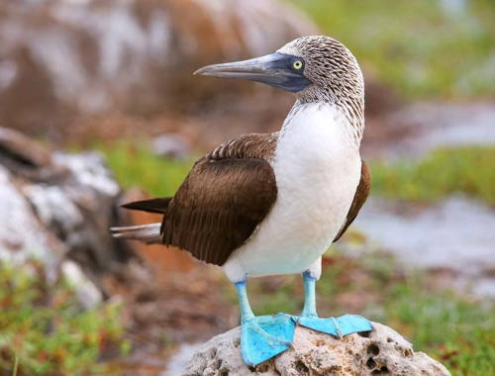
Question 8:
THIS IS A BLUE-FOOTED WHAT?

Slide 10
Question 9:
ACCORDING TO NANCY SINATRA, WHAT ARE MADE FOR WALKING?

Slide 11
Question 10:
WHAT DO ALL THESE ANSWERS HAVE IN COMMON?

Slide 12
ANSWERS WILL BE PROVIDED SHORTLY

Slide 13
Question 1:
WHAT BODY PARTS ARE MADE OF THE CLAVICLES, SCAPULAE, AND HUMERI?
SHOULDERS

Slide 14
Question 2:
WHAT 2010 "TRAVEL ROMANCE WITH THRILLER ELEMENTS" FILM STARRED ANGELINA JOLIE AND JOHNNY DEPP?
THE TOURIST

Slide 15
Question 3:
WHAT TWO ANIMALS ARE MOST COMMONLY USED IN LABORATORY RESEARCH?
MOUSE & RAT

Slide 16
Question 4:
THE MAIN ANTAGONIST OF "TOY STORY 3" IS WHAT SORT OF STUFFED ANIMAL?
BEAR

Slide 17
Question 5:
WHAT IS THE OLDEST EDIBLE FOOD EVER FOUND THAT WAS NOT FROZEN?
HONEY

Slide 18
Question 6:
WHOM DOES MAX VON SYDOW PLAY CHESS WITH IN THE FILM "THE SEVENTH SEAL"?
DEATH

Slide 19
Question 7:
WHAT 1994 KEANU REEVES AND SANDRA BULLOCK FILM HAD TAG LINE "GET READY FOR RUSH HOUR"?
SPEED

Slide 20
Question 8:
THIS IS A BLUE-FOOTED WHAT?
BOOBY

Slide 21
Question 9:
ACCORDING TO NANCY SINATRA, WHAT ARE MADE FOR WALKING?
BOOTS

Slide 22
Question 10:
WHAT DO ALL THESE ANSWERS HAVE IN COMMON?
CAN BE FOLLOWED BY "TRAP"

