Slide 1
IDENTIFY THE MOVIE FRANCHISE FROM ONE FRAME

Slide 2
Question 1:

Slide 3
Question 2:

Slide 4

Question 3:

Slide 5

Question 4:

Slide 6
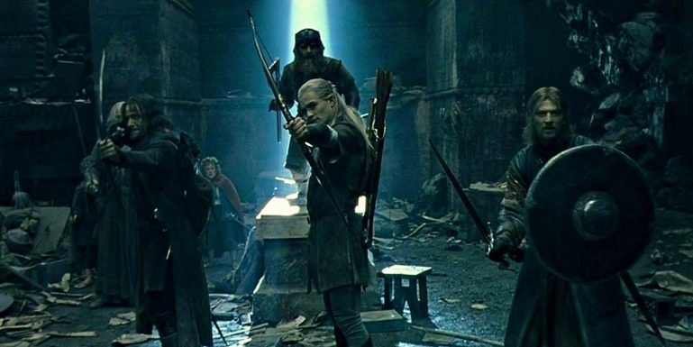
Question 5:

Slide 7
Question 6:

Slide 8

Question 7:

Slide 9
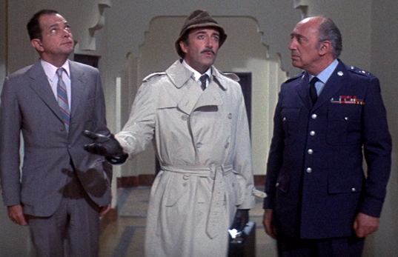
Question 8:

Slide 10
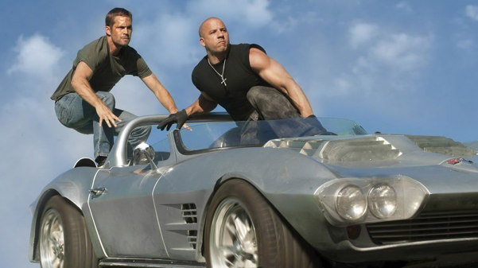
Question 9:

Slide 11

Question 10:

Slide 12
ANSWERS WILL BE PROVIDED SHORTLY

Slide 13
Question 1:
STAR WARS

Slide 14
Question 2:
THE GODFATHER

Slide 15
Question 3:
THE HUNGER GAMES

Slide 16
Question 4:
BACK TO THE FUTURE

Slide 17
Question 5:
LORD OF THE RINGS

Slide 18
Question 6:
KARATE KID

Slide 19
Question 7:
HALLOWEEN

Slide 20
Question 8:
THE PINK PANTHER

Slide 21
Question 9:
THE FAST AND THE FURIOUS

Slide 22
Question 10:
TWILIGHT

