Slide 1
SAME INITIALS

Slide 2
Question 1:
WHAT U.S. PRESIDENT IS CONSISTENTLY RANKED THE BEST BY HISTORIANS?

Slide 3
Question 2:
WHO SANG THE HIT SONGS "SK8ER BOI" AND "COMPLICATED"?

Slide 4
Question 3:
WHO IS THE LEAD SINGER OF MAROON 5?

Slide 5
Question 4:
WHO WAS THE STAR OF "MURDER, SHE WROTE"?

Slide 6
Question 5:
WHAT FRENCH NOBLEMAN RECOGNIZED AND NAMED OXYGEN AND HYDROGEN, AND DISCOVERED THE LAW OF CONSERVATION OF MASS?

Slide 7
Question 6:
WHO HAS BEEN THE PRESIDENT OF BELARUS SINCE 1994?

Slide 8
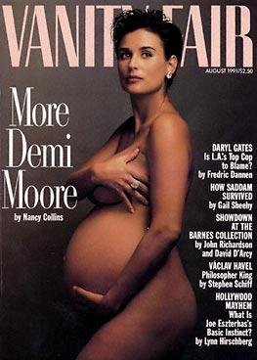
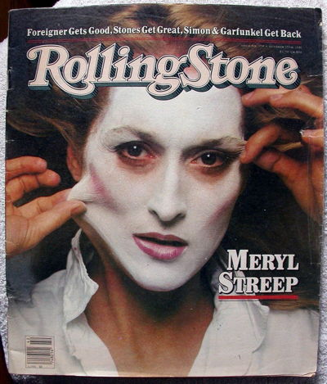
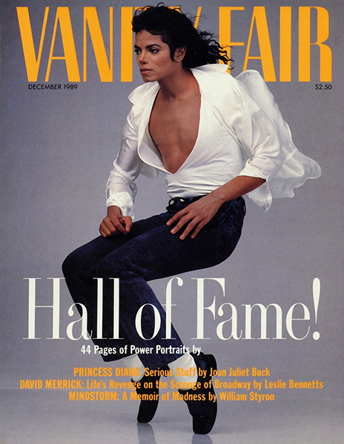
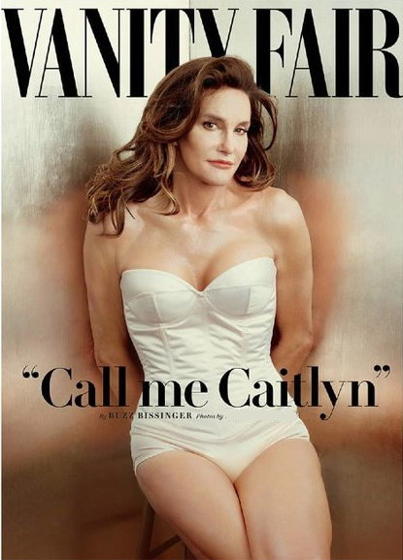
Question 7:
WHO TOOK THESE PHOTOS?

Slide 9
Question 8:
WHO WAS THE FEMALE LEAD SINGER OF THE EURYTHMICS?

Slide 10
Question 9:
WHAT TAIWANESE DIRECTOR WON 3 OSCARS FOR DIRECTING "BROKEBACK MOUNTAIN", "CROUCHING TIGER, HIDDEN DRAGON", AND "LIFE OF PI"?

Slide 11
Question 10:
AFTER BEING RUNNER-UP ON "AMERICAN IDOL", WHAT OPENLY GAY SINGER REPLACED FREDDIE MERCURY AS THE LEAD SINGER OF QUEEN?

Slide 12
ANSWERS WILL BE PROVIDED SHORTLY

Slide 13
Question 1:
WHAT U.S. PRESIDENT IS CONSISTENTLY RANKED THE BEST BY HISTORIANS?
ABRAHAM LINCOLN

Slide 14
Question 2:
WHO SANG THE HIT SONGS "SK8ER BOI" AND "COMPLICATED"?
AVRIL LAVIGNE

Slide 15
Question 3:
WHO IS THE LEAD SINGER OF MAROON 5?
ADAM LEVINE

Slide 16
Question 4:
WHO WAS THE STAR OF "MURDER, SHE WROTE"?
ANGELA LANSBURY

Slide 17
Question 5:
WHAT FRENCH NOBLEMAN RECOGNIZED AND NAMED OXYGEN AND HYDROGEN, AND DISCOVERED THE LAW OF CONSERVATION OF MASS?
ANTOINE LAVOISIER

Slide 18
Question 6:
WHO HAS BEEN THE PRESIDENT OF BELARUS SINCE 1994?
ALEXANDER LUKASHENKO

Slide 19
Question 7:
WHO TOOK THESE PHOTOS?
ANNIE LEIBOVITZ

Slide 20
Question 8:
WHO WAS THE FEMALE LEAD SINGER OF THE EURYTHMICS?
ANNIE LENNOX

Slide 21
Question 9:
WHAT TAIWANESE DIRECTOR WON 3 OSCARS FOR DIRECTING "BROKEBACK MOUNTAIN", "CROUCHING TIGER, HIDDEN DRAGON", AND "LIFE OF PI"?
ANG LEE

Slide 22
Question 10:
AFTER BEING RUNNER-UP ON "AMERICAN IDOL", WHAT OPENLY GAY SINGER REPLACED FREDDIE MERCURY AS THE LEAD SINGER OF QUEEN?
ADAM LAMBERT

