Slide 1
MATCHING SIMILAR WORLD FLAGS (1/3 POINT EACH)

Slide 2



Question 1:
MATCH THESE FLAGS WITH AUSTRIA, INDONESIA, POLAND?

Slide 3
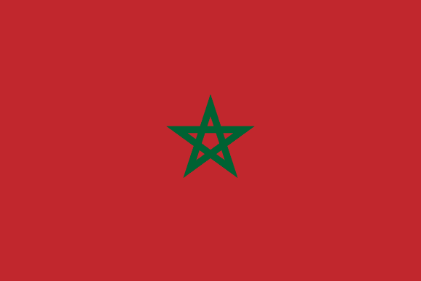

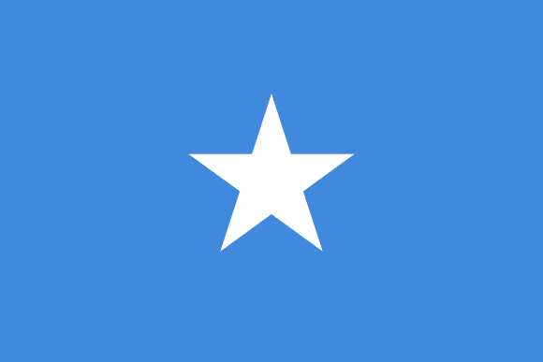
Question 2:
MATCH THESE FLAGS WITH MOROCCO, SOMALIA, VIETNAM?

Slide 4



Question 3:
MATCH THESE FLAGS WITH DENMARK, FINLAND, SWEDEN?

Slide 5
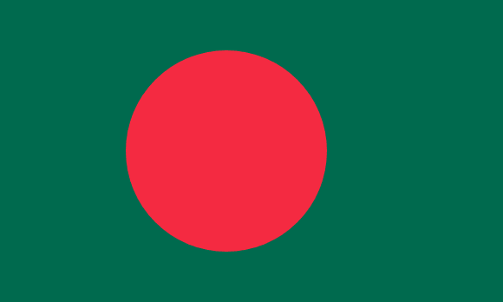

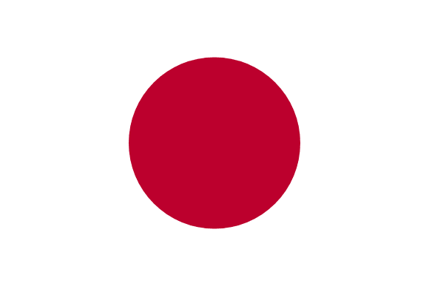
Question 4:
MATCH THESE FLAGS WITH BANGLADESH, JAPAN, PALAU?

Slide 6
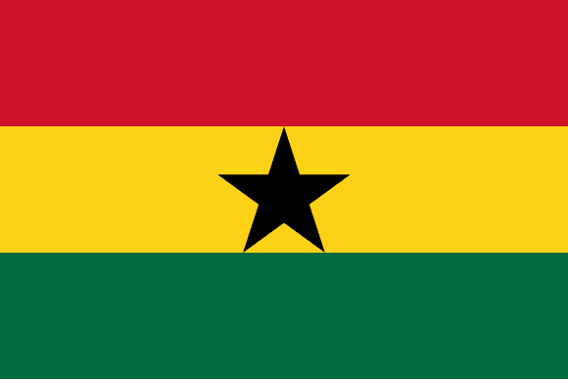
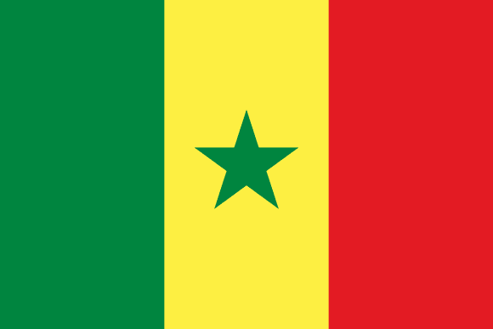
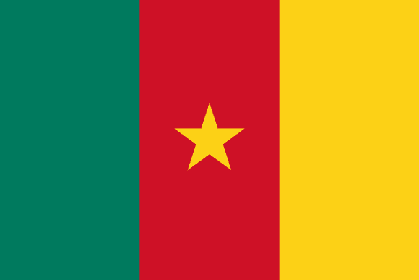
Question 5:
MATCH THESE FLAGS WITH CAMEROON, GHANA, SENEGAL?

Slide 7



Question 6:
MATCH THESE FLAGS WITH BAHRAIN, NEPAL, QATAR?

Slide 8



Question 7:
MATCH THESE FLAGS WITH BULGARIA, HUNGARY, KUWAIT?

Slide 9
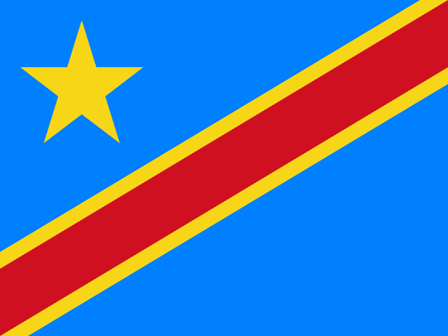
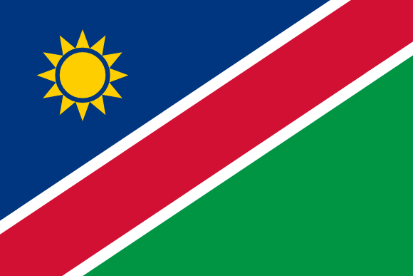

Question 8:
MATCH THESE FLAGS WITH DEMOCRATIC REPUBLIC OF CONGO, NAMIBIA, TANZANIA?

Slide 10



Question 9:
MATCH THESE FLAGS WITH ALGERIA, TUNISIA, TURKEY?

Slide 11



Question 10:
MATCH THESE FLAGS WITH BAHAMAS, PALESTINE, SUDAN?

Slide 12
ANSWERS WILL BE PROVIDED SHORTLY

Slide 13
Question 1:
MATCH THESE FLAGS WITH AUSTRIA, INDONESIA, POLAND?
POLAND, INDONESIA, AUSTRIA

Slide 14
Question 2:
MATCH THESE FLAGS WITH MOROCCO, SOMALIA, VIETNAM?
MOROCCO, VIETNAM, SOMALIA

Slide 15
Question 3:
MATCH THESE FLAGS WITH DENMARK, FINLAND, SWEDEN?
SWEDEN, FINLAND, DENMARK

Slide 16
Question 4:
MATCH THESE FLAGS WITH BANGLADESH, JAPAN, PALAU?
BANGLADESH, PALAU, JAPAN

Slide 17
Question 5:
MATCH THESE FLAGS WITH CAMEROON, GHANA, SENEGAL?
GHANA, SENEGAL, CAMEROON

Slide 18
Question 6:
MATCH THESE FLAGS WITH BAHRAIN, NEPAL, QATAR?
NEPAL, BAHRAIN, QATAR

Slide 19
Question 7:
MATCH THESE FLAGS WITH BULGARIA, HUNGARY, KUWAIT?
HUNGARY, KUWAIT, BULGARIA

Slide 20
Question 8:
MATCH THESE FLAGS WITH DEMOCRATIC REPUBLIC OF CONGO, NAMIBIA, TANZANIA?
DR of C, NAMIBIA, TANZANIA

Slide 21
Question 9:
MATCH THESE FLAGS WITH ALGERIA, TUNISIA, TURKEY?
TURKEY, ALGERIA, TUNISIA

Slide 22
Question 10:
MATCH THESE FLAGS WITH BAHAMAS, PALESTINE, SUDAN?
PALESTINE, BAHAMAS, SUDAN

