Slide 1
MUSIC SYMBOLS

Slide 2
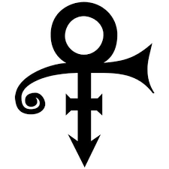
Question 1:
WHO CHANGED HIS NAME TO THIS SYMBOL?

Slide 3
Question 2:
WHOSE FIRST 5 ALBUMS ARE TITLED "+", "×", "÷", "=", AND "–"?

Slide 4
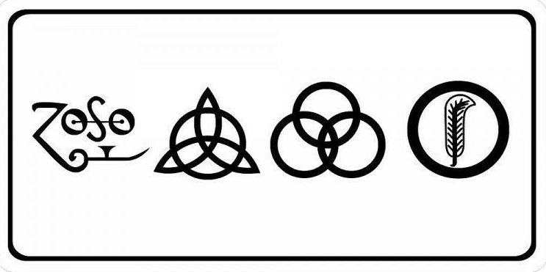
Question 3:
WHO TITLED THEIR 4TH ALBUM WITH THESE SYMBOLS?

Slide 5
Question 4:
HOW DOES ONE "SPELL" THE NAME OF THE ROCK BAND PRONOUNCED "CHK CHK CHK"?

Slide 6
Question 5:
WHAT ICONIC ALBUM COVER HAS THE BAND MEMBERS SPELLING OUT "NVUJ" IN SEMAPHORE?

Slide 7
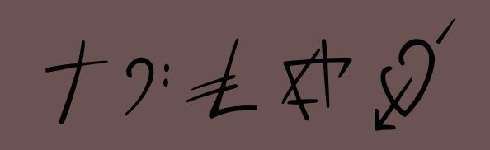
Question 6:
WHAT GEORGE MICHAEL ALBUM COVER CONTAINS THESE SYMBOLS?

Slide 8
Question 7:
WHAT METAL BAND HAS A SONG CALLED "K@Â£$%!"?

Slide 9
Question 8:
WHAT GRUNGE BAND HAS A SONG TITLED "🔴"?

Slide 10
Question 9:
WHAT GROUP'S FIRST ALBUM'S COVER CONTAINED A PRONUNCIATION GUIDE FOR THE BAND'S NAME?

Slide 11
Question 10:
WHAT CRASH TEST DUMMIES SONG IS TITLED ENTIRELY WITH PUNCTUATION?

Slide 12
ANSWERS WILL BE PROVIDED SHORTLY

Slide 13
Question 1:
WHO CHANGED HIS NAME TO THIS SYMBOL?
PRINCE

Slide 14
Question 2:
WHOSE FIRST 5 ALBUMS ARE TITLED "+", "×", "÷", "=", AND "–"?
ED SHEERAN

Slide 15
Question 3:
WHO TITLED THEIR 4TH ALBUM WITH THESE SYMBOLS?
LED ZEPPELIN

Slide 16
Question 4:
HOW DOES ONE "SPELL" THE NAME OF THE ROCK BAND PRONOUNCED "CHK CHK CHK"?
! ! !

Slide 17
Question 5:
WHAT ICONIC ALBUM COVER HAS THE BAND MEMBERS SPELLING OUT "NVUJ" IN SEMAPHORE?
HELP! (THE BEATLES)

Slide 18
Question 6:
WHAT GEORGE MICHAEL ALBUM COVER CONTAINS THESE SYMBOLS?
FAITH

Slide 19
Question 7:
WHAT METAL BAND HAS A SONG CALLED "K@Â£$%!"?
KORN

Slide 20
Question 8:
WHAT GRUNGE BAND HAS A SONG TITLED "🔴"?
PEARL JAM

Slide 21
Question 9:
WHAT GROUP'S FIRST ALBUM'S COVER CONTAINED A PRONUNCIATION GUIDE FOR THE BAND'S NAME?
LYNYRD SKYNYRD

Slide 22
Question 10:
WHAT CRASH TEST DUMMIES SONG IS TITLED ENTIRELY WITH PUNCTUATION?
. . .

