Slide 1
COMMON THREAD

Slide 2
Question 1:
WHAT IS THE FIRST WORD IN THE TITLE OF THE MOST FAMOUS PAINTING BY GRANT WOOD?

Slide 3
Question 2:
WHAT CITY IN CALIFORNIA WAS THE CAPITAL FROM 1777 TO 1854, JUST AFTER IT GAINED STATEHOOD?

Slide 4
Question 3:
IN WHAT 1996 FILM DOES ROBIN WILLIAMS PLAY A BOY WHO AGES AT 4 TIMES THE NORMAL RATE?

Slide 5
Question 4:
WHAT IS THE LAST NAME OF THE ACTOR WHO PLAYED RAYMOND ON "EVERYBODY LOVES RAYMOND"?

Slide 6
Question 5:
WHAT DO NEED TO PLAY "CAT'S CRADLE"?

Slide 7
Question 6:
IN WHAT SORT OF TOURNAMENT DO TEAMS PLAY TEAMS WITH SIMILAR RECORDS BUT NEVER THE SAME TEAM TWICE?

Slide 8
Question 7:
WHAT COLOR LIGHT HAS A WAVELENGTH BETWEEN 450 AND 500 NANOMETERS?

Slide 9
Question 8:
WHAT BAND SANG "SUNSHINE OF YOUR LOVE"?

Slide 10
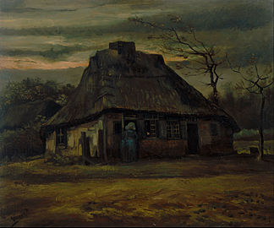
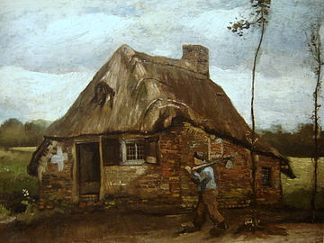
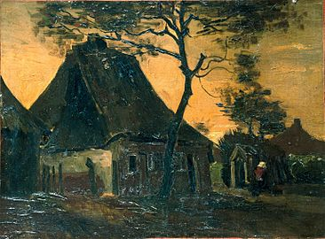
Question 9:
WHAT IS THE FIRST WORD OF THE TITLES OF THESE 3 VAN GOGH PAINTINGS?

Slide 11
Question 10:
WHAT DO ALL THESE ANSWERS HAVE IN COMMON?

Slide 12
ANSWERS WILL BE PROVIDED SHORTLY

Slide 13
Question 1:
WHAT IS THE FIRST WORD IN THE TITLE OF THE MOST FAMOUS PAINTING BY GRANT WOOD?
AMERICAN (GOTHIC)

Slide 14
Question 2:
WHAT CITY IN CALIFORNIA WAS THE CAPITAL FROM 1777 TO 1854, JUST AFTER IT GAINED STATEHOOD?
MONTEREY

Slide 15
Question 3:
IN WHAT 1996 FILM DOES ROBIN WILLIAMS PLAY A BOY WHO AGES AT 4 TIMES THE NORMAL RATE?
JACK

Slide 16
Question 4:
WHAT IS THE LAST NAME OF THE ACTOR WHO PLAYED RAYMOND ON "EVERYBODY LOVES RAYMOND"?
ROMANO

Slide 17
Question 5:
WHAT DO NEED TO PLAY "CAT'S CRADLE"?
STRING

Slide 18
Question 6:
IN WHAT SORT OF TOURNAMENT DO TEAMS PLAY TEAMS WITH SIMILAR RECORDS BUT NEVER THE SAME TEAM TWICE?
SWISS

Slide 19
Question 7:
WHAT COLOR LIGHT HAS A WAVELENGTH BETWEEN 450 AND 500 NANOMETERS?
BLUE

Slide 20
Question 8:
WHAT BAND SANG "SUNSHINE OF YOUR LOVE"?
CREAM

Slide 21
Question 9:
WHAT IS THE FIRST WORD OF THE TITLES OF THESE 3 VAN GOGH PAINTINGS?
COTTAGE

Slide 22
Question 10:
WHAT DO ALL THESE ANSWERS HAVE IN COMMON?
CAN BE FOLLOWED BY THE WORD "CHEESE"

