Slide 1
COMMON THREAD

Slide 2
Question 1:
ASIDE FROM THE SUN AND MOON, WHAT IS THE BRIGHTEST NATURAL OBJECT IN THE SKY?

Slide 3
Question 2:
WHAT COMPANY DID TIME WARNER CABLE AND BRIGHT HOUSE NETWORKS BECOME?

Slide 4
Question 3:
WHAT IS THE BEST-KNOWN 70'S CANDY THAT FIZZED WHEN EATEN?

Slide 5
Question 4:
WHAT IS THE NAME OF THE CHEMICAL COMPOUND C₈H₁₈?

Slide 6
Question 5:
THE ACTOR OMAR SHARIF WAS ONCE ONE OF THE BEST PLAYERS OF WHAT GAME?

Slide 7
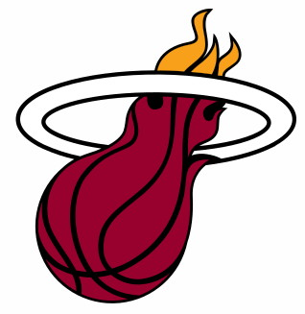
Question 6:
WHAT NBA FRANCHISE HAS THIS LOGO?

Slide 8
Question 7:
WHAT KEY IS IN THE UPPER LEFT HAND CORNER OF MOST KEYBOARDS?

Slide 9
Question 8:
WHAT DOES THE "M" IN "IM" STAND FOR?

Slide 10
Question 9:
AT WHAT ORLANDO GAY NIGHTCLUB WAS THERE A MASS SHOOTING IN 2016?

Slide 11
Question 10:
WHAT DO ALL THESE ANSWERS HAVE IN COMMON?

Slide 12
ANSWERS WILL BE PROVIDED SHORTLY

Slide 13
Question 1:
ASIDE FROM THE SUN AND MOON, WHAT IS THE BRIGHTEST NATURAL OBJECT IN THE SKY?
VENUS

Slide 14
Question 2:
WHAT COMPANY DID TIME WARNER CABLE AND BRIGHT HOUSE NETWORKS BECOME?
SPECTRUM

Slide 15
Question 3:
WHAT IS THE BEST-KNOWN 70'S CANDY THAT FIZZED WHEN EATEN?
POP ROCKS

Slide 16
Question 4:
WHAT IS THE NAME OF THE CHEMICAL COMPOUND C₈H₁₈?
OCTANE

Slide 17
Question 5:
THE ACTOR OMAR SHARIF WAS ONCE ONE OF THE BEST PLAYERS OF WHAT GAME?
BRIDGE

Slide 18
Question 6:
WHAT NBA FRANCHISE HAS THIS LOGO?
HEAT

Slide 19
Question 7:
WHAT KEY IS IN THE UPPER LEFT HAND CORNER OF MOST KEYBOARDS?
ESCAPE

Slide 20
Question 8:
WHAT DOES THE "M" IN "IM" STAND FOR?
(INSTANT) MESSAGE

Slide 21
Question 9:
AT WHAT ORLANDO GAY NIGHTCLUB WAS THERE A MASS SHOOTING IN 2016?
PULSE

Slide 22
Question 10:
WHAT DO ALL THESE ANSWERS HAVE IN COMMON?
SIRIUSXM RADIO STATIONS

