Slide 1
WELCOME TO THURSDAY NIGHT TRIVIA AT THE ELUSIVE GRAPE

Slide 2
NAME THESE FAMOUS DOGS OF FILM

Slide 3
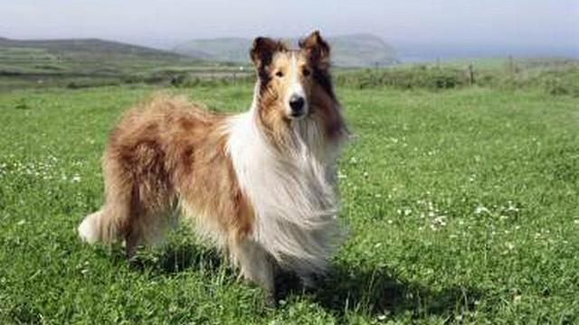
Question 1:

Slide 4
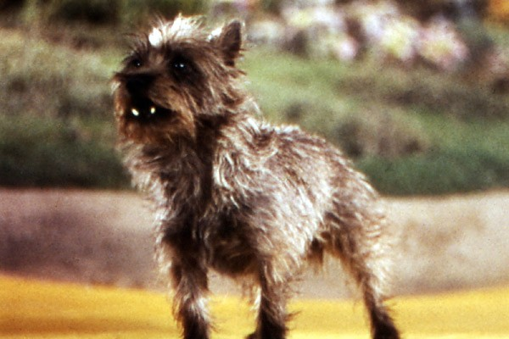
Question 2:

Slide 5
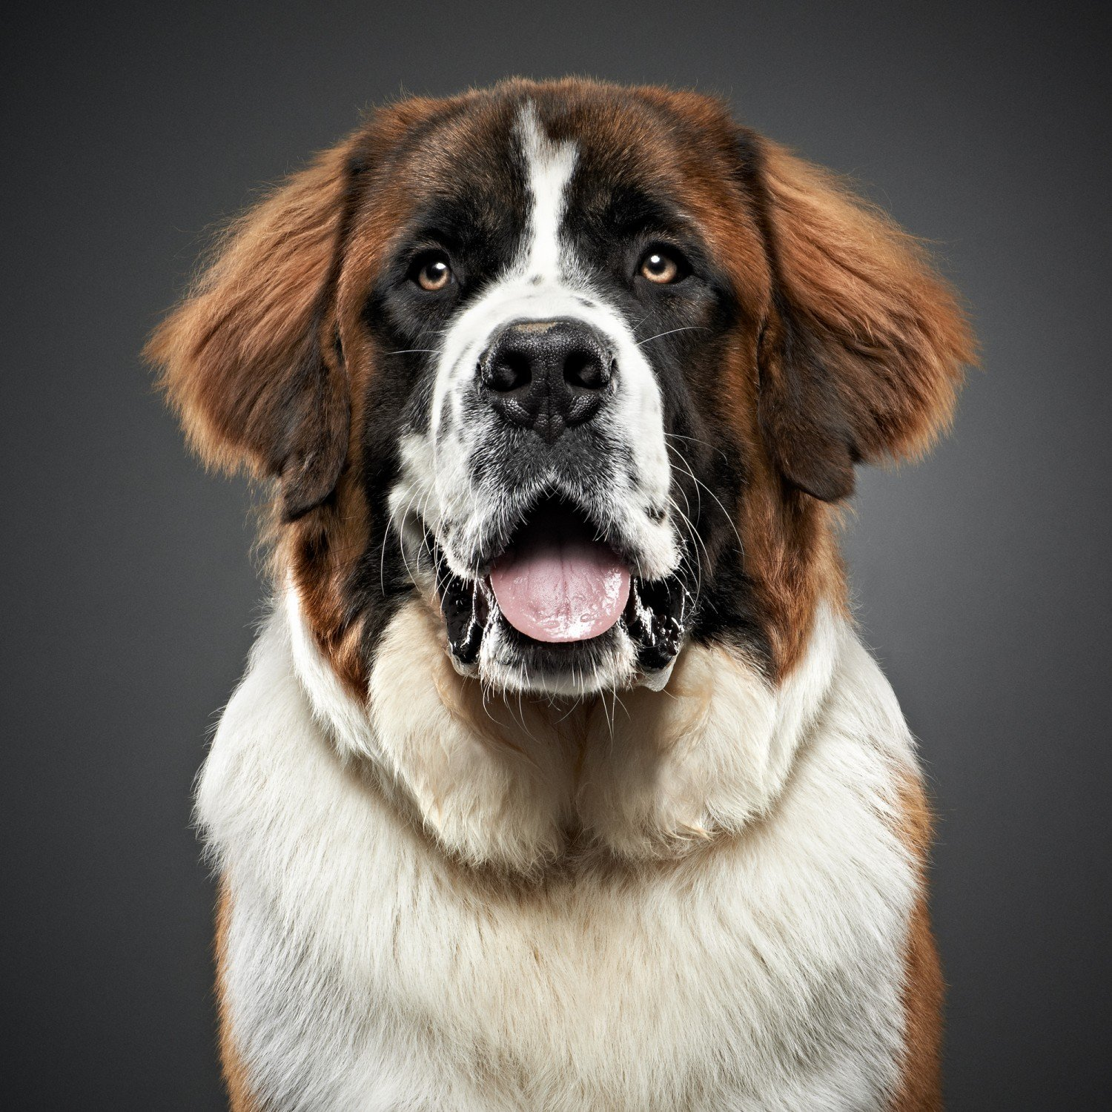
Question 3:

Slide 6
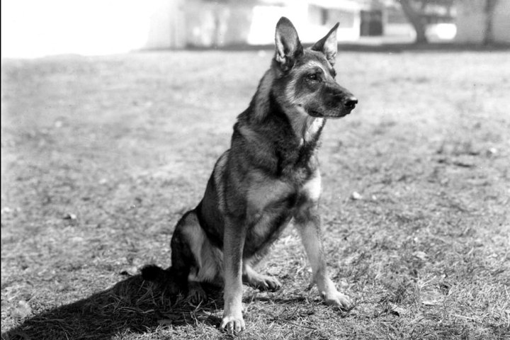
Question 4:

Slide 7
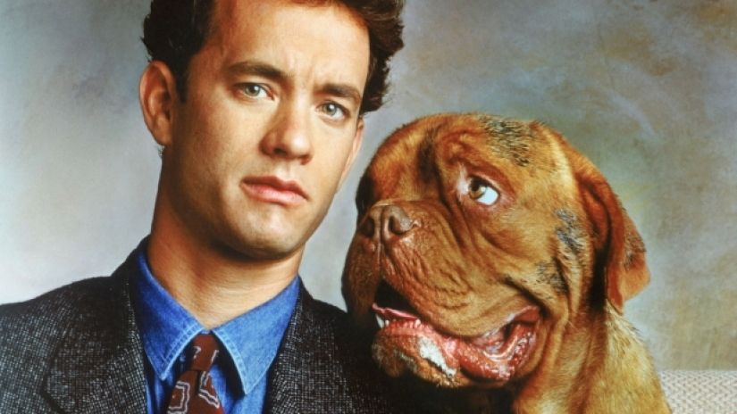
Question 5:

Slide 8
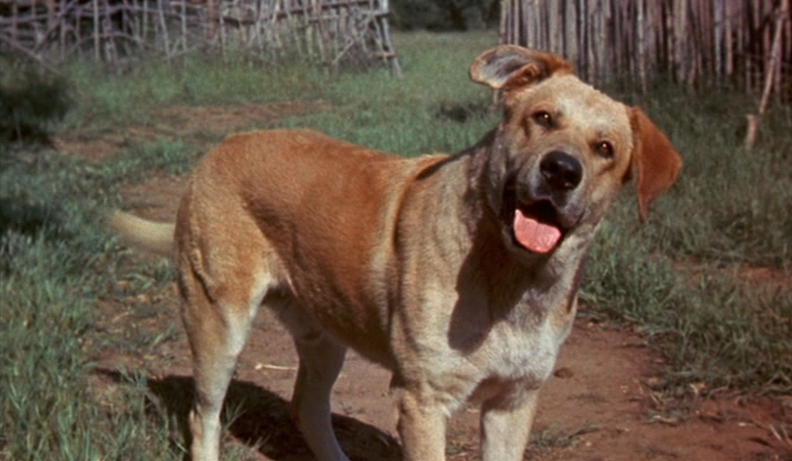
Question 6:

Slide 9
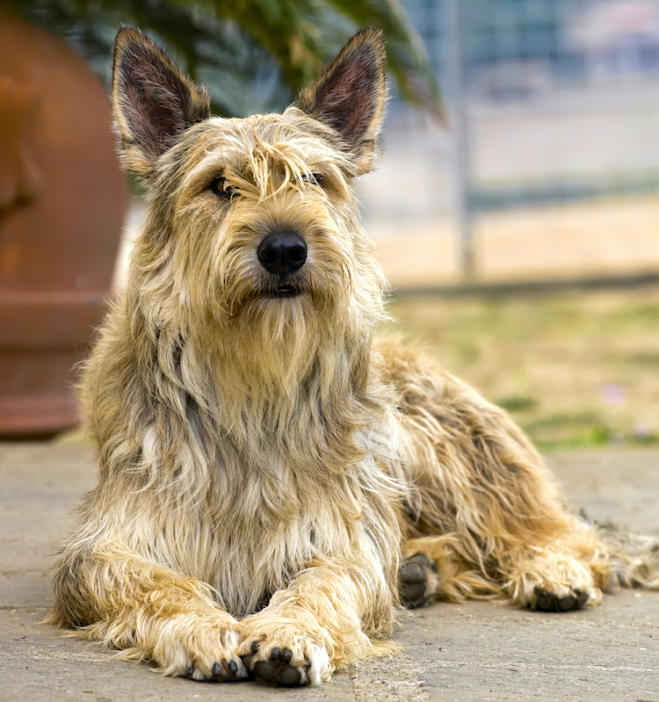
Question 7:

Slide 10
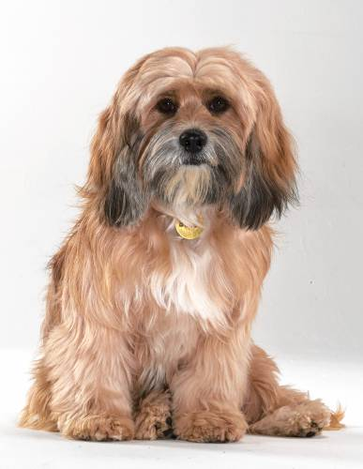
Question 8:

Slide 11
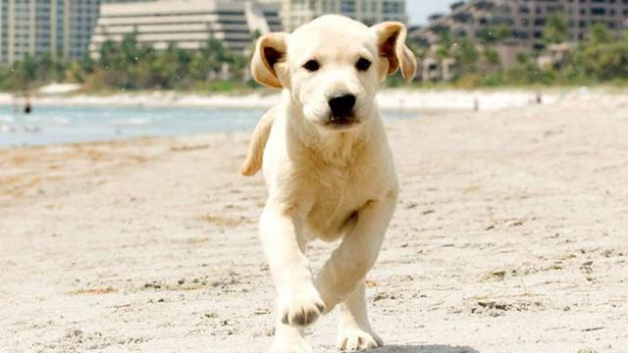
Question 9:

Slide 12
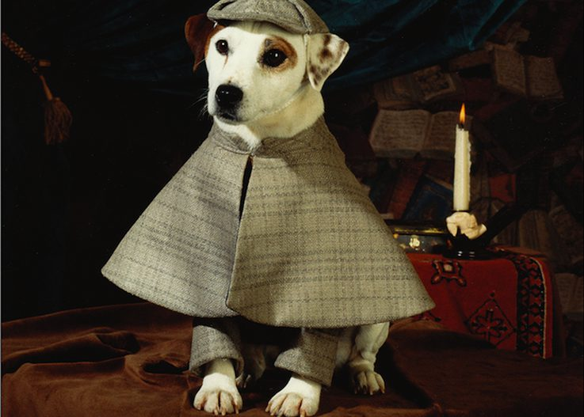
Question 10:

Slide 13
ANSWERS WILL BE PROVIDED SHORTLY

Slide 14
Question 1:
LASSIE

Slide 15
Question 2:
TOTO

Slide 16
Question 3:
BEETHOVEN

Slide 17
Question 4:
RIN TIN TIN

Slide 18
Question 5:
HOOCH

Slide 19
Question 6:
OLD YELLER

Slide 20
Question 7:
WINN–DIXIE

Slide 21
Question 8:
BENJI

Slide 22
Question 9:
MARLEY

Slide 23
Question 10:
WISHBONE

