Slide 1
CLUBS

Slide 2
Question 1:
WHAT ARE THE FOUR INGREDIENTS IN A TURKEY CLUB SANDWICH BESIDES TURKEY AND BREAD?

Slide 3
Question 2:
WHAT WAS THE NAME OF THE NIGHTCLUB IN ORLANDO WHERE 49 PEOPLE WERE KILLED IN A MASS SHOOTING IN 2016?

Slide 4
Question 3:
IS THE JACK OF CLUBS PLAYING CARD ONE OF THE "ONE-EYED JACKS"?

Slide 5
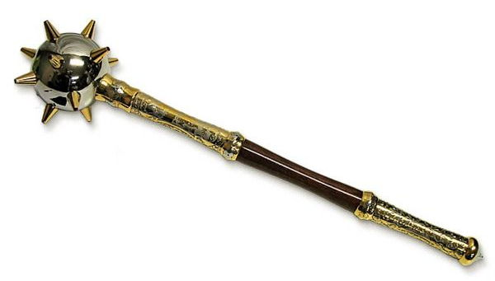
Question 4:
WHAT IS THIS KIND OF ANCIENT CLUB CALLED?

Slide 6
Question 5:
WHAT IS THE MAXIMUM NUMBER OF GOLF CLUBS A GOLFER IS ALLOWED TO CARRY IN A GOLF BAG? 14, 16, OR 18?

Slide 7
Question 6:
WHAT IS THE WORLD RECORD FOR THE LARGEST NUMBER OF CLUBS JUGGLED AT ONCE? 8, 10, OR 12?

Slide 8
Question 7:
TRUE OR FALSE? CLUB MED HAS RESORTS ON EVERY CONTINENT EXCEPT ANTARCTICA?

Slide 9
Question 8:
WHAT IS THE GAS THAT IS DISSOLVED IN CLUB SODA TO MAKE IT CARBONATED?

Slide 10
Question 9:
WHAT IS THE FIRST RULE OF FIGHT CLUB?

Slide 11
Question 10:
JANIS JOPLIN, JIMI HENDRIX, JIM MORRISON, KURT COBAIN, AND AMY WINEHOUSE ARE ALL IN WHAT "CLUB", NAMED AFTER THE AGE THEY DIED?

Slide 12
ANSWERS WILL BE PROVIDED SHORTLY

Slide 13
Question 1:
WHAT ARE THE FOUR INGREDIENTS IN A TURKEY CLUB SANDWICH BESIDES TURKEY AND BREAD?
BACON, LETTUCE, TOMATO & MAYO

Slide 14
Question 2:
WHAT WAS THE NAME OF THE NIGHTCLUB IN ORLANDO WHERE 49 PEOPLE WERE KILLED IN A MASS SHOOTING IN 2016?
PULSE

Slide 15
Question 3:
IS THE JACK OF CLUBS PLAYING CARD ONE OF THE "ONE-EYED JACKS"?
NO

Slide 16
Question 4:
WHAT IS THIS KIND OF ANCIENT CLUB CALLED?
MACE

Slide 17
Question 5:
WHAT IS THE MAXIMUM NUMBER OF GOLF CLUBS A GOLF IS ALLOWED TO CARRY IN A GOLF BAG? 14, 16, OR 18?
14

Slide 18
Question 6:
WHAT IS THE WORLD RECORD FOR THE LARGEST NUMBER OF CLUBS JUGGLED AT ONCE? 8, 10, OR 12?
8

Slide 19
Question 7:
TRUE OR FALSE? CLUB MED HAS RESORTS ON EVERY CONTINENT EXCEPT ANTARCTICA?
TRUE

Slide 20
Question 8:
WHAT IS THE GAS THAT IS DISSOLVED IN CLUB SODA TO MAKE IT CARBONATED?
CARBON DIOXIDE

Slide 21
Question 9:
WHAT IS THE FIRST RULE OF FIGHT CLUB?
DON'T TALK ABOUT FIGHT CLUB

Slide 22
Question 10:
JANIS JOPLIN, JIMI HENDRIX, JIM MORRISON, KURT COBAIN, AND AMY WINEHOUSE ARE ALL IN WHAT "CLUB", NAMED AFTER THE AGE THEY DIED?
THE 27 CLUB

