Slide 1
IDENTIFY THESE FEMALE LEADERS

Slide 2
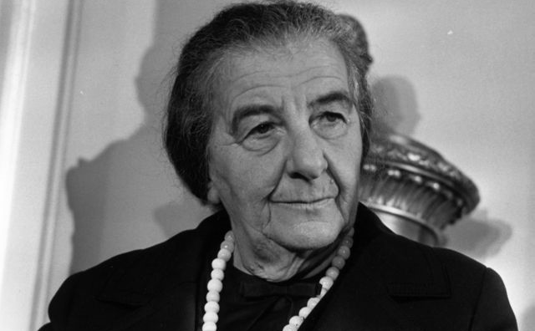
Question 1:

Slide 3
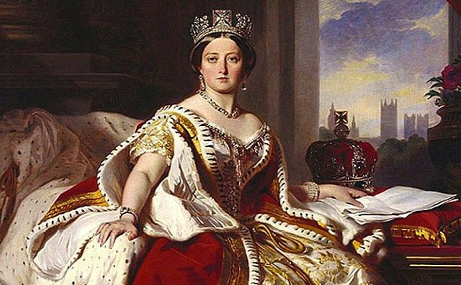
Question 2:

Slide 4
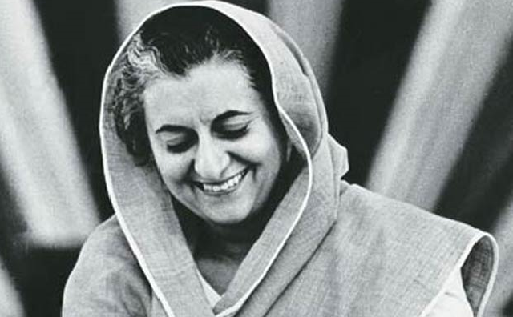
Question 3:

Slide 5
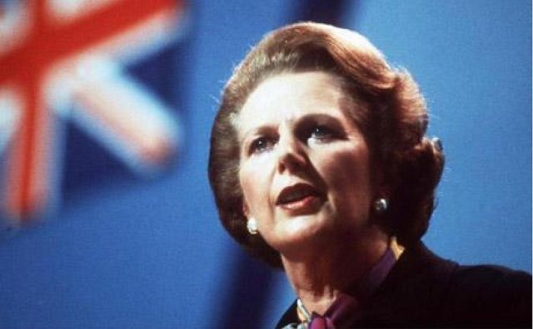
Question 4:

Slide 6
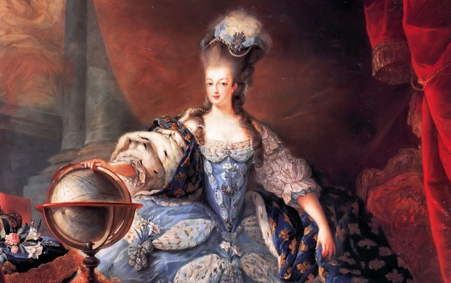
Question 5:

Slide 7
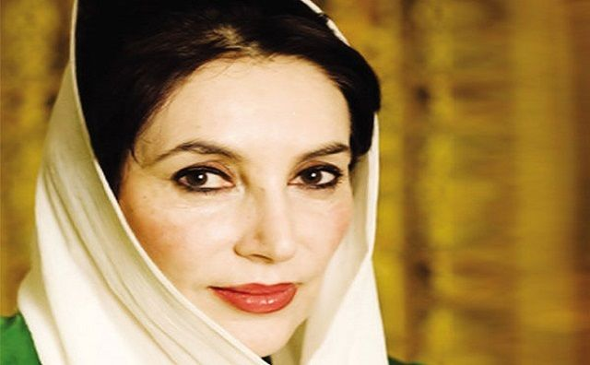
Question 6:

Slide 8
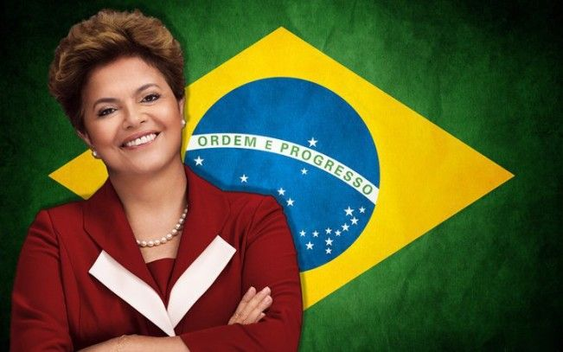
Question 7:

Slide 9
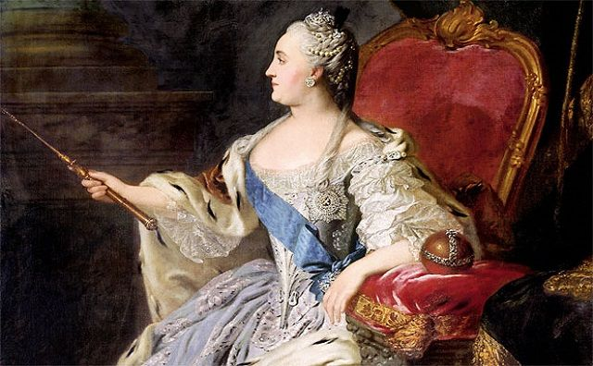
Question 8:

Slide 10
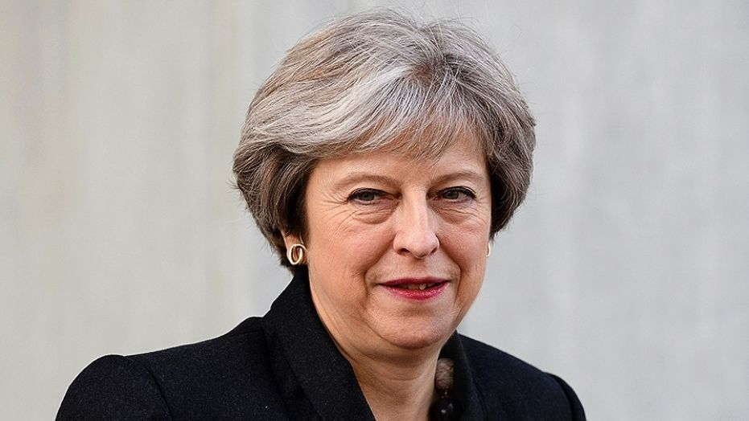
Question 9:

Slide 11
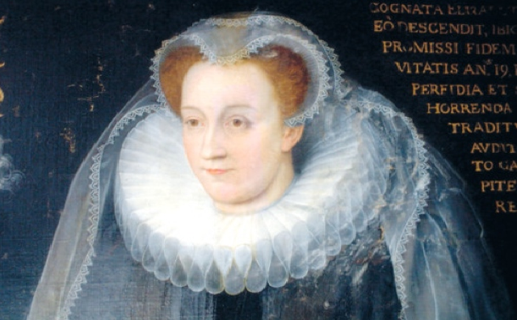
Question 10:

Slide 12
ANSWERS WILL BE PROVIDED SHORTLY

Slide 13
Question 1:
GOLDA MEIR

Slide 14
Question 2:
QUEEN VICTORIA

Slide 15
Question 3:
INDIRA GANDHI

Slide 16
Question 4:
MARGARET THATCHER

Slide 17
Question 5:
MARIE ANTOINETTE

Slide 18
Question 6:
BENAZIR BHUTTO

Slide 19
Question 7:
DILMA ROUSSEFF

Slide 20
Question 8:
CATHERINE THE GREAT

Slide 21
Question 9:
THERESA MAY

Slide 22
Question 10:
MARY, QUEEN OF SCOTS

