Slide 1
IDENTIFY THESE FAMOUS WOMEN IN THE ARTS

Slide 2
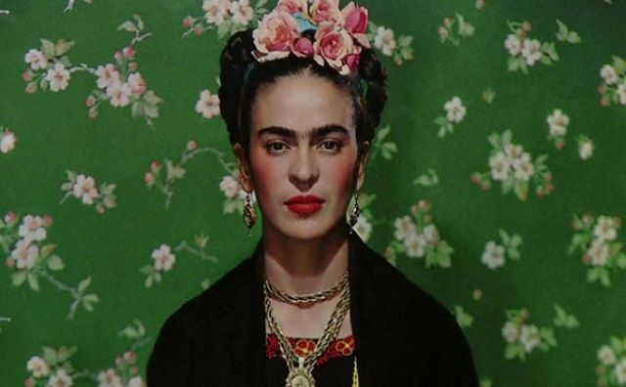
Question 1:

Slide 3
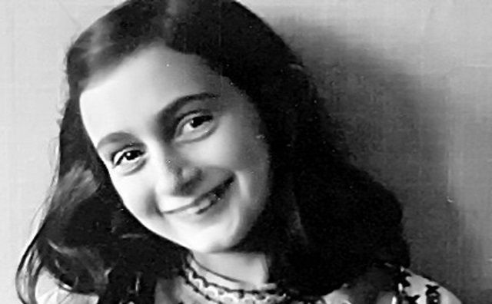
Question 2:

Slide 4
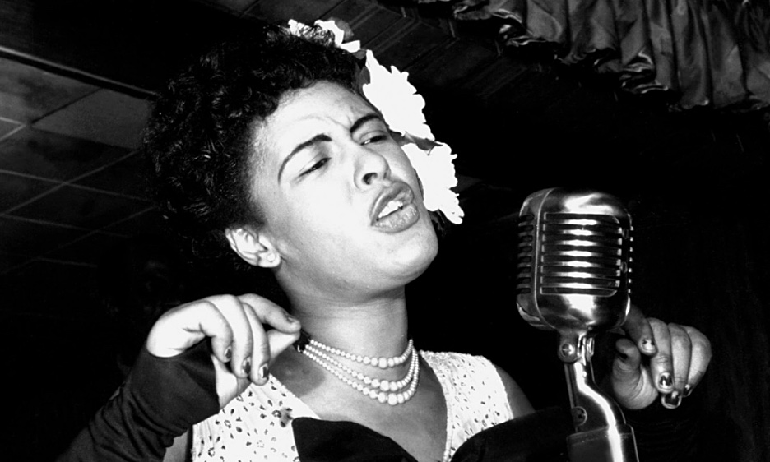
Question 3:

Slide 5
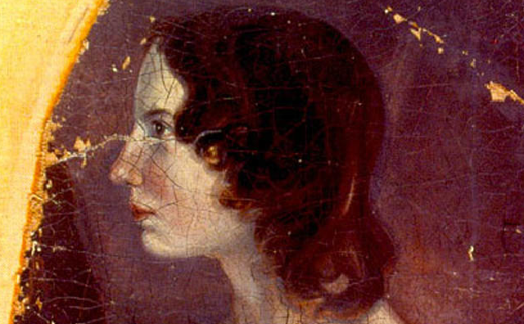
Question 4:

Slide 6
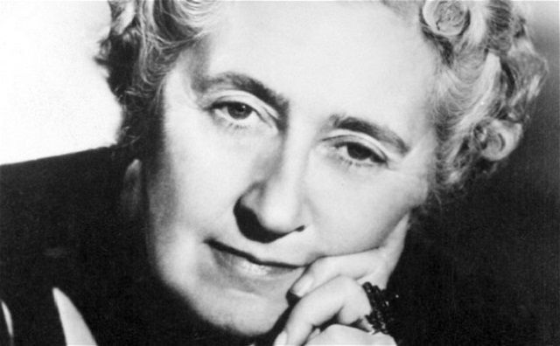
Question 5:

Slide 7
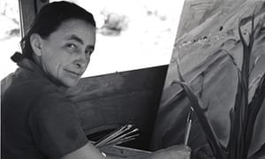
Question 6:

Slide 8
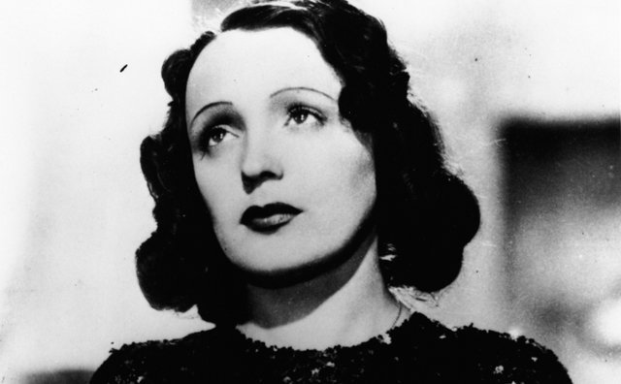
Question 7:

Slide 9
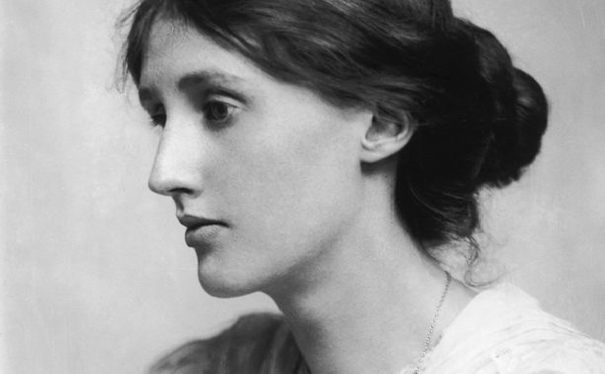
Question 8:

Slide 10
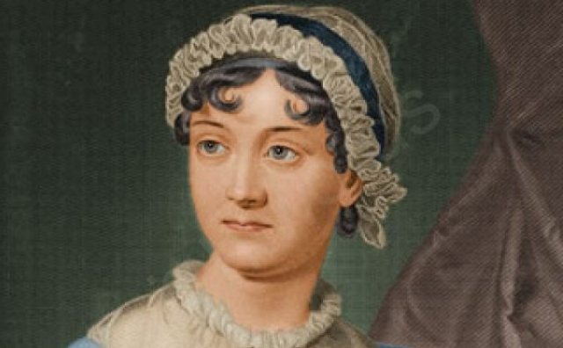
Question 9:

Slide 11
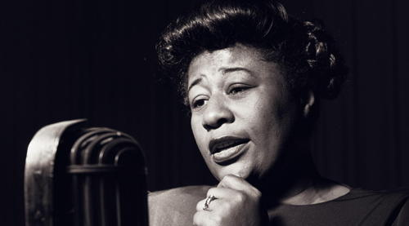
Question 10:

Slide 12
ANSWERS WILL BE PROVIDED SHORTLY

Slide 13
Question 1:
FRIDA KAHLO

Slide 14
Question 2:
ANNE FRANK

Slide 15
Question 3:
BILLIE HOLIDAY

Slide 16
Question 4:
EMILY BRONTË

Slide 17
Question 5:
AGATHA CHRISTIE

Slide 18
Question 6:
GEORGIA O'KEEFFE

Slide 19
Question 7:
ÉDITH PIAF

Slide 20
Question 8:
VIRGINIA WOOLF

Slide 21
Question 9:
JANE AUSTEN

Slide 22
Question 10:
ELLA FITZGERALD

