Slide 1
NAME THE TV SHOW THAT HAD THESE BROMANCES

Slide 2
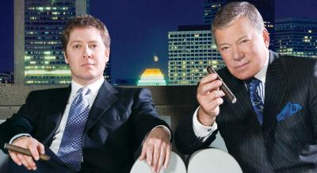
Question 1:

Slide 3
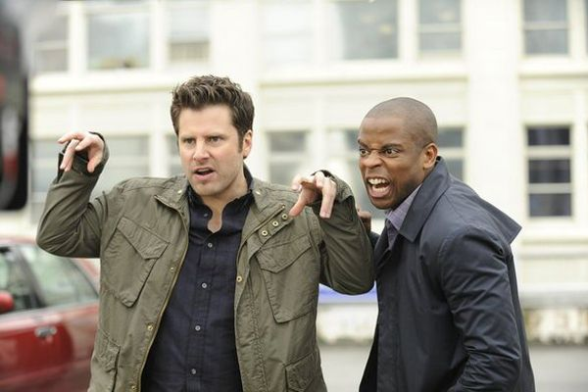
Question 2:

Slide 4
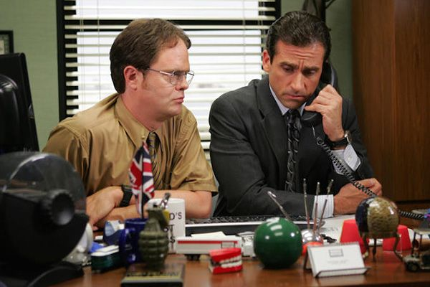
Question 3:

Slide 5
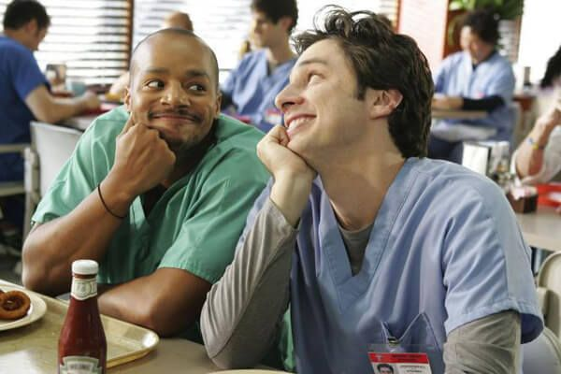
Question 4:

Slide 6
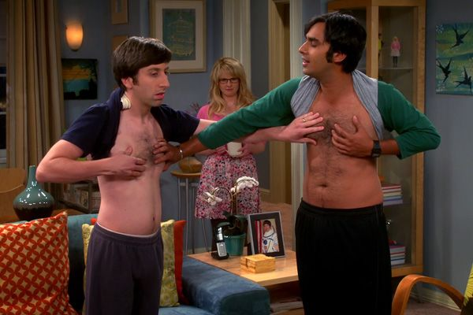
Question 5:

Slide 7
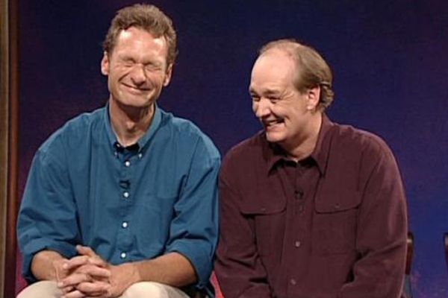
Question 6:

Slide 8
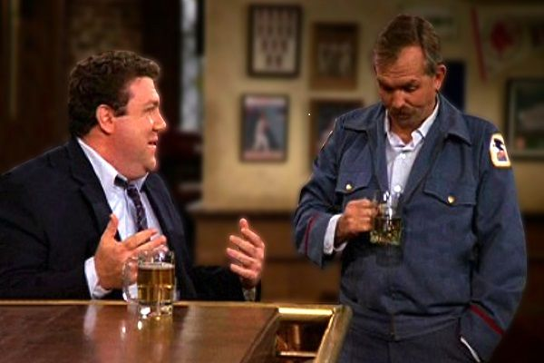
Question 7:

Slide 9
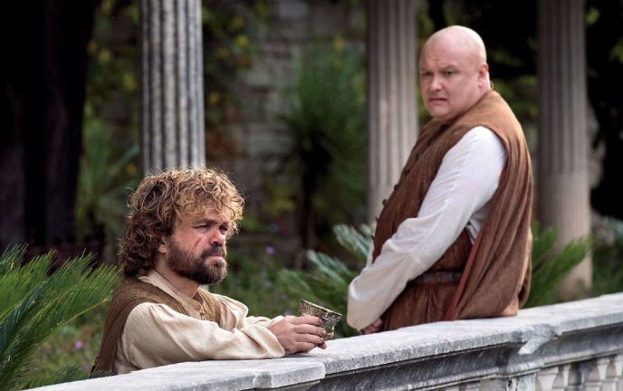
Question 8:

Slide 10
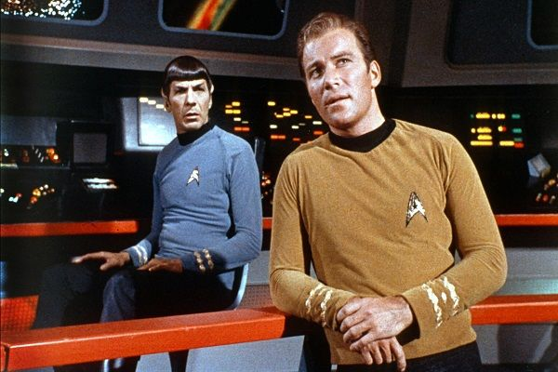
Question 9:

Slide 11
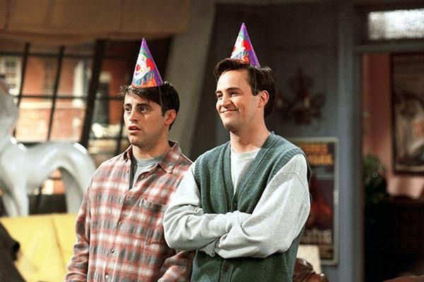
Question 10:

Slide 12
ANSWERS WILL BE PROVIDED SHORTLY

Slide 13
Question 1:
BOSTON LEGAL (ALAN & DENNY)

Slide 14
Question 2:
PSYCH (SHAWN & GUS)

Slide 15
Question 3:
THE OFFICE (DWIGHT & MICHAEL)

Slide 16
Question 4:
SCRUBS (TURK & J.D.)

Slide 17
Question 5:
THE BIG BANG THEORY (HOWARD & RAJ)

Slide 18
Question 6:
WHOSE LINE IS IT ANYWAY? (RYAN & COLIN)

Slide 19
Question 7:
CHEERS (NORM & CLIFF)

Slide 20
Question 8:
GAME OF THRONES (TYRION & VARYS)

Slide 21
Question 9:
STAR TREK (SPOCK & JIM)

Slide 22
Question 10:
FRIENDS (JOEY & CHANDLER)

