Slide 1
SAME INITIALS

Slide 2
Question 1:
THREE OF THE BEATLES WERE MARRIED TWICE. WHICH ONE WAS MARRIED THREE TIMES?

Slide 3
Question 2:
WHO REPLACED LARRY KING ON CNN FOR 3 YEARS?

Slide 4
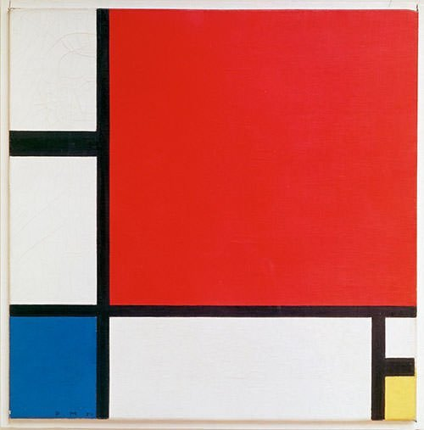
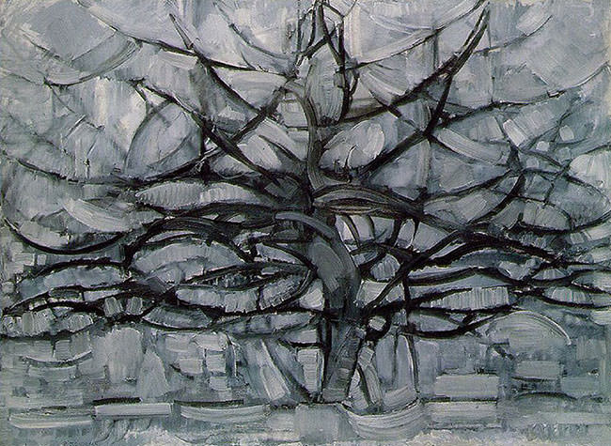
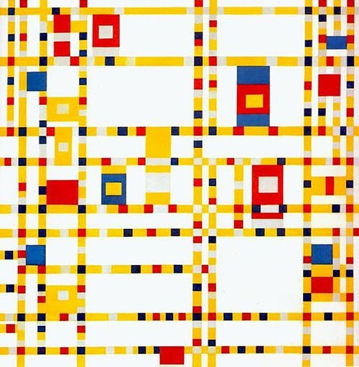
Question 3:
WHAT DUTCH ARTIST PAINTED THESE WORKS?

Slide 5
Question 4:
WHO WAS THE QUARTERBACK FOR THE INDIANAPOLIS COLTS 1998-2011?

Slide 6
Question 5:
WHAT PSYCHOLOGIST APPEARED WEEKLY ON "THE OPRAH WINFREY SHOW" BEFORE GETTING HIS OWN SHOW?

Slide 7
Question 6:
WHAT WAS THE FIRST WEEKLY HOUR-LONG SERIES ON TV?

Slide 8
Question 7:
WHO WAS THE FIRST WOMAN TO DIRECT A FILM THAT MADE MORE THAN $100 MILLION?

Slide 9
Question 8:
WHAT CAMPAIGN MANAGER OF DONALD TRUMP HAS BEEN SENTENCED TO 7 YEARS IN JAIL?

Slide 10
Question 9:
WHAT "LEFTY" WON EVERY MAJOR GOLF TOURNAMENT EXCEPT THE U.S. OPEN, WHERE HE FINISHED RUNNER-UP 6 TIMES?

Slide 11
Question 10:
WHO PLAYED JOHN STEED ON 6 SEASONS OF "THE AVENGERS"?

Slide 12
ANSWERS WILL BE PROVIDED SHORTLY

Slide 13
Question 1:
THREE OF THE BEATLES WERE MARRIED TWICE. WHICH ONE WAS MARRIED THREE TIMES?
PAUL MCCARTNEY

Slide 14
Question 2:
WHO REPLACED LARRY KING ON CNN FOR 3 YEARS?
PIERS MORGAN

Slide 15
Question 3:
WHAT DUTCH ARTIST PAINTED THESE WORKS?
PIET MONDRIAN

Slide 16
Question 4:
WHO WAS THE QUARTERBACK FOR THE INDIANAPOLIS COLTS 1998-2011?
PEYTON MANNING

Slide 17
Question 5:
WHAT PSYCHOLOGIST APPEARED WEEKLY ON "THE OPRAH WINFREY SHOW" BEFORE GETTING HIS OWN SHOW?
PHIL MCGRAW

Slide 18
Question 6:
WHAT WAS THE FIRST WEEKLY HOUR-LONG SERIES ON TV?
PERRY MASON

Slide 19
Question 7:
WHO WAS THE FIRST WOMAN TO DIRECT A FILM THAT MADE MORE THAN $100 MILLION?
PENNY MARSHALL

Slide 20
Question 8:
WHAT CAMPAIGN MANAGER OF DONALD TRUMP HAS BEEN SENTENCED TO 7 YEARS IN JAIL?
PAUL MANAFORT

Slide 21
Question 9:
WHAT "LEFTY" WON EVERY MAJOR GOLF TOURNAMENT EXCEPT THE U.S. OPEN, WHERE HE FINISHED RUNNER-UP 6 TIMES?
PHIL MICKELSON

Slide 22
Question 10:
WHO PLAYED JOHN STEED ON 6 SEASONS OF "THE AVENGERS"?
PATRICK MACNEE

