Slide 1
COMMON THREAD

Slide 2
Question 1:
WHICH COLOR OF THE RAINBOW IS NAMED FOR A DYE THAT THE ANCIENT GREEKS IMPORTED FROM ASIA?

Slide 3
Question 2:
COMPOSER FRÉDÉRIC CHOPIN IS BURIED IN PARIS, BUT HIS HEART WAS RETURNED TO WHAT COUNTRY OF HIS BIRTH?

Slide 4
Question 3:
WHO ENDOWED 5 AWARDS IN HOPES HE WOULDN'T BE REMEMBERED AS A "MERCHANT OF DEATH" FOR INVENTING DYNAMITE?

Slide 5
Question 4:
WHAT PLANET WAS DEMOTED TO "DWARF" STATUS BY THE IAU IN 2006?

Slide 6
Question 5:
WHAT U.S. STATE CONTAINS THE MOST SWIMMING POOLS?

Slide 7
Question 6:
WHAT COUNTRY IS THE MOST POPULAR TOURIST DESTINATION?

Slide 8
Question 7:
THE NORTHWEST AND MIDWEST CALL IT "POP". THE SOUTH CALLS IT "COKE". WHAT DOES NEW ENGLAND CALL IT?

Slide 9
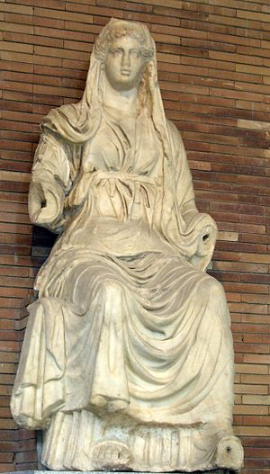
Question 8:
WHO WAS THE ROMAN GODDESS OF AGRICULTURE, WHO HAS AN ASTEROID NAMED FOR HER?

Slide 10
Question 9:
WHAT MARRIED COUPLE WON A NOBEL PRIZE IN 1903 FOR THE DISCOVERY OF RADIOACTIVITY?

Slide 11
Question 10:
WHAT DO ALL THESE ANSWERS HAVE IN COMMON?

Slide 12
ANSWERS WILL BE PROVIDED SHORTLY

Slide 13
Question 1:
WHICH COLOR OF THE RAINBOW IS NAMED FOR A DYE THAT THE ANCIENT GREEKS IMPORTED FROM ASIA?
INDIGO

Slide 14
Question 2:
COMPOSER FRÉDÉRIC CHOPIN IS BURIED IN PARIS, BUT HIS HEART WAS RETURNED TO WHAT COUNTRY OF HIS BIRTH?
POLAND

Slide 15
Question 3:
WHO ENDOWED 5 AWARDS IN HOPES HE WOULDN'T BE REMEMBERED AS A "MERCHANT OF DEATH" FOR INVENTING DYNAMITE?
ALFRED NOBEL

Slide 16
Question 4:
WHAT PLANET WAS DEMOTED TO "DWARF" STATUS BY THE IAU IN 2006?
PLUTO

Slide 17
Question 5:
WHAT U.S. STATE CONTAINS THE MOST SWIMMING POOLS?
CALIFORNIA

Slide 18
Question 6:
WHAT COUNTRY IS THE MOST POPULAR TOURIST DESTINATION?
FRANCE

Slide 19
Question 7:
THE NORTHWEST AND MIDWEST CALL IT "POP". THE SOUTH CALLS IT "COKE". WHAT DOES NEW ENGLAND CALL IT?
SODA

Slide 20
Question 8:
WHO WAS THE ROMAN GODDESS OF AGRICULTURE, WHO HAS AN ASTEROID NAMED FOR HER?
CERES

Slide 21
Question 9:
WHAT MARRIED COUPLE WON A NOBEL PRIZE IN 1903 FOR THE DISCOVERY OF RADIOACTIVITY?
MARIE AND PIERRE CURIE

Slide 22
Question 10:
WHAT DO ALL THESE ANSWERS HAVE IN COMMON?
CHEMICAL ELEMENTS ARE NAMED FOR THEM

