Slide 1
COMMON THREAD

Slide 2
Question 1:
WHAT NATURAL DISASTER CAUSED BY AN EARTHQUAKE KILLED MORE THAN 100,000 PEOPLE IN CHINA IN 1920?

Slide 3
Question 2:
WHAT 2006-2011 HBO SERIES STARRED BILL PULLMAN AS A POLYGAMIST?

Slide 4
Question 3:
WHAT IS THE LARGEST ARTESIAN SPRING IN THE WORLD AND THE SITE OF THE OLDEST COMMERCIAL TOURIST ATTRACTION IN FLORIDA?

Slide 5
Question 4:
WHAT IS THE FIRST NAME OF THE FEMALE POP STAR WHO SANG "LOVE SONG", "BRAVE", AND "KING OF ANYTHING"?

Slide 6
Question 5:
WHAT 1959 MUSICAL STARRING ETHEL MERMAN WAS MADE INTO A 1962 FILM STARRING ROSALIND RUSSELL AND NATALIE WOOD?

Slide 7
Question 6:
WHAT DID SIGMUND FREUD BELIEVE WERE MANIFESTATIONS OF ONE'S DEEPEST DESIRES AND ANXIETIES?

Slide 8
Question 7:
WHAT HIT SONG DID SARAH MCLACHLAN WRITE ABOUT THE HEROIN OVERDOSE OF THE SMASHING PUMPKINS KEYBOARDIST?

Slide 9
Question 8:
THE STATUE ATOP THE DOME OF THE U.S. CAPITOL BUILDING SINCE 1963 IS KNOWN AS THE STATUE OF WHAT?

Slide 10
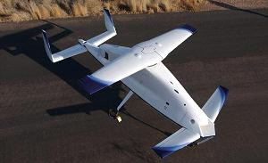
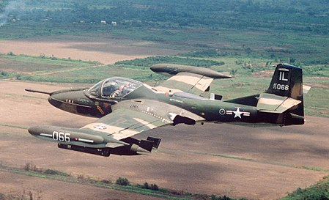
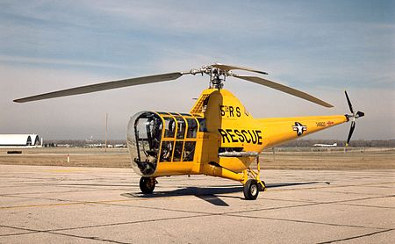
Question 9:
WHAT NICKNAME DO THESE AIRCRAFT HAVE?

Slide 11
Question 10:
WHAT DO ALL THESE ANSWERS HAVE IN COMMON?

Slide 12
ANSWERS WILL BE PROVIDED SHORTLY

Slide 13
Question 1:
WHAT NATURAL DISASTER CAUSED BY AN EARTHQUAKE KILLED MORE THAN 100,000 PEOPLE IN CHINA IN 1920?
LANDSLIDE

Slide 14
Question 2:
WHAT 2006-2011 HBO SERIES STARRED BILL PULLMAN AS A POLYGAMIST?
BIG LOVE

Slide 15
Question 3:
WHAT IS THE LARGEST ARTESIAN SPRING IN THE WORLD AND THE SITE OF THE OLDEST COMMERCIAL TOURIST ATTRACTION IN FLORIDA?
SILVER SPRINGS

Slide 16
Question 4:
WHAT IS THE FIRST NAME OF THE FEMALE POP STAR WHO SANG "LOVE SONG", "BRAVE", AND "KING OF ANYTHING"?
SARA (BAREILLES)

Slide 17
Question 5:
WHAT 1959 MUSICAL STARRING ETHEL MERMAN WAS MADE INTO A 1962 FILM STARRING ROSALIND RUSSELL AND NATALIE WOOD?
GYPSY

Slide 18
Question 6:
WHAT DID SIGMUND FREUD BELIEVE WERE MANIFESTATIONS OF ONE'S DEEPEST DESIRES AND ANXIETIES?
DREAMS

Slide 19
Question 7:
WHAT HIT SONG DID SARAH MCLACHLAN WRITE ABOUT THE HEROIN OVERDOSE OF THE SMASHING PUMPKINS KEYBOARDIST?
ANGEL

Slide 20
Question 8:
THE STATUE ATOP THE DOME OF THE U.S. CAPITOL BUILDING SINCE 1963 IS KNOWN AS THE STATUE OF WHAT?
FREEDOM

Slide 21
Question 9:
WHAT NICKNAME DO ALL THESE U.S. AIRCRAFT HAVE?
DRAGONFLY

Slide 22
Question 10:
WHAT DO ALL THESE ANSWERS HAVE IN COMMON?
NAMES OF FLEETWOOD MAC SONGS

