Slide 1
COMMON THREAD

Slide 2
Question 1:
WHAT IS THE FIRST NAME OF THE PERSON WHO HOSTED
"THE TONIGHT SHOW" AFTER JOHNNY CARSON?

Slide 3
Question 2:
WHAT IS EUROPE'S LARGEST PAY-TV BROADCASTER?

Slide 4
Question 3:
IN WHAT TYPE OF GOLF SHOT IS THE BALL HIT BRIEFLY INTO THE AIR OVER SOME OBSTACLE TO LAND AND ROLL ON THE GREEN?

Slide 5
Question 4:
WHAT ARE ENGLISH-SPEAKING PEOPLE, AS WELL AS THE RUSSIANS, SWISS, AND DUTCH, TOLD TO SAY WHEN THEIR PICTURE IS TAKEN?

Slide 6
Question 5:
WHAT DOES THE "B" STAND FOR IN THE MUSICAL ABBREVIATION "BS&T"?

Slide 7
Question 6:
WHAT 1999-2004 TV SERIES WAS A SPIN-OFF OF "BUFFY THE VAMPIRE SLAYER"?

Slide 8
Question 7:
WHAT IS THE LAST NAME OF THE FIRST U.S. SECRETARY OF HOMELAND SECURITY?

Slide 9
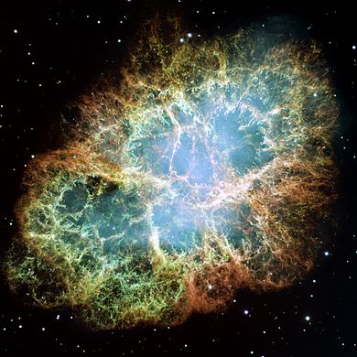
Question 8:
WHAT IS THE NAME OF THIS NEBULA, THE REMNANT OF A 1054 SUPERNOVA?

Slide 10
Question 9:
WHAT IS THE LAST WORD OF THE TITLE OF WALT WHITMAN'S MOST FAMOUS AND CONTROVERSIAL WORK?

Slide 11
Question 10:
WHAT DO ALL THESE ANSWERS HAVE IN COMMON?

Slide 12
ANSWERS WILL BE PROVIDED SHORTLY

Slide 13
Question 1:
WHAT IS THE FIRST NAME OF THE PERSON WHO HOSTED
"THE TONIGHT SHOW" AFTER JOHNNY CARSON?
JAY (LENO)

Slide 14
Question 2:
WHAT IS EUROPE'S LARGEST PAY-TV BROADCASTER?
SKY

Slide 15
Question 3:
IN WHAT TYPE OF GOLF SHOT IS THE BALL HIT BRIEFLY INTO THE AIR OVER SOME OBSTACLE TO LAND AND ROLL ON THE GREEN?
CHIP

Slide 16
Question 4:
WHAT ARE ENGLISH-SPEAKING PEOPLE, AS WELL AS THE RUSSIANS, SWISS, AND DUTCH, TOLD TO SAY WHEN THEIR PICTURE IS TAKEN?
CHEESE

Slide 17
Question 5:
WHAT DOES THE "B" STAND FOR IN THE MUSICAL ABBREVIATION "BS&T"?
BLOOD (SWEAT & TEARS)

Slide 18
Question 6:
WHAT 1999-2004 TV SERIES WAS A SPIN-OFF OF "BUFFY THE VAMPIRE SLAYER"?
ANGEL

Slide 19
Question 7:
WHAT IS THE LAST NAME OF THE FIRST U.S. SECRETARY OF HOMELAND SECURITY?
(TOM) RIDGE

Slide 20
Question 8:
WHAT IS THE NAME OF THIS NEBULA, THE REMNANT OF A 1054 SUPERNOVA?
CRAB

Slide 21
Question 9:
WHAT IS THE LAST WORD OF THE TITLE OF WALT WHITMAN'S MOST FAMOUS AND CONTROVERSIAL WORK?
(LEAVES OF) GRASS

Slide 22
Question 10:
WHAT DO ALL THESE ANSWERS HAVE IN COMMON?
THEY CAN ALL FOLLOW THE WORD "BLUE"

