Slide 1
COMMON THREAD: IDENTIFY THESE CELEBRITIES

Slide 2
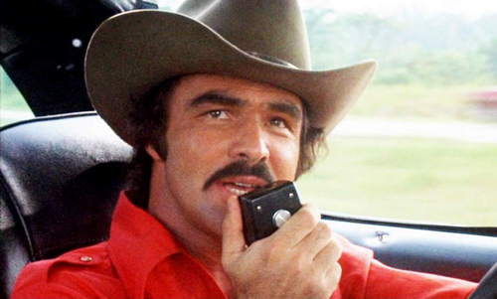
Question 1:

Slide 3
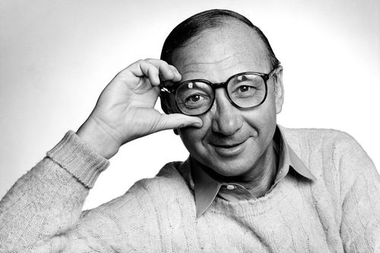
Question 2:

Slide 4
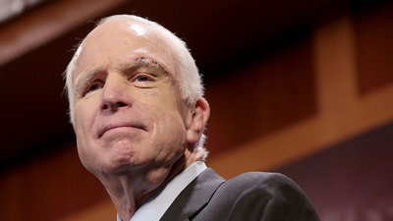
Question 3:

Slide 5
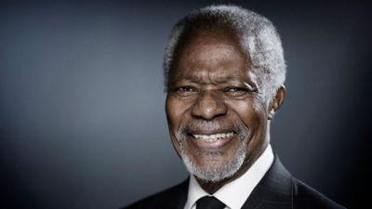
Question 4:

Slide 6
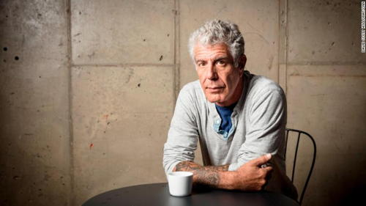
Question 5:

Slide 7
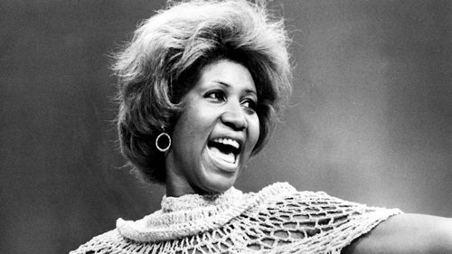
Question 6:

Slide 8
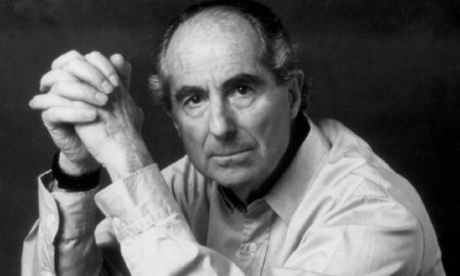
Question 7:

Slide 9
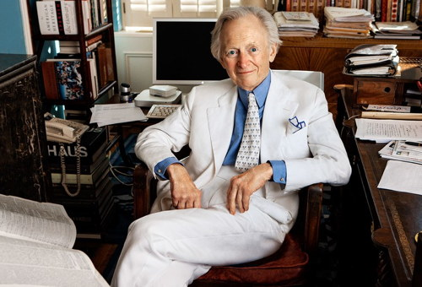
Question 8:

Slide 10
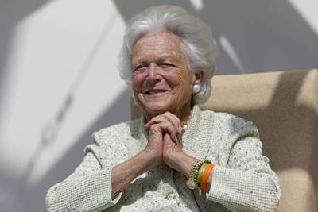
Question 9:

Slide 11
Question 10:
WHAT DO ALL THESE PEOPLE HAVE IN COMMON?

Slide 12
ANSWERS WILL BE PROVIDED SHORTLY

Slide 13
Question 1:
BURT REYNOLDS

Slide 14
Question 2:
NEIL SIMON

Slide 15
Question 3:
JOHN MCCAIN

Slide 16
Question 4:
KOFI ANNAN

Slide 17
Question 5:
ANTHONY BOURDAIN

Slide 18
Question 6:
ARETHA FRANKLIN

Slide 19
Question 7:
PHILIP ROTH

Slide 20
Question 8:
TOM WOLFE

Slide 21
Question 9:
BARBARA BUSH

Slide 22
Question 10:
WHAT DO ALL THESE PEOPLE HAVE IN COMMON?
THEY DIED IN 2018

