Slide 1
COMMON THREAD

Slide 2
Question 1:
WHAT PROHIBITION-ERA HARLEM WHITES-ONLY NIGHTCLUB IS FAMOUS FOR THE BLACK PERFORMERS WHO PLAYED THERE?

Slide 3
Question 2:
WHAT IS THE NICKNAME OF THE SHUTTLECOCK IN BADMINTON?

Slide 4
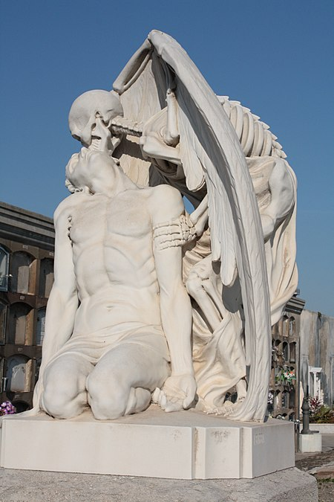
Question 3:
WHAT IS THE NAME OF THIS BARCELONA SCULPTURE?

Slide 5
Question 4:
WHAT IS THE NAME OF THE SEGMENT OF DISNEY’S "FANTASIA" STARRING MICKEY MOUSE?

Slide 6
Question 5:
WHAT TOP-10 SHERYL CROW SONG FROM THE ALBUM "TUESDAY NIGHT MUSIC CLUB" WAS HER FIRST PROMOTIONAL VIDEO?

Slide 7
Question 6:
WHAT IS THE RING NAME OF WRESTLER-TURNED-ACTOR DWAYNE JOHNSON?

Slide 8
Question 7:
HOW ARE THE SPORTS OF HOCKEY AND LACROSSE RESTARTED AFTER A GOAL?

Slide 9
Question 8:
WHAT IS THE NICKNAME OF DOUBLE-1’S IN THE GAME OF CRAPS?

Slide 10
Question 9:
THE EMPIRE STATE BUILDING WAS THE TALLEST BUILDING IN THE WORLD 1931-1972, UNTIL WHAT WAS BUILT?

Slide 11
Question 10:
WHAT DO ALL THESE ANSWERS HAVE IN COMMON?

Slide 12
ANSWERS WILL BE PROVIDED SHORTLY

Slide 13
Question 1:
WHAT PROHIBITION-ERA HARLEM WHITES-ONLY NIGHTCLUB IS FAMOUS FOR THE BLACK PERFORMERS WHO PLAYED THERE?
COTTON CLUB

Slide 14
Question 2:
WHAT IS THE NICKNAME OF THE SHUTTLECOCK IN BADMINTON?
BIRDIE

Slide 15
Question 3:
WHAT IS THE NAME OF THIS BARCELONA SCULPTURE?
THE KISS OF DEATH

Slide 16
Question 4:
WHAT IS THE NAME OF THE SEGMENT OF DISNEY’S "FANTASIA" STARRING MICKEY MOUSE?
THE SORCERER’S APPRENTICE

Slide 17
Question 5:
WHAT TOP-10 SHERYL CROW SONG FROM THE ALBUM "TUESDAY NIGHT MUSIC CLUB" WAS HER FIRST PROMOTIONAL VIDEO?
LEAVING LAS VEGAS

Slide 18
Question 6:
WHAT IS THE RING NAME OF WRESTLER-TURNED-ACTOR DWAYNE JOHNSON?
THE ROCK

Slide 19
Question 7:
HOW ARE THE SPORTS OF HOCKEY AND LACROSSE RESTARTED AFTER A GOAL?
FACE OFF

Slide 20
Question 8:
WHAT IS THE NICKNAME OF DOUBLE-1’S IN THE GAME OF CRAPS?
SNAKE EYES

Slide 21
Question 9:
THE EMPIRE STATE BUILDING WAS THE TALLEST BUILDING IN THE WORLD 1931-1972, UNTIL WHAT WAS BUILT?
WORLD TRADE CENTER

Slide 22
Question 10:
WHAT DO ALL THESE ANSWERS HAVE IN COMMON?
NAMES OF NICOLAS CAGE FILMS

