Slide 1
COMMON THREAD

Slide 2
Question 1:
WHAT COMPANY IS THE LARGEST PRODUCER OF FRUITS AND VEGETABLES?

Slide 3
Question 2:
WHAT IS THE TALLEST NORTH AMERICAN BIRD?

Slide 4
Question 3:
WHO SANG "TAKE ME HOME, COUNTRY ROADS"?

Slide 5
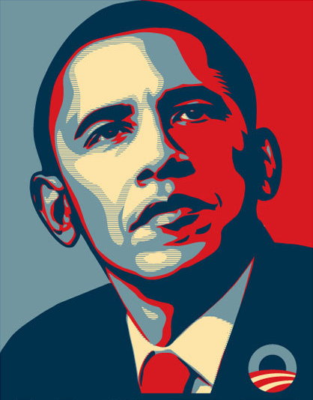
Question 4:
WHAT WORD APPEARED AT THE BOTTOM OF THIS POSTER?

Slide 6
Question 5:
WHAT GUITAR COMPANY MAKES THE LES PAUL, AND FILED FOR BANKRUPTCY IN 2018?

Slide 7
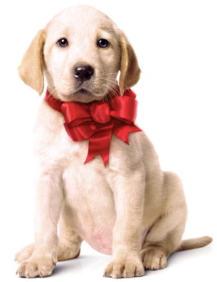
Question 6:
WHAT IS THE NAME OF THE FILM THIS DOG WAS IN?

Slide 8
Question 7:
WHO WAS RACHEL'S BOYFRIEND ON "FRIENDS"?

Slide 9
Question 8:
WHO PLAYED CAPTAIN AMERICA IN 8 FILMS?

Slide 10
Question 9:
WHAT WELSH POET WROTE "DO NOT GO GENTLE INTO THAT GOOD NIGHT"?

Slide 11
Question 10:
WHAT DO ALL THESE ANSWERS HAVE IN COMMON?

Slide 12
ANSWERS WILL BE PROVIDED SHORTLY

Slide 13
Question 1:
WHAT COMPANY IS THE LARGEST PRODUCER OF FRUITS AND VEGETABLES?
DOLE

Slide 14
Question 2:
WHAT IS THE TALLEST NORTH AMERICAN BIRD?
WHOOPING CRANE

Slide 15
Question 3:
WHO SANG "TAKE ME HOME, COUNTRY ROADS"?
JOHN DENVER

Slide 16
Question 4:
WHAT WORD APPEARED AT THE BOTTOM OF THIS POSTER?
HOPE

Slide 17
Question 5:
WHAT GUITAR COMPANY MAKES THE LES PAUL, AND FILED FOR BANKRUPTCY IN 2018?
GIBSON

Slide 18
Question 6:
WHAT IS THE NAME OF THE FILM THIS DOG WAS IN?
MARLEY & ME

Slide 19
Question 7:
WHO WAS RACHEL'S BOYFRIEND ON "FRIENDS"?
ROSS

Slide 20
Question 8:
WHO PLAYED CAPTAIN AMERICA IN 8 FILMS?
CHRIS EVANS

Slide 21
Question 9:
WHAT WELSH POET WROTE "DO NOT GO GENTLE INTO THAT GOOD NIGHT"?
DYLAN THOMAS

Slide 22
Question 10:
WHAT DO ALL THESE ANSWERS HAVE IN COMMON?
CONTAIN LAST NAMES OF PEOPLE NAMED BOB

