Slide 1
COMMON THREAD

Slide 2
Question 1:
WHAT 2004 FILM ABOUT RACIAL AND SOCIAL TENSIONS IN LOS ANGELES WON THE OSCAR FOR BEST PICTURE?

Slide 3
Question 2:
THE HOUSE OF COMMONS, THE HOUSE OF LORDS, AND THE QUEEN TOGETHER COMPRISE WHAT?

Slide 4
Question 3:
THE SIX FLAVORS OF QUARK ARE BOTTOM, TOP, DOWN, UP, STRANGE, AND WHAT?

Slide 5
Question 4:
WHOSE FOOTBALL TEAM IS THE BLACK KNIGHTS?

Slide 6
Question 5:
WHAT IS A SLIM, FLAT HANDBAG WITHOUT HANDLES CALLED?

Slide 7
Question 6:
IN WHAT 1930 HITCHCOCK FILM IS AN INNOCENT ACTRESS ON TRIAL FOR KILLING A TROUPE MEMBER?

Slide 8
Question 7:
WHAT GATHERING MARKS THE FORMAL BEGINNING OF THE YEAR AT MANY UNIVERSITIES?

Slide 9
Question 8:
WHICH OF THE 7 DEADLY SINS IS THOUGHT TO SEVER THE SOUL FROM GRACE?

Slide 10
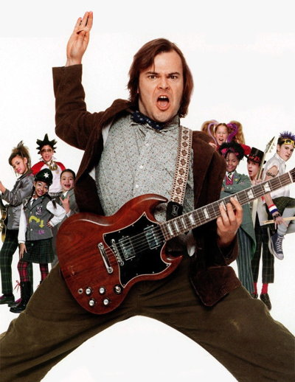
Question 9:
WHAT IS THE FIRST WORD IN THE TITLE OF THE FILM WITH THIS POSTER?

Slide 11
Question 10:
WHAT DO ALL THESE ANSWERS HAVE IN COMMON?

Slide 12
ANSWERS WILL BE PROVIDED SHORTLY

Slide 13
Question 1:
WHAT 2004 FILM ABOUT RACIAL AND SOCIAL TENSIONS IN LOS ANGELES WON THE OSCAR FOR BEST PICTURE?
CRASH

Slide 14
Question 2:
THE HOUSE OF COMMONS, THE HOUSE OF LORDS, AND THE QUEEN TOGETHER COMPRISE WHAT?
PARLIAMENT

Slide 15
Question 3:
THE SIX FLAVORS OF QUARK ARE BOTTOM, TOP, DOWN, UP, STRANGE, AND WHAT?
CHARM

Slide 16
Question 4:
WHOSE FOOTBALL TEAM IS THE BLACK KNIGHTS?
ARMY

Slide 17
Question 5:
WHAT IS A SLIM, FLAT HANDBAG WITHOUT HANDLES CALLED?
CLUTCH

Slide 18
Question 6:
IN WHAT 1930 HITCHCOCK FILM IS AN INNOCENT ACTRESS ON TRIAL FOR KILLING A TROUPE MEMBER?
MURDER!

Slide 19
Question 7:
WHAT GATHERING MARKS THE FORMAL BEGINNING OF THE YEAR AT MANY UNIVERSITIES?
CONVOCATION

Slide 20
Question 8:
WHICH OF THE 7 DEADLY SINS IS THOUGHT TO SEVER THE SOUL FROM GRACE?
PRIDE

Slide 21
Question 9:
WHAT IS THE FIRST WORD IN THE TITLE OF THE FILM WITH THIS POSTER?
SCHOOL (OF ROCK)

Slide 22
Question 10:
WHAT DO ALL THESE ANSWERS HAVE IN COMMON?
COLLECTIVE NOUNS OF ANIMALS

