Slide 1
COMMON THREAD

Slide 2
Question 1:
WHO WROTE "ORLANDO", "TO THE LIGHTHOUSE", AND "MRS. DALLOWAY"?

Slide 3
Question 2:
WHO WROTE "THE LEGEND OF SLEEPY HOLLOW"?

Slide 4
Question 3:
WHO WAS THE ALTER EGO OF MILEY CYRUS 2006-2011?

Slide 5
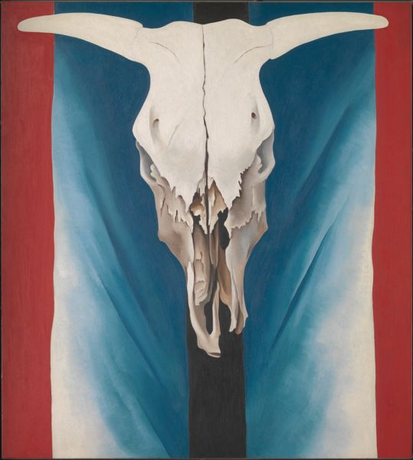
Question 4:
WHO PAINTED THIS PAINTING?

Slide 6
Question 5:
WHO WAS THE YOUNGEST SAG AWARD NOMINEE EVER, AT AGE 8, FOR HER ROLE IN "I AM SAM"?

Slide 7
Question 6:
WHO WROTE "CAT ON A HOT TIN ROOF"?

Slide 8
Question 7:
WHO WAS THE PROTAGONIST OF "RAIDERS OF THE LOST ARK"?

Slide 9
Question 8:
WHAT VENEZUELAN FASHION DESIGNER FOUNDED A LUXURY CLOTHING LINE WORN BY 3 FIRST LADIES?

Slide 10
Question 9:
WHAT RAPPER'S REAL NAME IS TRAMAR LACEL DILLARD?

Slide 11
Question 10:
WHAT DO ALL THESE ANSWERS HAVE IN COMMON?

Slide 12
ANSWERS WILL BE PROVIDED SHORTLY

Slide 13
Question 1:
WHO WROTE "ORLANDO", "TO THE LIGHTHOUSE", AND "MRS. DALLOWAY"?
VIRGINIA WOOLF

Slide 14
Question 2:
WHO WROTE "THE LEGEND OF SLEEPY HOLLOW"?
WASHINGTON IRVING

Slide 15
Question 3:
WHO WAS THE ALTER EGO OF MILEY CYRUS 2006-2011?
HANNAH MONTANA

Slide 16
Question 4:
WHO PAINTED THIS PAINTING?
GEORGIA O'KEEFFE

Slide 17
Question 5:
WHO WAS THE YOUNGEST SAG AWARD NOMINEE EVER, AT AGE 8, FOR HER ROLE IN "I AM SAM"?
DAKOTA FANNING

Slide 18
Question 6:
WHO WROTE "CAT ON A HOT TIN ROOF"?
TENNESSEE WILLIAMS

Slide 19
Question 7:
WHO WAS THE PROTAGONIST OF "RAIDERS OF THE LOST ARK"?
INDIANA JONES

Slide 20
Question 8:
WHAT VENEZUELAN FASHION DESIGNER FOUNDED A LUXURY CLOTHING LINE WORN BY 3 FIRST LADIES?
CAROLINA HERRERA

Slide 21
Question 9:
WHAT RAPPER'S REAL NAME IS TRAMAR LACEL DILLARD?
FLO RIDA

Slide 22
Question 10:
WHAT DO ALL THESE ANSWERS HAVE IN COMMON?
CONTAIN NAMES OF STATES

