Slide 1
COMMON THREAD

Slide 2
Question 1:
WHAT IS THE LONGEST DOORS SONG, OVER 11 MINUTES LONG?

Slide 3
Question 2:
WHAT TV SHOW WAS PETER KRAUSE ON BEFORE HIS CURRENT SHOW, "9-1-1", BUT AFTER "SIX FEET UNDER"?

Slide 4
Question 3:
WHAT 1971 ROMANTIC FILM DIRECTED BY INGMAR BERGMAN STARRED ELLIOT GOULD, BIBI ANDERSSON, AND MAX VON SYDOW?

Slide 5
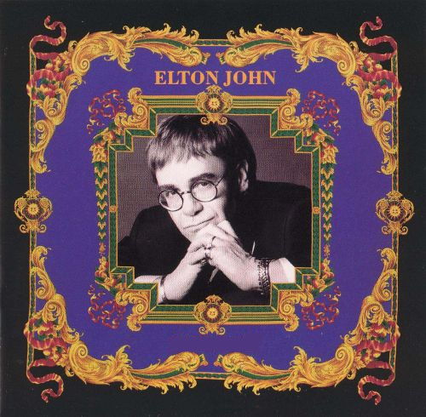
Question 4:
WHAT IS THE NAME OF THIS 1992 ELTON JOHN ALBUM?

Slide 6
Question 5:
WHO TAUGHT THE SUPERHERO DAREDEVIL TO FIGHT?

Slide 7
Question 6:
WHAT 2001 FILM ABOUT COCAINE STARRED JOHNNY DEPP AND PENÉLOPE CRUZ?

Slide 8
Question 7:
WHAT WAS THE NAME OF SAPPHIRE'S 1996 DEBUT NOVEL, MADE INTO A FILM IN 2009?

Slide 9
Question 8:
WHAT 1991 FANTASY FILM STARRED ROBIN WILLIAMS, JULIA ROBERTS, AND DUSTIN HOFFMAN IN THE TITLE ROLE?

Slide 10
Question 9:
WHAT REGION OF A GOLF COURSE HAS GRASS THAT IS COURSER AND HIGHER THAN ON THE FAIRWAY OR GREEN?

Slide 11
Question 10:
WHAT DO ALL THESE ANSWERS (WITHOUT THE WORD "THE") HAVE IN COMMON?

Slide 12
ANSWERS WILL BE PROVIDED SHORTLY

Slide 13
Question 1:
WHAT IS THE LONGEST DOORS SONG, OVER 11 MINUTES LONG?
THE END

Slide 14
Question 2:
WHAT TV SHOW WAS PETER KRAUSE ON BEFORE HIS CURRENT SHOW, "9-1-1", BUT AFTER "SIX FEET UNDER"?
THE CATCH

Slide 15
Question 3:
WHAT 1971 ROMANTIC FILM DIRECTED BY INGMAR BERGMAN STARRED ELLIOT GOULD, BIBI ANDERSSON, AND MAX VON SYDOW?
THE TOUCH

Slide 16
Question 4:
WHAT IS THE NAME OF THIS 1992 ELTON JOHN ALBUM?
THE ONE

Slide 17
Question 5:
WHO TAUGHT THE SUPERHERO DAREDEVIL TO FIGHT?
STICK

Slide 18
Question 6:
WHAT 2001 FILM ABOUT COCAINE STARRED JOHNNY DEPP AND PENÉLOPE CRUZ?
BLOW

Slide 19
Question 7:
WHAT WAS THE NAME OF SAPPHIRE'S 1996 DEBUT NOVEL, MADE INTO A FILM IN 2009?
PUSH

Slide 20
Question 8:
WHAT 1991 FANTASY FILM STARRED ROBIN WILLIAMS, JULIA ROBERTS, AND DUSTIN HOFFMAN IN THE TITLE ROLE?
HOOK

Slide 21
Question 9:
WHAT REGION OF A GOLF COURSE HAS GRASS THAT IS COURSER AND HIGHER THAN ON THE FAIRWAY OR GREEN?
THE ROUGH

Slide 22
Question 10:
WHAT DO ALL THESE ANSWERS (WITHOUT THE WORD "THE") HAVE IN COMMON?
CAN BE FOLLOWED BY THE WORD "UP"

