Slide 1
COMMON THREAD

Slide 2
Question 1:
IN THE 2000 PRESIDENTIAL ELECTION, WHAT WAS AN INCOMPLETELY PUNCHED HOLE ON A PUNCH CARD BALLOT CALLED?

Slide 3
Question 2:
WHAT DID BENJAMIN FRANKLIN WANT TO BE THE UNITED STATES NATIONAL BIRD?

Slide 4
Question 3:
WHAT U.S. STATE PRODUCES THE MOST PEANUTS?

Slide 5
Question 4:
WHO WAS A CAST MEMBER ON MAD TV, AND STARRED WITH KEEGAN-MICHAEL KEY IN A COMEDY SERIES, BOTH FOR 5 YEARS?

Slide 6
Question 5:
WHAT ARE THE 2ND MOST POPULAR GIRL SCOUT COOKIES, AFTER THIN MINTS?

Slide 7
Question 6:
WHAT IVY LEAGUE SCHOOL WAS CALLED KING'S COLLEGE BEFORE THE REVOLUTIONARY WAR?

Slide 8
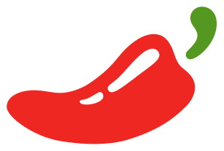
Question 7:
WHOSE LOGO IS THIS?

Slide 9
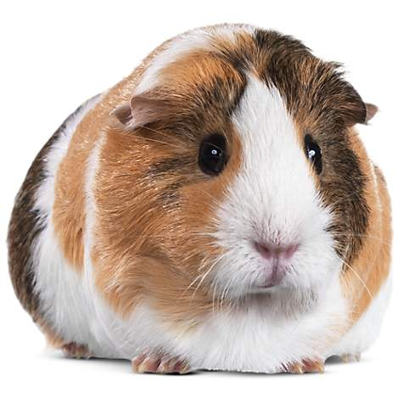
Question 8:
WHAT ANIMAL IS THIS?

Slide 10
Question 9:
THE 2 BEST-SELLING ALBUMS OF 1978 WERE "SATURDAY NIGHT FEVER" AND WHAT OTHER JOHN TRAVOLTA SOUNDTRACK?

Slide 11
Question 10:
WHAT DO ALL THESE ANSWERS HAVE IN COMMON?

Slide 12
ANSWERS WILL BE PROVIDED SHORTLY

Slide 13
Question 1:
IN THE 2000 PRESIDENTIAL ELECTION, WHAT WAS AN INCOMPLETELY PUNCHED HOLE ON A PUNCH CARD BALLOT CALLED?
HANGING CHAD

Slide 14
Question 2:
WHAT DID BENJAMIN FRANKLIN WANT TO BE THE UNITED STATES NATIONAL BIRD?
TURKEY

Slide 15
Question 3:
WHAT U.S. STATE PRODUCES THE MOST PEANUTS?
GEORGIA

Slide 16
Question 4:
WHO WAS A CAST MEMBER ON MAD TV, AND STARRED WITH KEEGAN-MICHAEL KEY IN A COMEDY SERIES, BOTH FOR 5 YEARS?
JORDAN PEELE

Slide 17
Question 5:
WHAT ARE THE 2ND MOST POPULAR GIRL SCOUT COOKIES, AFTER THIN MINTS?
SAMOAS

Slide 18
Question 6:
WHAT IVY LEAGUE SCHOOL WAS CALLED KING'S COLLEGE BEFORE THE REVOLUTIONARY WAR?
COLUMBIA UNIVERSITY

Slide 19
Question 7:
WHOSE LOGO IS THIS?
CHILI'S

Slide 20
Question 8:
WHAT ANIMAL IS THIS?
GUINEA PIG

Slide 21
Question 9:
THE 2 BEST-SELLING ALBUMS OF 1978 WERE "SATURDAY NIGHT FEVER" AND WHAT OTHER JOHN TRAVOLTA SOUNDTRACK?
GREASE

Slide 22
Question 10:
WHAT DO ALL THESE ANSWERS HAVE IN COMMON?
CONTAIN NAMES (OR HOMOPHONES) OF COUNTRIES

