Slide 1
COMMON THREAD

Slide 2
Question 1:
WHAT VEGETABLE DID GREGOR MENDEL STUDY TO DISCOVER THE LAWS OF HEREDITY?

Slide 3
Question 2:
THE MYERS-BRIGGS TEST IS AN INVENTORY OF 16 BASIC TYPES OF WHAT?

Slide 4
Question 3:
WHAT SHRINKING SUPERHERO WITH A TEENY-TINY NAME IS THE ALTER EGO OF DR. RAY PALMER?

Slide 5
Question 4:
IN SUBTRACTION, A NUMBER CALLED THE SUBTRAHEND IS TAKEN AWAY FROM THE MINUEND. WHAT IS THE RESULT CALLED?

Slide 6
Question 5:
WHAT BASIC VERB FORMS ARE FORMED IN ENGLISH BY PUTTING THE WORD "TO" BEFORE THE VERB?

Slide 7
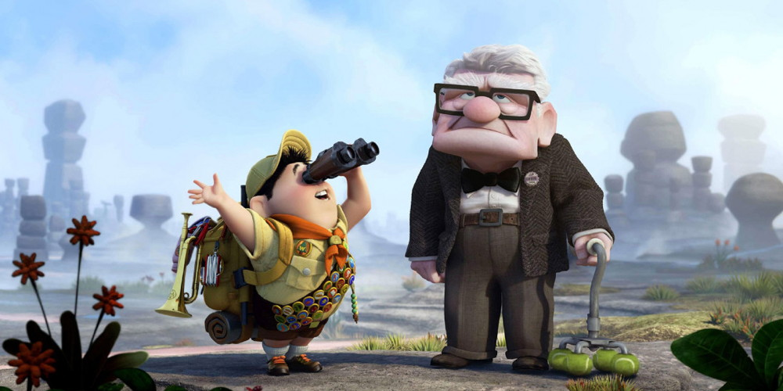
Question 6:
WHAT FILM FEATURES THESE CHARACTERS?

Slide 8
Question 7:
THERE ARE 360 DEGREES IN A CIRCLE. WHAT IS 1/3600TH OF A DEGREE CALLED?

Slide 9
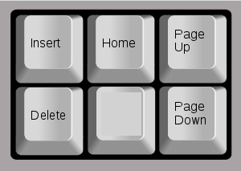
Question 8:
WHAT KEY ON MOST KEYBOARDS IS RIGHT BELOW THE "HOME" KEY?

Slide 10
Question 9:
IN BASKETBALL, A BLOCKING MOVE IS KNOWN AS A "PICK" OR WHAT OTHER TERM?

Slide 11
Question 10:
WHAT DO ALL THESE ANSWERS HAVE IN COMMON?

Slide 12
ANSWERS WILL BE PROVIDED SHORTLY

Slide 13
Question 1:
WHAT VEGETABLE DID GREGOR MENDEL STUDY TO DISCOVER THE LAWS OF HEREDITY?
PEAS

Slide 14
Question 2:
THE MYERS-BRIGGS TEST IS AN INVENTORY OF 16 BASIC TYPES OF WHAT?
PERSONALITY

Slide 15
Question 3:
WHAT SHRINKING SUPERHERO WITH A TEENY-TINY NAME IS THE ALTER EGO OF DR. RAY PALMER?
THE ATOM

Slide 16
Question 4:
IN SUBTRACTION, A NUMBER CALLED THE SUBTRAHEND IS TAKEN AWAY FROM THE MINUEND. WHAT IS THE RESULT CALLED?
THE DIFFERENCE

Slide 17
Question 5:
WHAT BASIC VERB FORMS ARE FORMED IN ENGLISH BY PUTTING THE WORD "TO" BEFORE THE VERB?
INFINITIVES

Slide 18
Question 6:
WHAT FILM FEATURES THESE CHARACTERS?
UP

Slide 19
Question 7:
THERE ARE 360 DEGREES IN A CIRCLE. WHAT IS 1/3600TH OF A DEGREE CALLED?
SECOND

Slide 20
Question 8:
WHAT KEY ON MOST KEYBOARDS IS RIGHT BELOW THE "HOME" KEY?
END

Slide 21
Question 9:
IN BASKETBALL, A BLOCKING MOVE IS KNOWN AS A "PICK" OR WHAT OTHER TERM?
SCREEN

Slide 22
Question 10:
WHAT DO ALL THESE ANSWERS HAVE IN COMMON?
THEY CAN FOLLOW "SPLIT"

