Slide 1
COMMON THREAD

Slide 2
Question 1:
WHAT IS THE FIRST NAME OF THE ACTOR WHO STARRED IN "DRIVING MISS DAISY" AND "THE SHAWSHANK REDEMPTION"?

Slide 3
Question 2:
WHAT IS THE EXERCISE THAT CONSISTS OF HALF OF A SIT-UP CALLED?

Slide 4
Question 3:
WHAT IS THE NAME OF THE CLOWN FISH THAT STARRED IN A 2003 ANIMATED FILM?

Slide 5
Question 4:
WHAT ANIMAL IS THE NATIONAL SYMBOL OF AUSTRALIA?

Slide 6
Question 5:
WHAT COUNTY IS CHICAGO LOCATED IN?

Slide 7
Question 6:
WHAT CANADIAN RAPPER SANG "ONE DANCE", "WORK", AND "HOTLINE BLING"?

Slide 8
Question 7:
WHAT GROUP SANG "HORSE WITH NO NAME" AND VENTURA HIGHWAY"?

Slide 9
Question 8:
WHAT IS THE FIRST NAME OF THE QUARTERBACK WHO STARTED FOR THE REDSKINS 2015-2017 AND THE VIKINGS EVER SINCE?

Slide 10
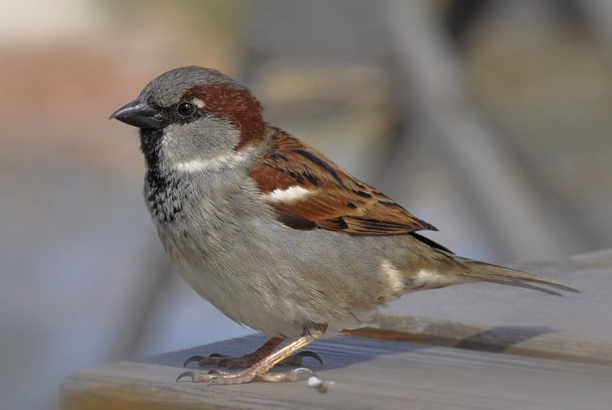
Question 9:
WHAT FAMILY OF BIRD IS THIS?

Slide 11
Question 10:
WHAT DO ALL THESE ANSWERS HAVE IN COMMON?

Slide 12
ANSWERS WILL BE PROVIDED SHORTLY

Slide 13
Question 1:
WHAT IS THE FIRST NAME OF THE ACTOR WHO STARRED IN "DRIVING MISS DAISY" AND "THE SHAWSHANK REDEMPTION"?
MORGAN (FREEMAN)

Slide 14
Question 2:
WHAT IS THE EXERCISE THAT CONSISTS OF HALF OF A SIT-UP CALLED?
CRUNCH

Slide 15
Question 3:
WHAT IS THE NAME OF THE CLOWN FISH THAT STARRED IN A 2003 ANIMATED FILM?
NEMO

Slide 16
Question 4:
WHAT ANIMAL IS THE NATIONAL SYMBOL OF AUSTRALIA?
KANGAROO

Slide 17
Question 5:
WHAT COUNTY IS CHICAGO LOCATED IN?
COOK

Slide 18
Question 6:
WHAT CANADIAN RAPPER SANG "ONE DANCE", "WORK", AND "HOTLINE BLING"?
DRAKE

Slide 19
Question 7:
WHAT GROUP SANG "HORSE WITH NO NAME" AND VENTURA HIGHWAY"?
AMERICA

Slide 20
Question 8:
WHAT IS THE FIRST NAME OF THE QUARTERBACK WHO STARTED FOR THE REDSKINS 2015-2017 AND THE VIKINGS EVER SINCE?
KIRK (COUSINS)

Slide 21
Question 9:
WHAT FAMILY OF BIRD IS THIS?
SPARROW

Slide 22
Question 10:
WHAT DO ALL THESE ANSWERS HAVE IN COMMON?
THEY ARE ALL CAPTAINS

