Slide 1
PEOPLE COMMON THREAD

Slide 2
Question 1:
WHO WROTE "THE NAKED AND THE DEAD", "ARMIES OF THE NIGHT", AND "THE EXECUTIONER'S SONG"?

Slide 3
Question 2:
WHAT GROUP DID KEITH RICHARDS PLAY GUITAR FOR?

Slide 4
Question 3:
WHAT WAS THE BEST-SELLING MUSIC GROUP OF ALL TIME?

Slide 5
Question 4:
WHO WROTE "ATLAS SHRUGGED"?

Slide 6
Question 5:
WHO CO-WROTE AND PRODUCED "YOU'VE LOST THAT LOVIN' FEELING", THE RIGHTEOUS BROTHERS SONG THAT RECEIVED THE MOST AIRPLAY IN THE U.S. IN THE 20TH CENTURY?

Slide 7
Question 6:
WHAT SATIRICAL COMEDIAN WAS CONVICTED OF VULGARITY IN 1964, BUT PARDONED POSTHUMOUSLY?

Slide 8
Question 7:
WHAT WELSH POET WROTE "DO NOT GO GENTLE INTO THAT GOOD NIGHT"?

Slide 9
Question 8:
WHAT SINGER-SONGWRITER WAS BORN ROBERT ALLEN ZIMMERMAN?

Slide 10
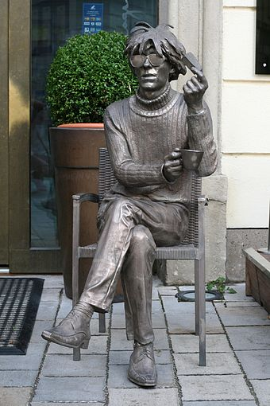
Question 9:
THIS STATUE LOCATED IN BRATISLAVA, SLOVAKIA IS OF WHAT POP ARTIST?

Slide 11
Question 10:
WHAT DO ALL THESE PEOPLE HAVE IN COMMON?

Slide 12
ANSWERS WILL BE PROVIDED SHORTLY

Slide 13
Question 1:
WHO WROTE "THE NAKED AND THE DEAD", "ARMIES OF THE NIGHT", AND "THE EXECUTIONER'S SONG"?
NORMAN MAILER

Slide 14
Question 2:
WHAT GROUP DID KEITH RICHARDS PLAY GUITAR FOR?
THE ROLLING STONES

Slide 15
Question 3:
WHAT WAS THE BEST-SELLING MUSIC GROUP OF ALL TIME?
THE BEATLES

Slide 16
Question 4:
WHO WROTE "ATLAS SHRUGGED"?
AYN RAND

Slide 17
Question 5:
WHO CO-WROTE AND PRODUCED "YOU'VE LOST THAT LOVIN' FEELING", THE RIGHTEOUS BROTHERS SONG THAT RECEIVED THE MOST AIRPLAY IN THE U.S. IN THE 20TH CENTURY?
PHIL SPECTOR

Slide 18
Question 6:
WHAT SATIRICAL COMEDIAN WAS CONVICTED OF VULGARITY IN 1964, BUT PARDONED POSTHUMOUSLY?
LENNY BRUCE

Slide 19
Question 7:
WHAT WELSH POET WROTE "DO NOT GO GENTLE INTO THAT GOOD NIGHT"?
DYLAN THOMAS

Slide 20
Question 8:
WHAT SINGER-SONGWRITER WAS BORN ROBERT ALLEN ZIMMERMAN?
BOB DYLAN

Slide 21
Question 9:
THIS STATUE LOCATED IN BRATISLAVA, SLOVAKIA IS OF WHAT POP ARTIST?
ANDY WARHOL

Slide 22
Question 10:
WHAT DO ALL THESE PEOPLE HAVE IN COMMON?
MENTIONED IN THE SIMON & GARFUNKEL SONG "A SIMPLE DESULTORY PHILIPPIC"

