Slide 1
COMMON THREAD

Slide 2
Question 1:
IN THE SONG "TWELVE DAYS OF CHRISTMAS", WHAT NEW GIFT IS GIVEN ON DAY THREE?

Slide 3
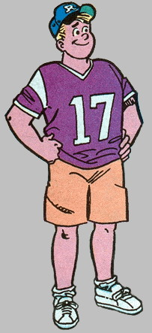
Question 2:
WHO IS THIS ARCHIE COMICS CHARACTER?

Slide 4
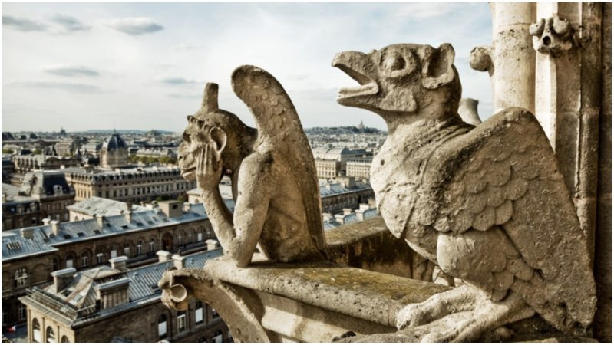
Question 3:
THESE STATUES ON NOTRE DAME ARE CALLED WHAT?

Slide 5
Question 4:
AMONG THE MOST POPULAR SUSHI ROLLS, WHAT ROLL CONSISTS OF AVOCADO, CRAB, AND CUCUMBER?

Slide 6
Question 5:
WHAT MYTHICAL ANIMAL, A RABBIT WITH HORNS, IS A POPULAR MYTH AND MEME IN WYOMING?

Slide 7
Question 6:
WHAT WEED'S NAME MEANS "LION'S TOOTH"?

Slide 8
Question 7:
WHAT FORD PONY CAR IS NOW THE LONGEST-PRODUCED FORD NAMPLATE?

Slide 9
Question 8:
IN GREEK MYTHOLOGY, WHAT FEMALE CREATURE HAD SNAKES INSTEAD OF HAIR?

Slide 10
Question 9:
SINCE 2004, TRAVELOCITY HAS USED WHAT OBJECT IN MUCH OF THEIR ADVERTISING?

Slide 11
Question 10:
WHAT DO ALL THESE ANSWERS HAVE IN COMMON?

Slide 12
ANSWERS WILL BE PROVIDED SHORTLY

Slide 13
Question 1:
IN THE SONG "TWELVE DAYS OF CHRISTMAS", WHAT NEW GIFT IS GIVEN ON DAY THREE?
FRENCH HENS

Slide 14
Question 2:
WHO IS THIS ARCHIE COMICS CHARACTER?
MOOSE

Slide 15
Question 3:
THESE STATUES ON NOTRE DAME ARE CALLED WHAT?
GARGOYLES

Slide 16
Question 4:
AMONG THE MOST POPULAR SUSHI ROLLS, WHAT ROLL CONSISTS OF AVOCADO, CRAB, AND CUCUMBER?
CALIFORNIA ROLL

Slide 17
Question 5:
WHAT MYTHICAL ANIMAL, A RABBIT WITH HORNS, IS A POPULAR MYTH AND MEME IN WYOMING?
JACKALOPE

Slide 18
Question 6:
WHAT WEED'S NAME MEANS "LION'S TOOTH"?
DANDELION

Slide 19
Question 7:
WHAT FORD PONY CAR IS NOW THE LONGEST-PRODUCED FORD NAMPLATE?
MUSTANG

Slide 20
Question 8:
IN GREEK MYTHOLOGY, WHAT FEMALE CREATURE HAD SNAKES INSTEAD OF HAIR?
MEDUSA

Slide 21
Question 9:
SINCE 2004, TRAVELOCITY HAS USED WHAT OBJECT IN MUCH OF THEIR ADVERTISING?
GNOME

Slide 22
Question 10:
WHAT DO ALL THESE ANSWERS HAVE IN COMMON?
"THE MASKED SINGER" COSTUMES THIS SEASON

