Slide 1
COMMON THREAD

Slide 2
Question 1:
CANCER, SCORPIO, AND PISCES ARE KNOWN AS WHAT SORT OF ZODIAC SIGNS?

Slide 3
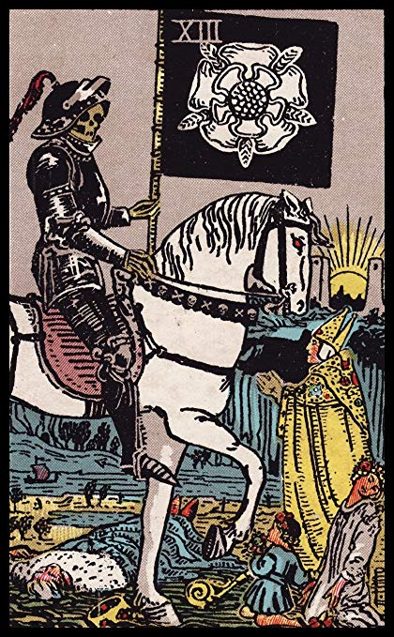
Question 2:
WHAT TAROT CARD IS THIS?

Slide 4
Question 3:
SOME BRITISH FOLKS CALL IT A LORRY. WHAT DO WE CALL IT?

Slide 5
Question 4:
WHAT BROTHER OF JOAQUIN PHOENIX DIED IN 1993 OF A DRUG OVERDOSE?

Slide 6
Question 5:
AT WENDY'S, WHAT SORT OF HAMBURGER WOULD YOU ORDER IF YOU WANTED A "BACONATOR" WITHOUT BACON?

Slide 7
Question 6:
WHAT IS THE FIRST WORD OF THE MAIN COMPETITOR TO MATCHBOX DIE-CAST CARS FROM 1968 TO 1997?

Slide 8
Question 7:
BERNIE BOSTON WAS A PULITZER PRIZE FINALIST FOR A PHOTOGRAPH OF A VIETNAM WAR PROTESTOR PUTTING WHAT INTO A GUN?

Slide 9
Question 8:
WHAT WAS THE FIRST NAME OF THE STRONG FEMALE CHARACTER PLAYED BY CANDICE BERGEN FOR 11 SEASONS?

Slide 10
Question 9:
THE BEST-SELLING ALBUM IN U.K. HISTORY IS THE 1981 GREATEST HITS ALBUM BY WHAT GROUP?

Slide 11
Question 10:
WHAT DO ALL THESE ANSWERS HAVE IN COMMON?

Slide 12
The End
Answers will be provided shortly

Slide 13
Question 1:
CANCER, SCORPIO, AND PISCES ARE KNOWN AS WHAT SORT OF ZODIAC SIGNS?
WATER

Slide 14
Question 2:
WHAT TAROT CARD IS THIS?
DEATH

Slide 15
Question 3:
SOME BRITISH FOLKS CALL IT A LORRY. WHAT DO WE CALL IT?
TRUCK

Slide 16
Question 4:
WHAT BROTHER OF JOAQUIN PHOENIX DIED IN 1993 OF A DRUG OVERDOSE?
RIVER

Slide 17
Question 5:
AT WENDY'S, WHAT SORT OF HAMBURGER WOULD YOU ORDER IF YOU WANTED A "BACONATOR" WITHOUT BACON?
DOUBLE

Slide 18
Question 6:
WHAT IS THE FIRST WORD OF THE MAIN COMPETITOR TO MATCHBOX DIE-CAST CARS FROM 1968 TO 1997?
HOT (WHEELS)

Slide 19
Question 7:
BERNIE BOSTON WAS A PULITZER PRIZE FINALIST FOR A PHOTOGRAPH OF A VIETNAM WAR PROTESTOR PUTTING WHAT INTO A GUN?
FLOWER

Slide 20
Question 8:
WHAT WAS THE FIRST NAME OF THE STRONG FEMALE CHARACTER PLAYED BY CANDICE BERGEN FOR 11 SEASONS?
MURPHY (BROWN)

Slide 21
Question 9:
THE BEST-SELLING ALBUM IN U.K. HISTORY IS THE 1981 GREATEST HITS ALBUM BY WHAT GROUP?
QUEEN

Slide 22
Question 10:
WHAT DO ALL THESE ANSWERS HAVE IN COMMON?
CAN BE FOLLOWED BY "BED"

