Slide 1
COMMON THREAD

Slide 2
Question 1:
WHAT TYPE OF SHOE, OFTEN USED FOR BASKETBALL, EXTENDS SLIGHTLY OVER THE WEARER'S ANKLE?

Slide 3
Question 2:
WHAT IS THE 3-LETTER VIETNAMESE WORD FOR RICE VERMICELLI NOODLES?

Slide 4
Question 3:
WHAT WORD, COMING FROM THE OLD NORSE WORD "SKEGG" MEANING BEARD, REFERS TO A CARPET WITH A DEEP PILE?

Slide 5
Question 4:
WHAT WAS THE 1987-1990 ANIMATED SERIES STARRING UNCLE SCROOGE, HUEY, DEWEY, AND LOUIE?

Slide 6
Question 5:
WHAT IS THE FIRST NAME OF THE SECOND MAN TO WALK ON THE MOON?

Slide 7
Question 6:
THE OLYMPICS CALLS IT ROWING, BUT COLLEGES USUALLY CALL IT WHAT?

Slide 8
Question 7:
THE 5 NATIONS OF THE IROQUOIS ARE THE ONONDAGA, ONEIDA, CAYUGA, SENECA, AND WHAT?

Slide 9
Question 8:
USING EUROPE AS AN EXAMPLE, WHAT NAME HAS BEEN SUGGESTED FOR A UNIVERSAL CURRENCY FOR AFRICA?

Slide 10
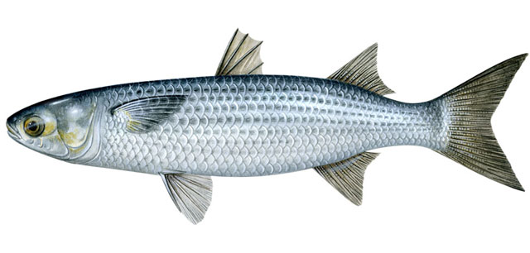
Question 9:
WHAT SORT OF FISH IS THIS?

Slide 11
Question 10:
WHAT DO ALL THESE ANSWERS HAVE IN COMMON?

Slide 12
ANSWERS WILL BE PROVIDED SHORTLY

Slide 13
Question 1:
WHAT TYPE OF SHOE, OFTEN USED FOR BASKETBALL, EXTENDS SLIGHTLY OVER THE WEARER'S ANKLE?
HIGH–TOP

Slide 14
Question 2:
WHAT IS THE 3-LETTER VIETNAMESE WORD FOR RICE VERMICELLI NOODLES?
BÚN

Slide 15
Question 3:
WHAT WORD, COMING FROM THE OLD NORSE WORD "SKEGG" MEANING BEARD, REFERS TO A CARPET WITH A DEEP PILE?
SHAG

Slide 16
Question 4:
WHAT WAS THE 1987-1990 ANIMATED SERIES STARRING UNCLE SCROOGE, HUEY, DEWEY, AND LOUIE?
DUCK TALES

Slide 17
Question 5:
WHAT IS THE FIRST NAME OF THE SECOND MAN TO WALK ON THE MOON?
BUZZ (ALDRIN)

Slide 18
Question 6:
THE OLYMPICS CALLS IT ROWING, BUT COLLEGES USUALLY CALL IT WHAT?
CREW

Slide 19
Question 7:
THE 5 NATIONS OF THE IROQUOIS ARE THE ONONDAGA, ONEIDA, CAYUGA, SENECA, AND WHAT?
MOHAWK

Slide 20
Question 8:
USING EUROPE AS AN EXAMPLE, WHAT NAME HAS BEEN SUGGESTED FOR A UNIVERSAL CURRENCY FOR AFRICA?
AFRO

Slide 21
Question 9:
WHAT SORT OF FISH IS THIS?
MULLET

Slide 22
Question 10:
WHAT DO ALL THESE ANSWERS HAVE IN COMMON?
NAMES OF HAIRSTYLES

