Slide 1
ACTOR COMMON THREAD

Slide 2
Question 1:
WHO PLAYED ANT-MAN IN 4 MARVEL FILMS?

Slide 3
Question 2:
WHO STARRED IN "IDIOCRACY", "MY SUPER EX-GIRLFRIEND", AND "THE RIDICULOUS 6"?

Slide 4
Question 3:
WHO CREATED AND STARRED IN "PORTLANDIA", AND IS THE BANDLEADER FOR SETH MYERS?

Slide 5
Question 4:
WHO PLAYED THE TITLE ROLE IN "THE 40-YEAR-OLD VIRGIN"?

Slide 6
Question 5:
WHO STARRED IN "JESSE" "SAMANTHA WHO?", "UP ALL NIGHT" AND "DEAD TO ME"?

Slide 7
Question 6:
WHO WAS GOLDEN GLOBE-NOMINATED FOR "SCHOOL OF ROCK" AND "BERNIE"?

Slide 8
Question 7:
WHAT COMIC ACTOR STARRED IN "KNOCKED UP", "THE GREEN HORNET", AND "FUNNY PEOPLE"?

Slide 9
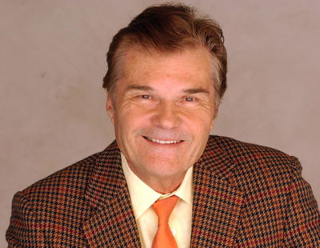
Question 8:
WHO IS THIS ACTOR, WHO DIED IN 2020?

Slide 10
Question 9:
WHO MEETS THE PARENTS IN "MEET THE PARENTS" AND WAS WALTER IN "THE SECRET LIFE OF WALTER MITTY"?

Slide 11
Question 10:
WHAT DO ALL THESE ACTORS HAVE IN COMMON?

Slide 12
ANSWERS WILL BE PROVIDED SHORTLY

Slide 13
Question 1:
WHO PLAYED ANT-MAN IN 4 MARVEL FILMS?
PAUL RUDD

Slide 14
Question 2:
WHO STARRED IN "IDIOCRACY", "MY SUPER EX-GIRLFRIEND", AND "THE RIDICULOUS 6"?
LUKE WILSON

Slide 15
Question 3:
WHO CREATED AND STARRED IN "PORTLANDIA", AND IS THE BANDLEADER FOR SETH MYERS?
FRED ARMISEN

Slide 16
Question 4:
WHO PLAYED THE TITLE ROLE IN "THE 40-YEAR-OLD VIRGIN"?
STEVE CARELL

Slide 17
Question 5:
WHO STARRED IN "JESSE" "SAMANTHA WHO?", "UP ALL NIGHT" AND "DEAD TO ME"?
CHRISTINA APPLEGATE

Slide 18
Question 6:
WHO WAS GOLDEN GLOBE-NOMINATED FOR "SCHOOL OF ROCK" AND "BERNIE"?
JACK BLACK

Slide 19
Question 7:
WHAT COMIC ACTOR STARRED IN "KNOCKED UP", "THE GREEN HORNET", AND "FUNNY PEOPLE"?
SETH ROGAN

Slide 20
Question 8:
WHO IS THIS ACTOR, WHO DIED IN 2020?
FRED WILLARD

Slide 21
Question 9:
WHO MEETS THE PARENTS IN "MEET THE PARENTS" AND WAS WALTER IN "THE SECRET LIFE OF WALTER MITTY"?
BEN STILLER

Slide 22
Question 10:
WHAT DO ALL THESE ACTORS HAVE IN COMMON?
WERE IN "ANCHORMAN: THE LEGEND OF RON BURGUNDY"

