Slide 1
COMMON THREAD

Slide 2
Question 1:
WHAT IS THE MOST POPULAR PET IN AFRICA?

Slide 3
Question 2:
WHAT IS THE MOST RADIOACTIVE FRUIT, BECAUSE OF ITS HIGH POTASSIUM CONTENT?

Slide 4
Question 3:
WHAT IS THE ALLOY OF COPPER AND ZINC CALLED?

Slide 5
Question 4:
HOW MANY PLAGUES WERE INFLICTED ON EGYPT IN EXODUS 7:12?

Slide 6
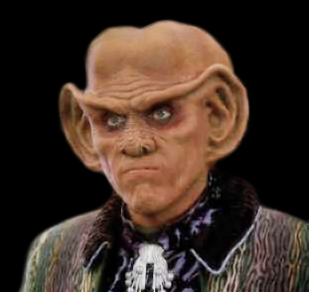
Question 5:
WHAT IS THE NAME OF THIS "STAR TREK" CHARACTER?

Slide 7
Question 6:
WHAT IS THE NAME OF THE MOST POPULAR INSECT REPELLENT?

Slide 8
Question 7:
IN WRITTEN ENGLISH, WHAT IS THE MOST COMMON 4-LETTER WORD STARTING WITH "D"?

Slide 9
Question 8:
WHAT DOES THE MIDDLE "S" STAND FOR IN "USSS"?

Slide 10
Question 9:
WHAT OBJECT APPEARS IN STETSON UNIVERSITY'S SPORTS LOGO BESIDES THE LETTER "S"?

Slide 11
Question 10:
WHAT DO ALL THESE ANSWERS HAVE IN COMMON?

Slide 12
The End
Answers will be provided shortly

Slide 13
Question 1:
WHAT IS THE MOST POPULAR PET IN AFRICA?
DOG

Slide 14
Question 2:
WHAT IS THE MOST RADIOACTIVE FRUIT, BECAUSE OF ITS HIGH POTASSIUM CONTENT?
BANANA

Slide 15
Question 3:
WHAT IS THE ALLOY OF COPPER AND ZINC CALLED?
BRASS

Slide 16
Question 4:
HOW MANY PLAGUES WERE INFLICTED ON EGYPT IN EXODUS 7:12?
10

Slide 17
Question 5:
WHAT IS THE NAME OF THIS "STAR TREK" CHARACTER?
QUARK

Slide 18
Question 6:
WHAT IS THE NAME OF THE MOST POPULAR INSECT REPELLENT?
OFF

Slide 19
Question 7:
IN WRITTEN ENGLISH, WHAT IS THE MOST COMMON 4-LETTER WORD STARTING WITH "D"?
DOWN

Slide 20
Question 8:
WHAT DOES THE MIDDLE "S" STAND FOR IN "USSS"?
(UNITED STATES) SECRET (SERVICE)

Slide 21
Question 9:
WHAT OBJECT APPEARS IN STETSON UNIVERSITY'S SPORTS LOGO BESIDES THE LETTER "S"?
HAT

Slide 22
Question 10:
WHAT DO ALL THESE ANSWERS HAVE IN COMMON?
THEY CAN FOLLOW "TOP"

