Slide 1
PEOPLE COMMON THREAD

Slide 2
Question 1:
WHAT GONZO JOURNALIST WAS THE BASIS FOR THE DOONESBURY CHARACTER "DUKE"?

Slide 3
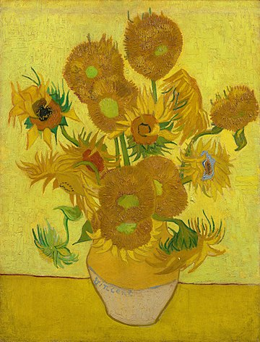
Question 2:
WHO PAINTED "SUNFLOWERS"?

Slide 4
Question 3:
WHO WROTE "THE OLD MAN AND THE SEA"?

Slide 5
Question 4:
DUE TO HIS EXPLORATIONS WITH WILLIAM CLARK, WHO WAS APPOINTED GOVERNOR OF THE LOUISIANA TERRITORY IN 1807?

Slide 6
Question 5:
WHAT ACTRESS STARRED IN THE FILMS "CLASH BY NIGHT" (1942) AND "DON'T BOTHER TO KNOCK" (1952)?

Slide 7
Question 6:
WHO PLAYED SUPERMAN ON THE 1950'S SHOW "THE ADVENTURES OF SUPERMAN"?

Slide 8
Question 7:
WHAT PIONEER OF STREAM OF CONSCIOUSNESS WROTE "MRS DALLOWAY"?

Slide 9
Question 8:
WHO WAS JOJO'S IMAGINARY FRIEND IN THE FILM "JOJO RABBIT"?

Slide 10
Question 9:
WHO PLAYED THE TITLE CHARACTER IN "THE WORLD ACCORDING TO GARP"?

Slide 11
Question 10:
WHAT DO ALL THESE PEOPLE HAVE IN COMMON?

Slide 12
The End
Answers will be provided shortly

Slide 13
Question 1:
WHAT GONZO JOURNALIST WAS THE BASIS FOR THE DOONESBURY CHARACTER "DUKE"?
HUNTER S. THOMPSON

Slide 14
Question 2:
WHO PAINTED "SUNFLOWERS"?
VINCENT VAN GOGH

Slide 15
Question 3:
WHO WROTE "THE OLD MAN AND THE SEA"?
ERNEST HEMINGWAY

Slide 16
Question 4:
DUE TO HIS EXPLORATIONS WITH WILLIAM CLARK, WHO WAS APPOINTED GOVERNOR OF THE LOUISIANA TERRITORY IN 1807?
MERIWETHER LEWIS

Slide 17
Question 5:
WHAT ACTRESS STARRED IN THE FILMS "CLASH BY NIGHT" (1942) AND "DON'T BOTHER TO KNOCK" (1952)?
MARILYN MONROE

Slide 18
Question 6:
WHO PLAYED SUPERMAN ON THE 1950'S SHOW "THE ADVENTURES OF SUPERMAN"?
GEORGE REEVES

Slide 19
Question 7:
WHAT PIONEER OF STREAM OF CONSCIOUSNESS WROTE "MRS DALLOWAY"?
VIRGINIA WOOLF

Slide 20
Question 8:
WHO WAS JOJO'S IMAGINARY FRIEND IN THE FILM "JOJO RABBIT"?
ADOLF HITLER

Slide 21
Question 9:
WHO PLAYED THE TITLE CHARACTER IN "THE WORLD ACCORDING TO GARP"?
ROBIN WILLIAMS

Slide 22
Question 10:
WHAT DO ALL THESE PEOPLE HAVE IN COMMON?
THEY COMMITTED SUICIDE

