Slide 1
COMMON THREAD

Slide 2
Question 1:
WHAT IS THE ANTOINETTE PERRY AWARD FOR EXCELLENCE BETTER KNOWN AS?

Slide 3
Question 2:
WHICH OF NEW YORK CITY'S 5 BOROUGHS IS PREDOMINANTLY ON THE MAINLAND?

Slide 4
Question 3:
WHAT WAS THE FIRST NAME OF THE CELEBRITY CHEF AND TRAVEL DOCUMENTARIAN WHO KILLED HIMSELF IN 2018?

Slide 5
Question 4:
WHAT IS THE ITALIAN PHRASE FOR "NICE OVEN"?

Slide 6

Question 5:
WHO IS THIS GUY?

Slide 7
Question 6:
WHAT IS THE FIRST NAME OF JON VOIGHT'S ACTRESS DAUGHTER?

Slide 8
Question 7:
WHAT HAS BECOME A GENERIC TERM FOR A WOOD-BODIED RESONATOR GUITAR, NAMED FOR A PARTICULAR BRAND FOUNDED IN 1929?

Slide 9
Question 8:
WHAT COCKTAIL IS MADE FROM PROSECCO AND PEACH PURÉE?

Slide 10
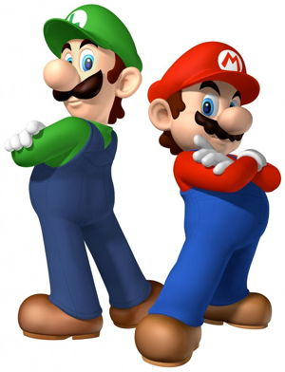
Question 9:
WHO ARE THESE GUYS?

Slide 11
Question 10:
WHAT DO ALL THESE ANSWERS HAVE IN COMMON?

Slide 12
ANSWERS WILL BE PROVIDED SHORTLY

Slide 13
Question 1:
WHAT IS THE ANTOINETTE PERRY AWARD FOR EXCELLENCE BETTER KNOWN AS?
TONY

Slide 14
Question 2:
WHICH OF NEW YORK CITY'S 5 BOROUGHS IS PREDOMINANTLY ON THE MAINLAND?
BRONX

Slide 15
Question 3:
WHAT WAS THE FIRST NAME OF THE CELEBRITY CHEF AND TRAVEL DOCUMENTARIAN WHO KILLED HIMSELF IN 2018?
ANTHONY (BOURDAIN)

Slide 16
Question 4:
WHAT IS THE ITALIAN PHRASE FOR "NICE OVEN"?
FORNO BELLO

Slide 17
Question 5:
WHO IS THIS GUY?
TOM (AND JERRY)

Slide 18
Question 6:
WHAT IS THE FIRST NAME OF JON VOIGHT'S ACTRESS DAUGHTER?
ANGELINA (JOLIE)

Slide 19
Question 7:
WHAT HAS BECOME A GENERIC TERM FOR A WOOD-BODIED RESONATOR GUITAR, NAMED FOR A PARTICULAR BRAND FOUNDED IN 1929?
DOBRO

Slide 20
Question 8:
WHAT COCKTAIL IS MADE FROM PROSECCO AND PEACH PURÉE?
BELLINI

Slide 21
Question 9:
WHO ARE THESE GUYS?
MARIO & LUIGI

Slide 22
Question 10:
WHAT DO ALL THESE ANSWERS HAVE IN COMMON?
NAMES OF DELAND PIZZA PLACES

