Slide 1
PEOPLE COMMON THREAD

Slide 2
Question 1:
WHAT SOUTH AFRICAN IS THE ONLY NON-AMERICAN TO WIN ALL FOUR OF THE MAJOR GOLF TOURNAMENTS?

Slide 3
Question 2:
WHAT RETIRED RACECAR OWNER NOW RUNS A TEAM THAT HAS WON THE INDY 500 RACE 18 TIMES?

Slide 4
Question 3:
WHAT QUARTERBACK LED THE DALLAS COWBOYS TO WINS IN SUPER BOWLS VI AND XII (AND LOSSES IN SUPER BOWLS X AND XIII)?

Slide 5
Question 4:
WHO IS THE BEST-SELLING SOLO MUSIC ARTIST OF ALL TIME?

Slide 6
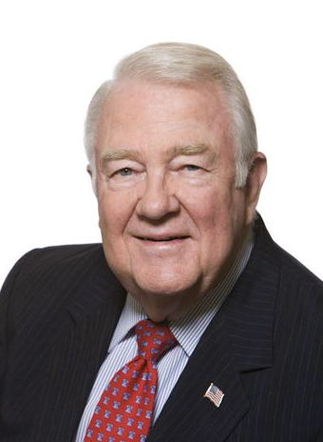
Question 5:
WHO SERVED AS U.S. ATTORNEY GENERAL 1985-1988?

Slide 7
Question 6:
WHO WAS THE FIRST ITALIAN-AMERICAN TO SERVE AS A U.S. SUPREME COURT JUSTICE?

Slide 8
Question 7:
WHAT PRO BASEBALL PLAYER WAS KNOWN AS "THE BAMBINO"?

Slide 9
Question 8:
WHO HOSTED THE MOST-LISTENED-TO RADIO PROGRAM IN THE U.S. UNTIL HIS DEATH IN 2021?

Slide 10
Question 9:
WHO WAS THE YEAR-END #1 RANKED GOLFER EVERY YEAR BETWEEN 1998 AND 2009 EXCEPT FOR 2004?

Slide 11
Question 10:
WHAT DO ALL THESE PEOPLE HAVE IN COMMON?

Slide 12
ANSWERS WILL BE PROVIDED SHORTLY

Slide 13
Question 1:
WHAT SOUTH AFRICAN IS THE ONLY NON-AMERICAN TO WIN ALL FOUR OF THE MAJOR GOLF TOURNAMENTS?
GARY PLAYER

Slide 14
Question 2:
WHAT RETIRED RACECAR OWNER NOW RUNS A TEAM THAT HAS WON THE INDY 500 RACE 18 TIMES?
ROGER PENSKE

Slide 15
Question 3:
WHAT QUARTERBACK LED THE DALLAS COWBOYS TO WINS IN SUPER BOWLS VI AND XII (AND LOSSES IN SUPER BOWLS X AND XIII)?
ROGER STAUBACH

Slide 16
Question 4:
WHO IS THE BEST-SELLING SOLO MUSIC ARTIST OF ALL TIME?
ELVIS PRESLEY

Slide 17
Question 5:
WHO SERVED AS U.S. ATTORNEY GENERAL 1985-1988?
EDWIN MEESE

Slide 18
Question 6:
WHO WAS THE FIRST ITALIAN-AMERICAN TO SERVE AS A U.S. SUPREME COURT JUSTICE?
ANTONIN SCALIA

Slide 19
Question 7:
WHAT PRO BASEBALL PLAYER WAS KNOWN AS "THE BAMBINO"?
BABE RUTH

Slide 20
Question 8:
WHO HOSTED THE MOST-LISTENED-TO RADIO PROGRAM IN THE U.S. UNTIL HIS DEATH IN 2021?
RUSH LIMBAUGH

Slide 21
Question 9:
WHO WAS THE YEAR-END #1 RANKED GOLFER EVERY YEAR BETWEEN 1998 AND 2009 EXCEPT FOR 2004?
TIGER WOODS

Slide 22
Question 10:
WHAT DO ALL THESE PEOPLE HAVE IN COMMON?
THEY WERE AWARDED THE PRESIDENTIAL MEDAL OF FREEDOM BY DONALD TRUMP

