Slide 1
COMMON THREAD

Slide 2
Question 1:
ON "MORK AND MINDY", MORK'S SPACESHIP WAS SHAPED LIKE A WHAT?

Slide 3
Question 2:
WHAT CW SERIES FOLLOWED THE CRIME FIGHTING OF PLAYBOY OLIVER QUEEN FOR 8 SEASONS?

Slide 4
Question 3:
WHAT COLOR HAS THE LARGEST VISIBLE WAVELENGTH, ABOUT 700 NANOMETERS?

Slide 5
Question 4:
WHAT 70'S FUNK BAND SANG "WHY CAN'T WE BE FRIENDS"?

Slide 6
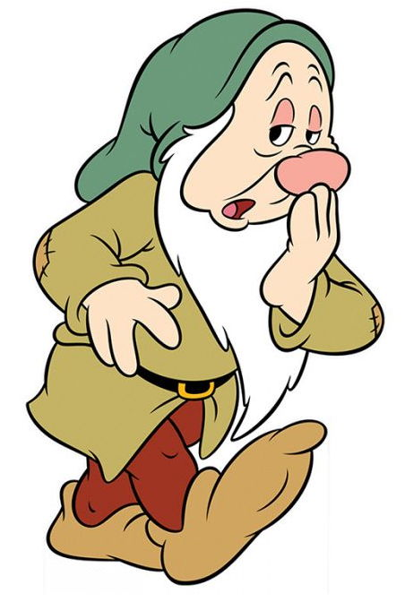
Question 5:
WHAT DISNEY CHARACTER IS THIS?

Slide 7
Question 6:
IN CRICKET, WHAT CONSISTS OF 6 CONSECUTIVE LEGAL DELIVERIES BOWLED FROM ONE END OF THE PITCH?

Slide 8
Question 7:
WHAT IS THE HUMAN BODY'S LARGEST ORGAN?

Slide 9
Question 8:
THERE ARE CURRENTLY 2 BRANDS OF MACBOOK COMPUTER, THE PRO AND THE WHAT?

Slide 10
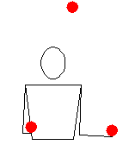
Question 9:
WHAT IS THIS JUGGLING PATTERN CALLED?

Slide 11
Question 10:
WHAT DO ALL THESE ANSWERS HAVE IN COMMON?

Slide 12
ANSWERS WILL BE PROVIDED SHORTLY

Slide 13
Question 1:
ON "MORK AND MINDY", MORK'S SPACESHIP WAS SHAPED LIKE A WHAT?
EGG

Slide 14
Question 2:
WHAT CW SERIES FOLLOWED THE CRIME FIGHTING OF PLAYBOY OLIVER QUEEN FOR 8 SEASONS?
ARROW

Slide 15
Question 3:
WHAT COLOR HAS THE LARGEST VISIBLE WAVELENGTH, ABOUT 700 NANOMETERS?
RED

Slide 16
Question 4:
WHAT 70'S FUNK BAND SANG "WHY CAN'T WE BE FRIENDS"?
WAR

Slide 17
Question 5:
WHAT DISNEY CHARACTER IS THIS?
SLEEPY

Slide 18
Question 6:
IN CRICKET, WHAT CONSISTS OF 6 CONSECUTIVE LEGAL DELIVERIES BOWLED FROM ONE END OF THE PITCH?
OVER

Slide 19
Question 7:
WHAT IS THE HUMAN BODY'S LARGEST ORGAN?
SKIN

Slide 20
Question 8:
THERE ARE CURRENTLY 2 BRANDS OF MACBOOK COMPUTER, THE PRO AND THE WHAT?
AIR

Slide 21
Question 9:
WHAT IS THIS JUGGLING PATTERN CALLED?
SHOWER

Slide 22
Question 10:
WHAT DO ALL THESE ANSWERS HAVE IN COMMON?
CAN BE FOLLOWED BY "HEAD"

