Slide 1
IDENTIFY THE STEVE MARTIN FILMS FROM THE POSTERS

Slide 2
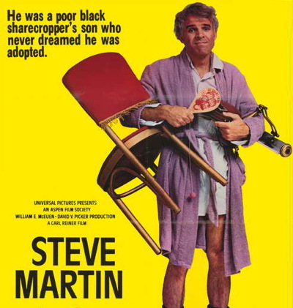
Question 1:

Slide 3

Question 2:

Slide 4
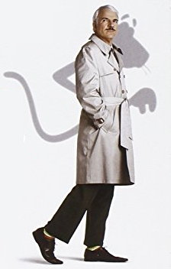
Question 3:

Slide 5
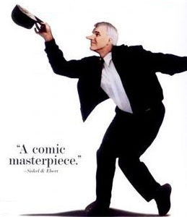
Question 4:

Slide 6
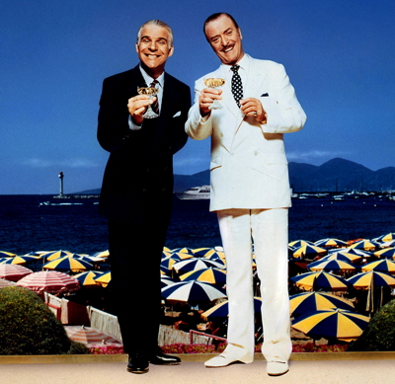
Question 5:

Slide 7
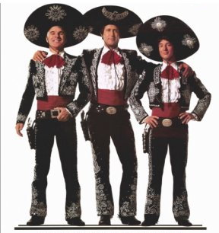
Question 6:

Slide 8
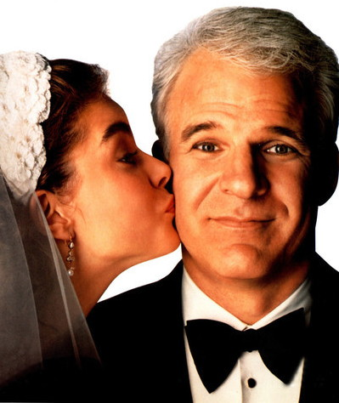
Question 7:

Slide 9
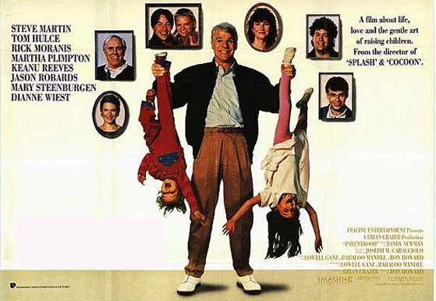
Question 8:

Slide 10

Question 9:

Slide 11
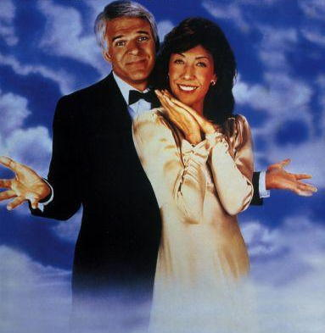
Question 10:

Slide 12
The End
Answers will be provided shortly

Slide 13
Question 1:
THE JERK

Slide 14
Question 2:
CHEAPER BY THE DOZEN

Slide 15
Question 3:
THE PINK PANTHER

Slide 16
Question 4:
ROXANNE

Slide 17
Question 5:
DIRTY ROTTEN SCOUNDRELS

Slide 18
Question 6:
THREE AMIGOS

Slide 19
Question 7:
FATHER OF THE BRIDE

Slide 20
Question 8:
PARENTHOOD

Slide 21
Question 9:
PLANES, TRAINS, AND AUTOMOBILES

Slide 22
Question 10:
ALL OF ME

