Slide 1
DAYS OF THE WEEK

Slide 2
Question 1:
WHAT WAS THE FIRST NAME OF GOMEZ AND MORTICIA ADDAMS' DAUGHTER?

Slide 3
Question 2:
WHAT IS THE ONLY DAY OF THE WEEK NOT MENTIONED IN THE BEATLES' SONG "LADY MADONNA"?

Slide 4
Question 3:
FOR JEWS, THE SABBATH STARTS ON WHAT DAY OF THE WEEK?

Slide 5
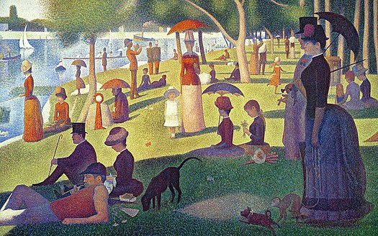
Question 4:
WHAT DAY IS IN THE TITLE OF THIS GEORGES SEURAT PAINTING?

Slide 6
Question 5:
WHAT MITCH ALBOM NOVEL, THAT CONTAINS A DAY OF THE WEEK IN THE TITLE, WAS MADE INTO A 1999 FILM?

Slide 7
Question 6:
WHAT 1976 FILM ABOUT SWITCHING BODIES STARRING JODIE FOSTER WAS REMADE IN 2003 STARRING JAMIE LEE CURTIS AND LINDSAY LOHAN?

Slide 8
Question 7:
PRESIDENTIAL ELECTIONS IN THE U.K. ARE HELD ON WHAT DAY OF THE WEEK?

Slide 9
Question 8:
WHAT IS THE ONLY DAY OF THE WEEK WHOSE NAME HAS AN ANAGRAM?

Slide 10
Question 9:
WHAT DID ROBINSON CRUSOE NAME HIS COMPANION?

Slide 11
Question 10:
WHAT DAY OF THE WEEK IS THE FIRST DAY OF LENT?

Slide 12
The End
Answers will be provided shortly

Slide 13
Question 1:
WHAT WAS THE FIRST NAME OF GOMEZ AND MORTICIA ADDAMS' DAUGHTER?
WEDNESDAY

Slide 14
Question 2:
WHAT IS THE ONLY DAY OF THE WEEK NOT MENTIONED IN THE BEATLES' SONG "LADY MADONNA"?
SATURDAY

Slide 15
Question 3:
FOR JEWS, THE SABBATH STARTS ON WHAT DAY OF THE WEEK?
FRIDAY

Slide 16
Question 4:
WHAT DAY IS IN THE TITLE OF THIS GEORGES SEURAT PAINTING?
(A) SUNDAY (AFTERNOON ON THE ISLAND OF LA GRANDE JATTE)

Slide 17
Question 5:
WHAT MITCH ALBOM NOVEL, THAT CONTAINS A DAY OF THE WEEK IN THE TITLE, WAS MADE INTO A 1999 FILM?
TUESDAYS WITH MORRIE

Slide 18
Question 6:
WHAT 1976 FILM ABOUT SWITCHING BODIES STARRING JODIE FOSTER WAS REMADE IN 2003 STARRING JAMIE LEE CURTIS AND LINDSAY LOHAN?
FREAKY FRIDAY

Slide 19
Question 7:
PRESIDENTIAL ELECTIONS IN THE U.K. ARE HELD ON WHAT DAY OF THE WEEK?
THURSDAY

Slide 20
Question 8:
WHAT IS THE ONLY DAY OF THE WEEK WHOSE NAME HAS AN ANAGRAM?
MONDAY (DYNAMO)

Slide 21
Question 9:
WHAT DID ROBINSON CRUSOE NAME HIS COMPANION?
FRIDAY

Slide 22
Question 10:
WHAT DAY OF THE WEEK IS THE FIRST DAY OF LENT?
(ASH) WEDNESDAY

