Slide 1
HAND

Slide 2
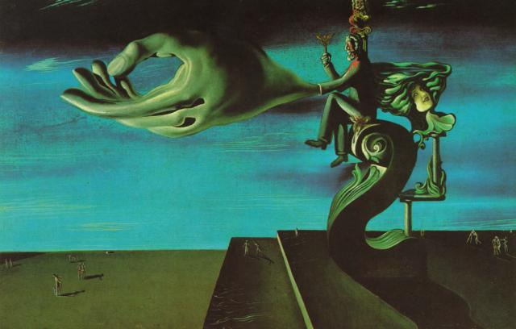
Question 1:
WHO PAINTED THIS PAINTING, ENTITLED "THE HAND"?

Slide 3
Question 2:
WAS THE EGYPTIAN HIEROGLYPH IN THE SHAPE OF A HAND USED FOR THE SOUND "H", "A", "N", OR "D"?

Slide 4
Question 3:
HOW MANY HANDS, USED TO MEASURE THE HEIGHT OF HORSES, ARE THERE IN A FOOT? 2, 3, OR 4?

Slide 5
Question 4:
WHAT POKER HAND BARELY BEATS 3-OF-A-KIND?

Slide 6
Question 5:
THE "RIGHT HAND RULE" IS A MNEMONIC TO CALCULATE THE DIRECTION OF WHAT IN MATHEMATICS OR PHYSICS?

Slide 7
Question 6:
WHAT PERCENT OF THE POPULATION IS LEFT-HANDED? 10%, 15% OR 20%?

Slide 8
Question 7:
WHO PLAYED LUKE IN THE FILM "COOL HAND LUKE"?

Slide 9
Question 8:
WHAT CHOREOGRAPHER WAS THE MAIN PROPONENT OF "JAZZ HANDS"?

Slide 10
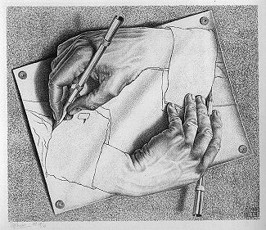
Question 9:
WHAT ARTIST DREW "DRAWING HANDS"?

Slide 11
Question 10:
WHAT IS THE BEST-SELLING SONG CONTAINING THE WORD "HAND" IN THE TITLE?

Slide 12
The End
Answers will be provided shortly

Slide 13
Question 1:
WHO PAINTED THIS PAINTING, ENTITLED "THE HAND"?
SALVADOR DALI

Slide 14
Question 2:
WAS THE EGYPTIAN HIEROGLYPH IN THE SHAPE OF A HAND USED FOR THE SOUND "H", "A", "N", OR "D"?
D

Slide 15
Question 3:
HOW MANY HANDS, USED TO MEASURE THE HEIGHT OF HORSES, ARE THERE IN A FOOT? 2, 3, OR 4?
3

Slide 16
Question 4:
WHAT POKER HAND BARELY BEATS 3-OF-A-KIND?
STRAIGHT

Slide 17
Question 5:
THE "RIGHT HAND RULE" IS A MNEMONIC TO CALCULATE THE DIRECTION OF WHAT IN MATHEMATICS OR PHYSICS?
CROSS PRODUCT

Slide 18
Question 6:
WHAT PERCENT OF THE POPULATION IS LEFT-HANDED? 10%, 15% OR 20%?
10%

Slide 19
Question 7:
WHO PLAYED LUKE IN THE FILM "COOL HAND LUKE"?
PAUL NEWMAN

Slide 20
Question 8:
WHAT CHOREOGRAPHER WAS THE MAIN PROPONENT OF "JAZZ HANDS"?
BOB FOSSE

Slide 21
Question 9:
WHAT ARTIST DREW "DRAWING HANDS"?
M. C. ESCHER

Slide 22
Question 10:
WHAT IS THE BEST-SELLING SONG CONTAINING THE WORD "HAND" IN THE TITLE?
I WANNA HOLD YOUR HAND

