Slide 1
IDENTIFY THESE ACTOR CARICATURES (BY MAGIXL)

Slide 2
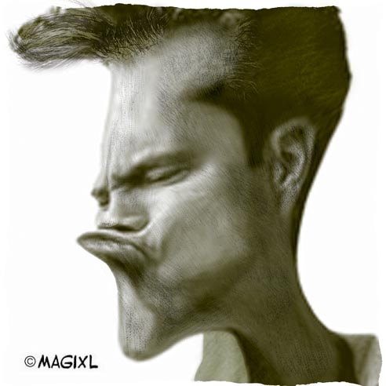
Question 1:

Slide 3
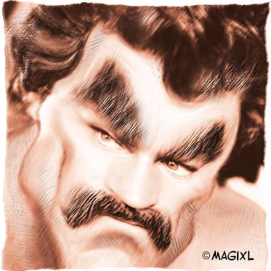
Question 2:

Slide 4
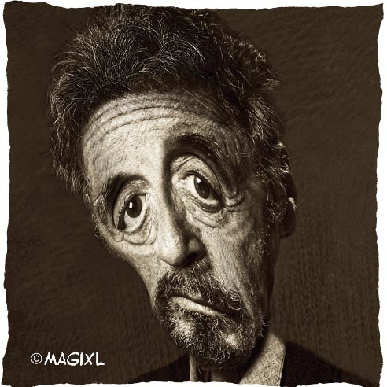
Question 3:

Slide 5
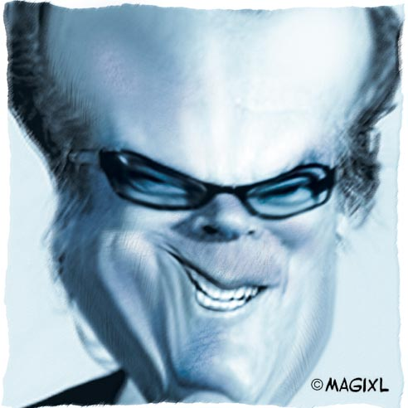
Question 4:

Slide 6
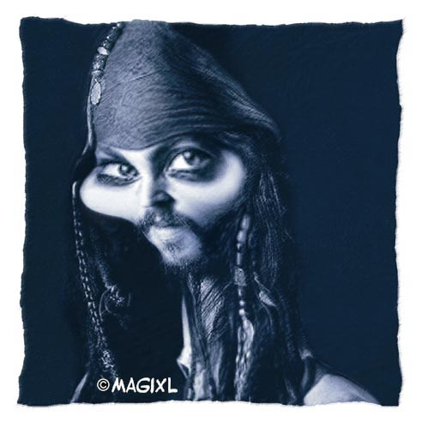
Question 5:

Slide 7
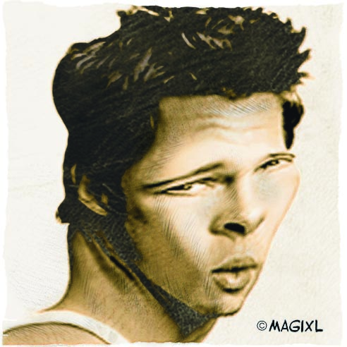
Question 6:

Slide 8
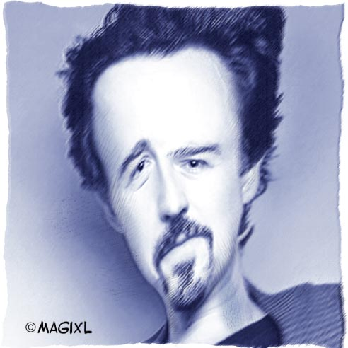
Question 7:

Slide 9
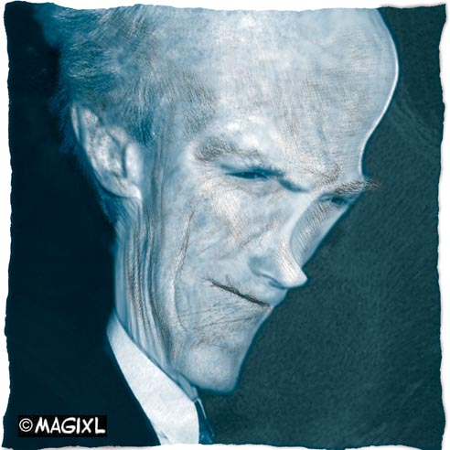
Question 8:

Slide 10
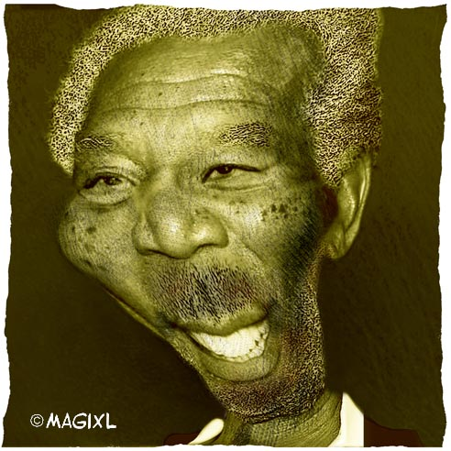
Question 9:

Slide 11
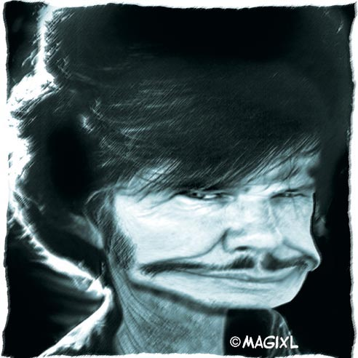
Question 10:

Slide 12
ANSWERS WILL BE PROVIDED SHORTLY

Slide 13
Question 1:
JIM CARREY

Slide 14
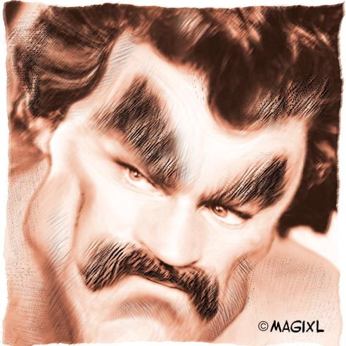
Question 2:
TOM SELLECK

Slide 15
Question 3:
AL PACINO

Slide 16
Question 4:
JACK NICHOLSON

Slide 17
Question 5:
JOHNNY DEPP

Slide 18
Question 6:
BRAD PITT

Slide 19
Question 7:
EDWARD NORTON

Slide 20
Question 8:
CLINT EASTWOOD

Slide 21
Question 9:
MORGAN FREEMAN

Slide 22
Question 10:
CHARLES BRONSON

